Slide 1
Underwater Filter/Vacuum Model UFV-260
Tri Nuclear Corp.
Notes:
Material to hand out:
PP Notes, CD-Rom, OI-2,5 & 6
Training Aids needed:
Filter cartridge, UT-9 & rope, FM-260 Kit, UCB-1

Slide 2
Training Objectives
The trainees at the end of this session will be able to describe:
The Principals of Operation
UFV-260 Equipment Description
Assembly & Installation in pool
System Operations
Storage Requirements
UFV-260 Precautions & Limitations

Slide 3
References
Tri Nuclear OI-2 UFV-260 Operating Instructions
Tri Nuclear OI-5 Pump Troubleshooting Guidelines
Tri Nuclear OI-6 Rope Filter Lift Tool Operating Instructions

Slide 4
UFV-260 Principals of Operation
System designed to operate remotely underwater
System designed to operate under negative pressure
This means that the Filter cartridges on suction side of pump
Notes:
The UFV-260 system operates under negative pressure. This design feature eliminates the need for special bolted pressure closures on the filter and pump housings requiring tooling for operation. Each filter and pump housing seals with a simple flat cover plate held in place by negative pressure during operation.
One of the many benefits of this design is that it requires no special tooling to install or remove a pump underwater. With the pump installed correctly in the pump tube, the weight of the pump keeps it in place during normal operation.

Slide 5
UFV-260 Principals of Operation
Advantages of the Tri Nuclear UFV’s
Eliminates the need for pressure closures on the filter and pump housings along with special tooling required to operate them.
Allows for quick, easy change out of filter cartridges
Allows for the Pump and filters to be seated by gravity/negative pressure
Filtered water passes through the pump, minimizing internal contamination & resultant hot spots
Notes:
The UFV-260 system operates under negative pressure. This design feature eliminates the need for special bolted pressure closures on the filter and pump housings requiring tooling for operation. Each filter and pump housing seals with a simple flat cover plate held in place by negative pressure during operation.
One of the many benefits of this design is that it requires no special tooling to install or remove a pump underwater. With the pump installed correctly in the pump tube, the weight of the pump keeps it in place during normal operation.

Slide 6
UFV-260 Principals of Operation
Notes:
The UFV-260 system operates under negative pressure. This design feature eliminates the need for special bolted pressure closures on the filter and pump housings requiring tooling for operation. Each filter and pump housing seals with a simple flat cover plate held in place by negative pressure during operation.
One of the many benefits of this design is that it requires no special tooling to install or remove a pump underwater. With the pump installed correctly in the pump tube, the weight of the pump keeps it in place during normal operation.

Slide 7
UFV-260 Principals of Operation
Multi-Purpose Unit
Can be used for water clarification and vacuuming operations
Two (2) - 2” x 50ft suction hoses
MxF camlock couplers
Two (2) - Filter Cartridges
System Flow Rate : 260 GPM

Slide 8
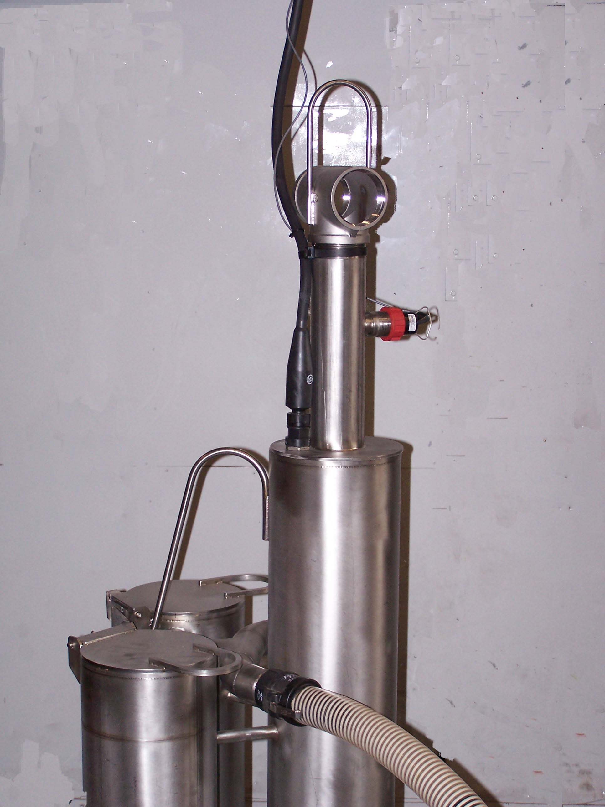
UFV-260
Base: 24" x 24"
Height: 70"
Weight: 250 lbs
System flow rate: 260 GPM
Material:
Main Housing:
304 Stainless steel
2” camlock connectors:
Polypropylene (prior to 2010)
316 Stainless Steel (after 2010)
Filter tube sheet o-ring: Buna-N

Slide 9
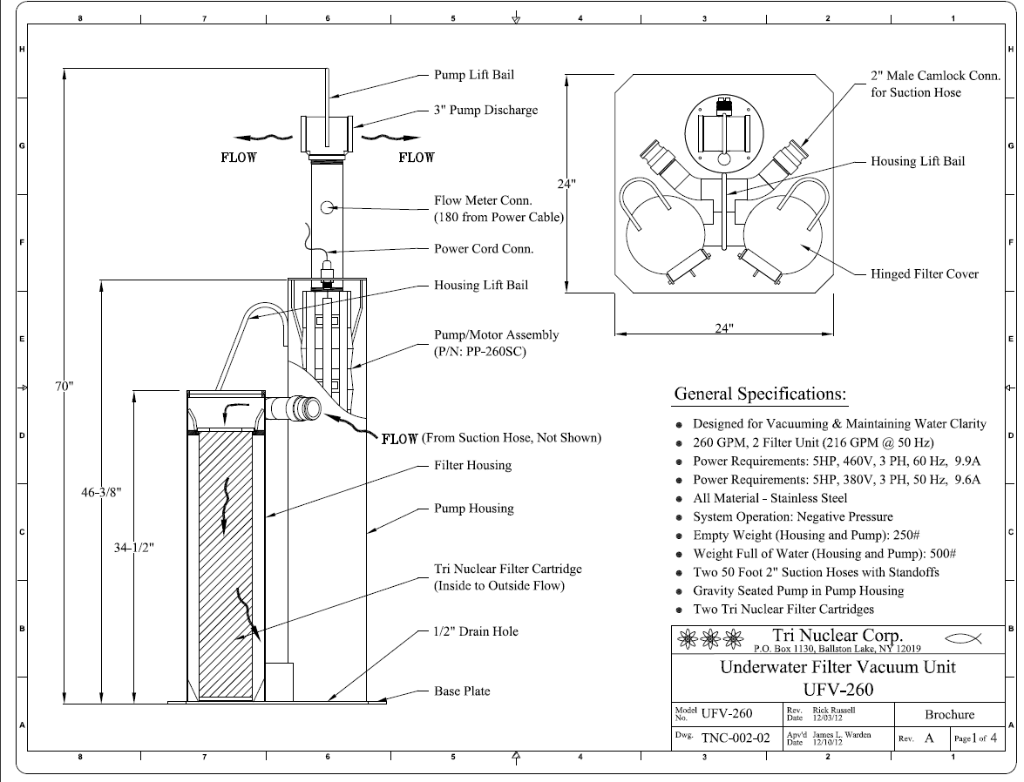

Slide 10
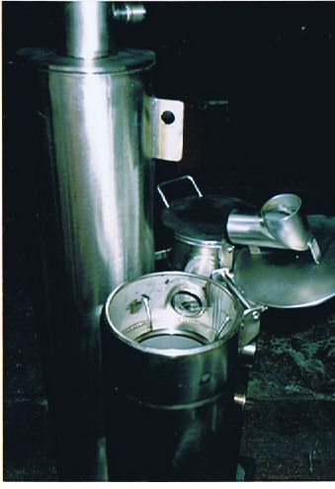
Flow Diverter
Pump Tube
Lift Eye
Flow
Filter Tube & Cover Machined Sealing Surfaces
Over/Under
Suction ports
PRE-1997 UFV-260 Housing
18” x 24”
Base Plate
Filter Tube
Notes:
Old Style design UFV-260 (over/under) design Some plants still have these legacy units left.
Our records are unclear as to when we went to a 24x24 base plate – sometime between 1994 & 1997
The increased size of the base plate was for stability.

Slide 11
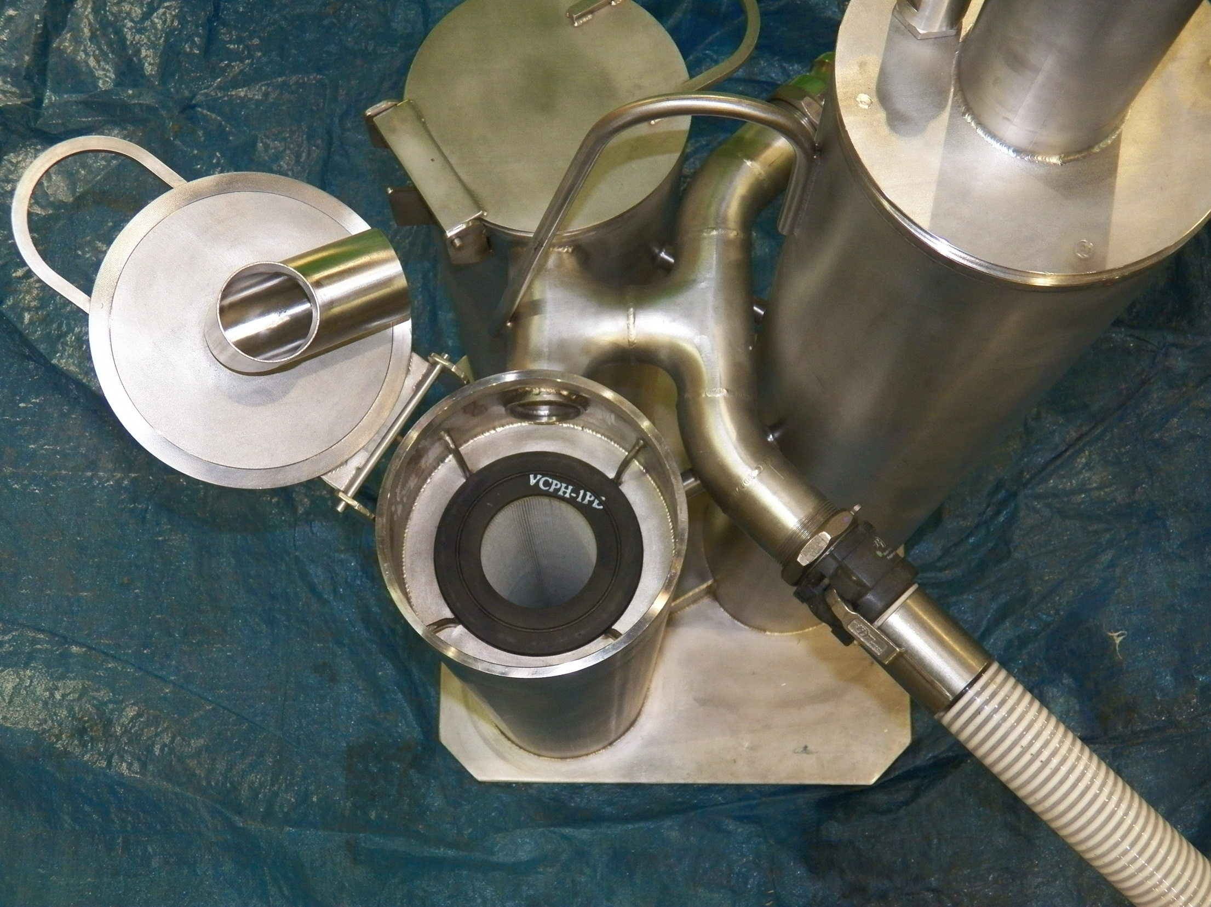
Flow Diverter
Pump Tube
Flow
Filter Tube & Cover Machined Sealing Surfaces
Suction
Filter Tube
24” x 24” Base Plate
Notes:
11
Current design UFV-260 (all UFV-260 manufactured after 1997)
Eliminates over under crud traps
Ease of opening filter covers
Greater overall stability of unit due to larger base plate and hose connection re-location

Slide 12
Detailed Description: UFV-260
2 Filter housings
8” Pipe
Overall Height 34.5”
Filter cartridges are held in place by the negative pressure of the pump
Filter cartridges are positively sealed on an internal tube sheet with O-Ring.

Slide 13
Detailed Description: UFV-260
Filter Housing
4 filter guides prevent filter from “hanging up” on the top of the tube sheet

Slide 14
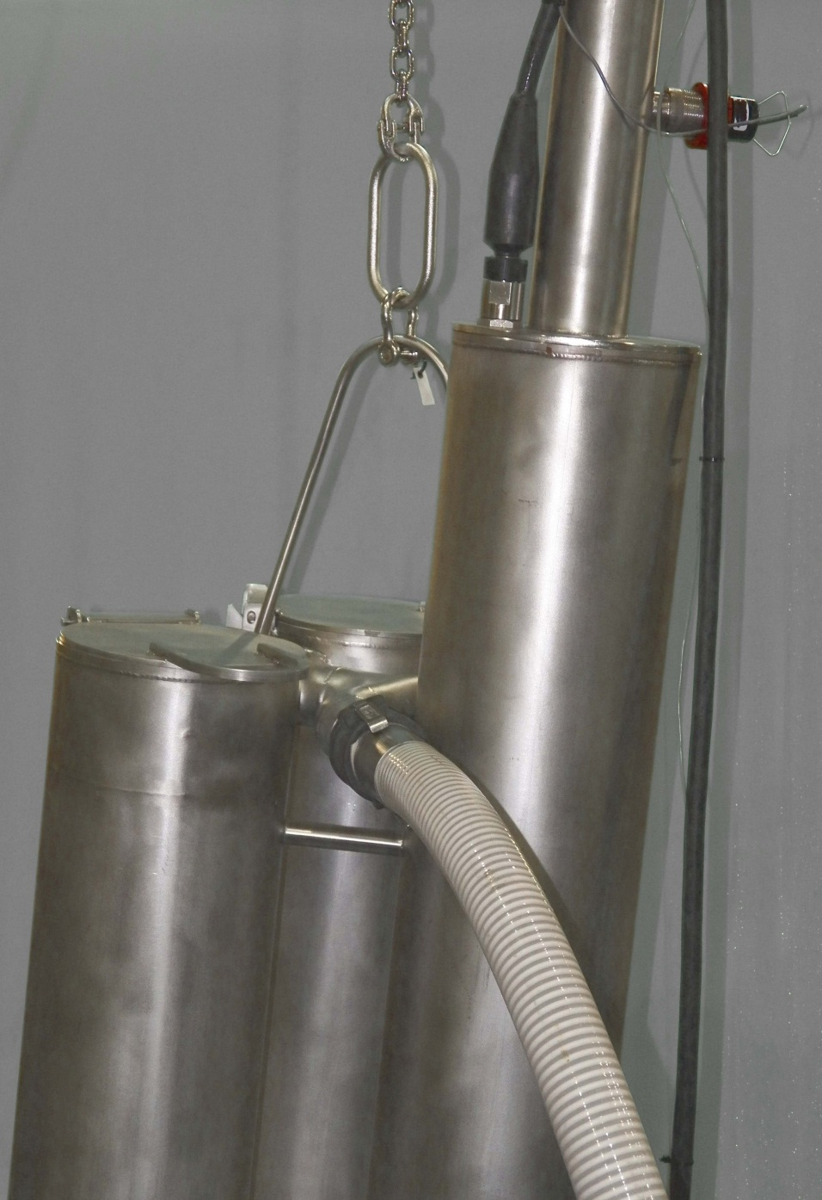
Detailed Description: UFV-260
Filter Housing
½” Bypass pipe located under the tube sheet and connects to the pump tube
Prevents accumulation of gasses that may come out of solution during normal operation
Notes:
Only on UFV-260 housings manufactured after 1997

Slide 15
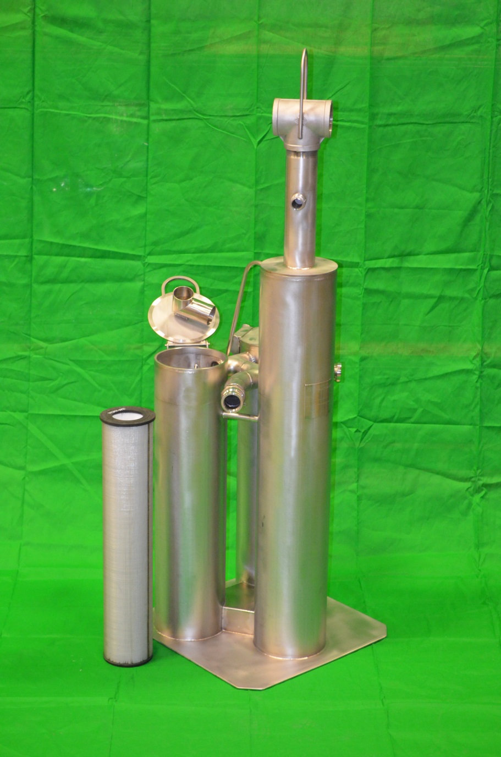
Detailed Description: UFV-260
One pump tube
Pump Tube Height 46”
Contains the Pump/Motor assembly
Provides a path for the “clean” water to the pump.
(1) 1/2” drain hole located in the pump tube base plate to allow water to drain out when unit is removed from pool.

Slide 16
Machined Seating Surface on Pump Tube
Anti-Rotation Pin
UFV-260 Lift Bale

Slide 17
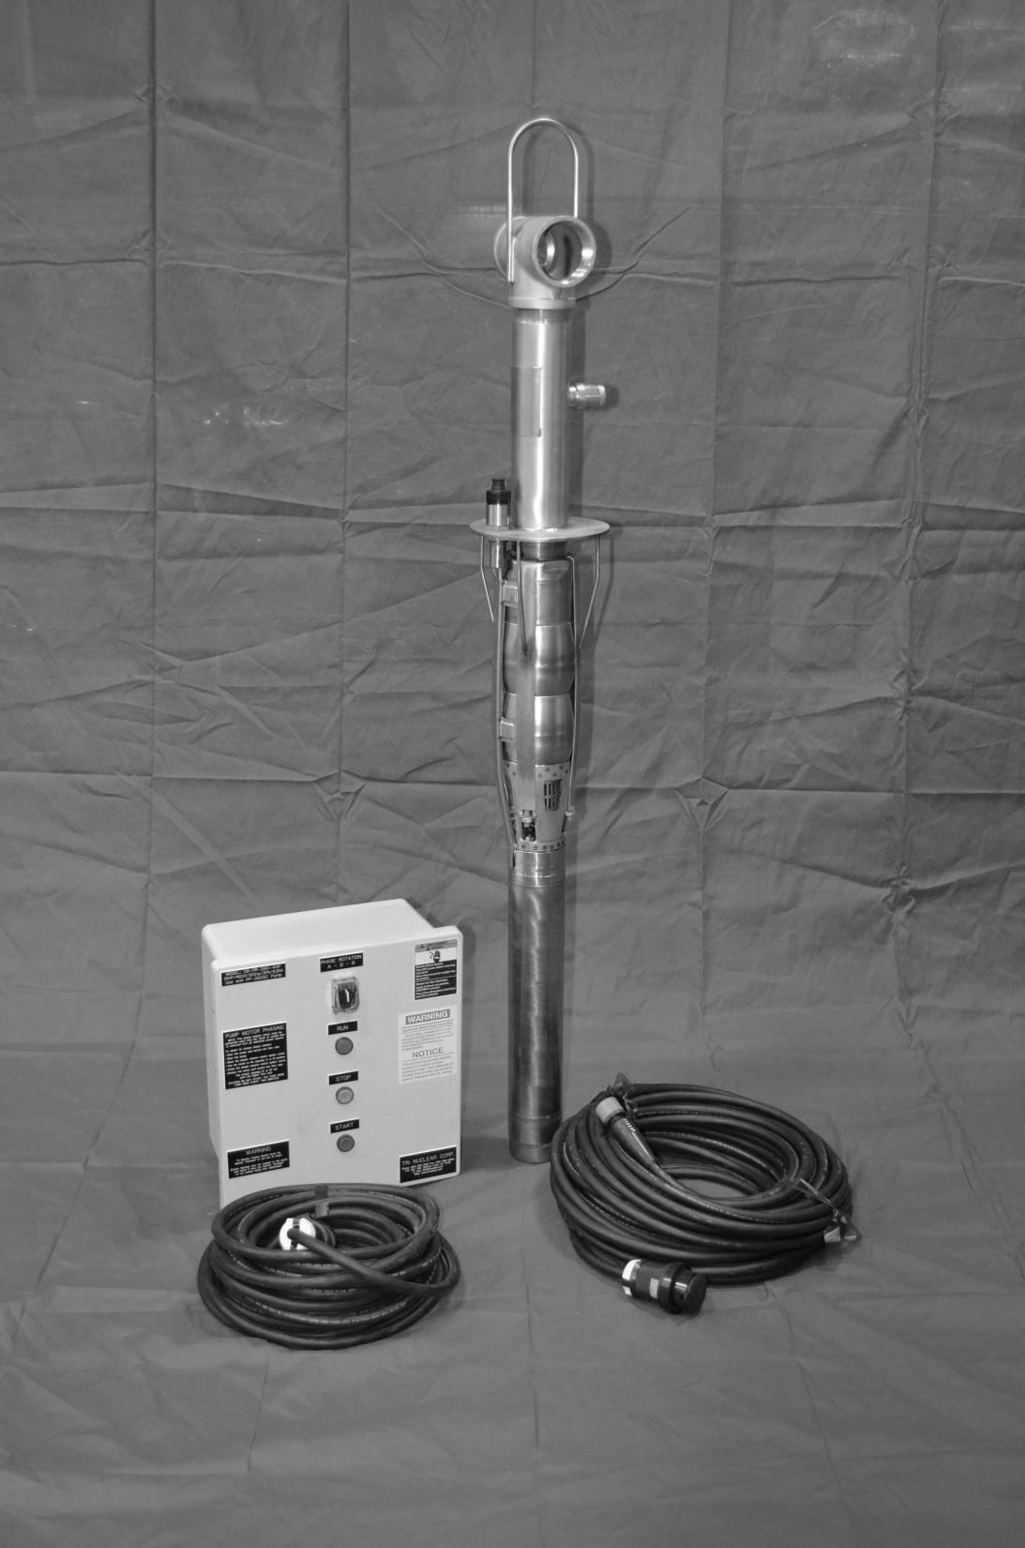
PP-260SC Pump/Motor Assembly

Slide 18
Detailed Description: PP-260SC Pump & Motor
Grundfos Submersible Motor
Stainless Steel
5 HP, Constant Speed
460V, 3 Phase, 60Hz AC
Squirrel Cage Induction Motor
9.9 amps Max running, 54amps starting
Approx. 6.1 amps @ 260 gpm
Max operating temp 140F
Time operating above 105F should be minimized

Slide 19
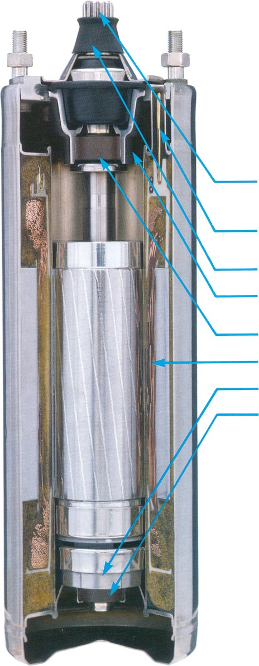
ONE-PIECE SPLINE SHAFT - Wear resistant, hardened stainless steel ensures maximum
resistance to corrosion.
LEADCONNECTOR- 3-wire with ground conforms to National Electrical Code.
SAND SLINGER - Protects against penetration of sand into the motor. (N/A for our applications)
INTERNALCOOLINGCHAMBER- Eliminates the need for a flow inducer sleeve.
UPPER RADIAL BEARING - Water lubricated ceramic bearing runs against a tungsten
carbide shaft journal providing extra long bearing life.
BUILT-IN LIGHTNING PROTECTION - Highly insulated stator is hermetically sealed in
stainless steel and encapsulated in polyurethane foam.
THRUST BEARING - Ceramic on carbon design provides longer thrust bearing life.
LOWER RADIAL BEARING - (same as upper radial bearing)

Slide 20
Detailed Description: PP-260SC Pump & Motor
Grundfos Submersible Pump
Stainless Steel
5 HP, Single Stage Centrifugal Pump
260 GPM Design Flow (460/60)
Pump Cover
3” discharge pipe
3” threaded tee
Flow meter fitting
Power cable disconnect
Machined for metal to metal contact to pump tube
4 pump guides help “self center” the pump in the pump tube as the pump is installed

Slide 21
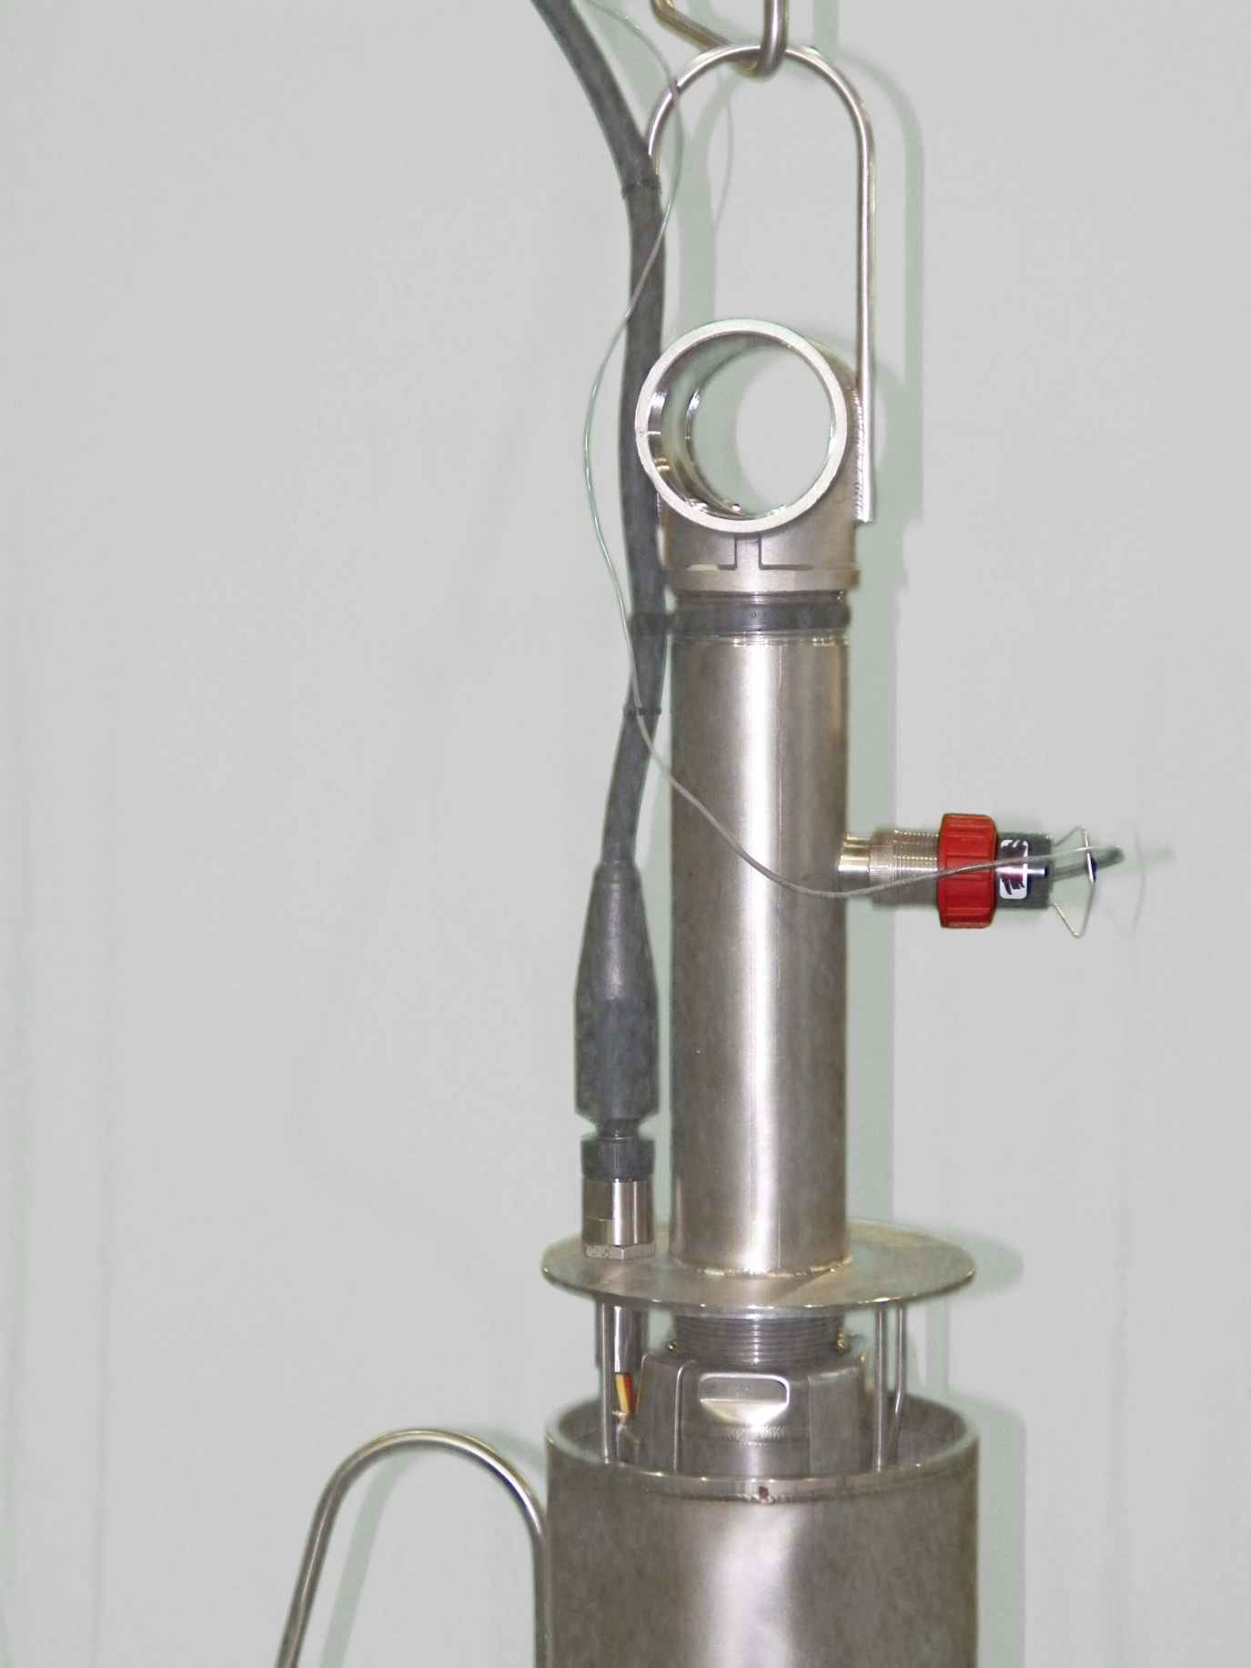
Pump Discharge
Zip Tie to provide vertical support power cable
Flow Meter Installed
PSC-100P Power Cable Installed
All pump SC connectors are now Stainless Steel (since Jan 2009)
Notes:
Show and explain the problems with the old plastic SC connectors and the new SS connectors.

Slide 22
3” NPT Discharge to pump cover
Check valve w/1” hole drilled in it.
Upper radial & thrust bearings
NOTE: The 2nd stage impellor is NOT installed on the PP-260SCpumps (but the 2nd stage volute is in place)
Upthrust bearing
1st stage impellor
Suction Strainer

Slide 23
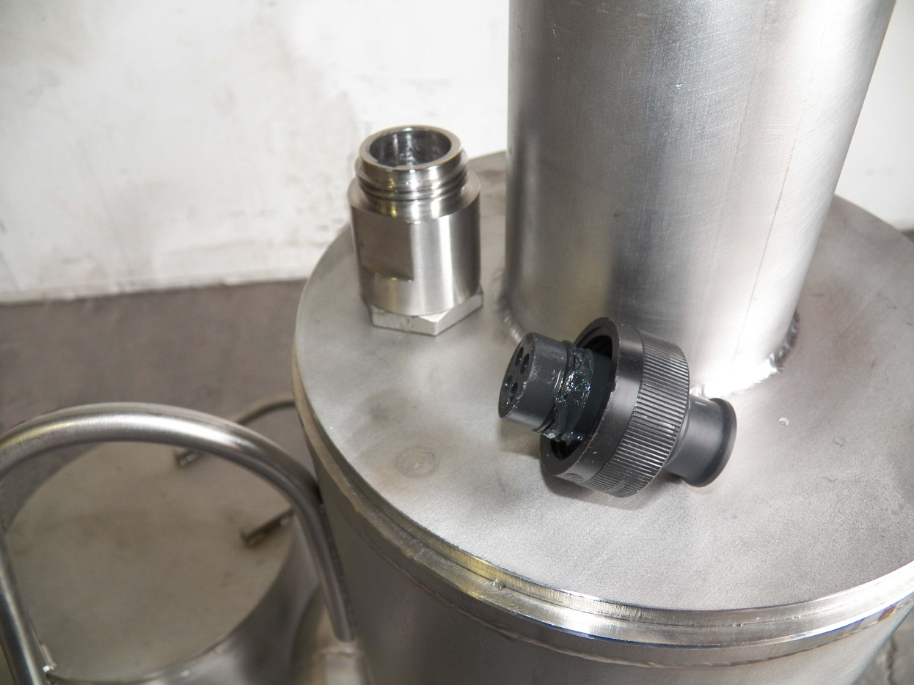
Seal Plug P/N SC-P
Installed whenever a power cord is removed from the pump
Protects the threads of the sea con connector
Prevents FME from entering the seacon connector

Slide 24
Detailed Description: Pump Control Boxes
5 versions in the field
CB-260 (pre May 2005)
2 button Start/Stop Control Box, (3) K-50 Thermal Overload Heaters installed for overload protection, Nema 1 box
CB-260-4X (May 2005 – Aug 2009)
2 button Start/Stop Control Box w/green run light, Adjustable overcurrent trip, Nema 4X fiberglass box
CB-PR-260-4X (Aug 2009 – Dec 2012)
Same as CB-260-4x, but can reverse pump motor phase
CB-PR-260-4XP (Dec 2012 – Feb 2017)
Same as CB-PR-260-4x, but has twist lock plugs for power cable and drop cable.
CB-260-FM (Feb 2017 - Pres.)
Same as CB-PR-260-4XP, but with integrated flow meter.

Slide 25
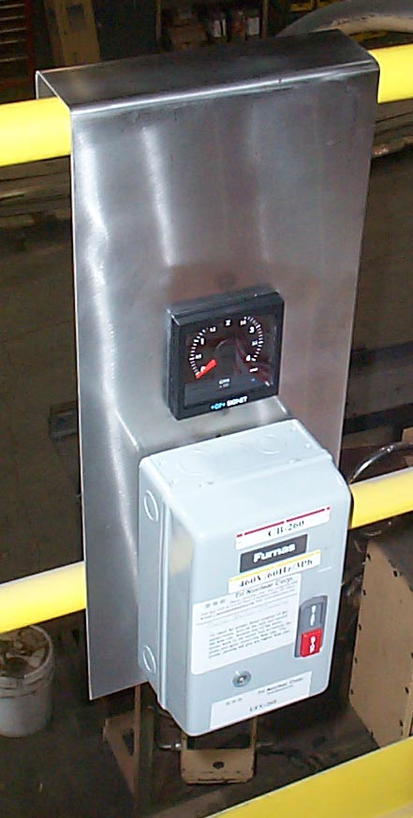
Detailed Description: Control Box – CB-***; Prior to May 2005
2 button Start/Stop Control Box
(3) K-50 Thermal Overload Heaters installed for overload protection
Must be connected to in plant power source
Control Box (CB-260) & Flow Meter (FM-260) mounted on the Control Panel (UT-10)
Notes:
25
Advantages – simple and sailor proof.
Disadvantage of this control box:
No longer supported by Tri Nuclear – in 2005 the Motor starter mfg moved to Mexico then to China – lead times became too long and unpredictable for our line of business.
Housed in a Nema 1 box (not water or moisture tight)

Slide 26
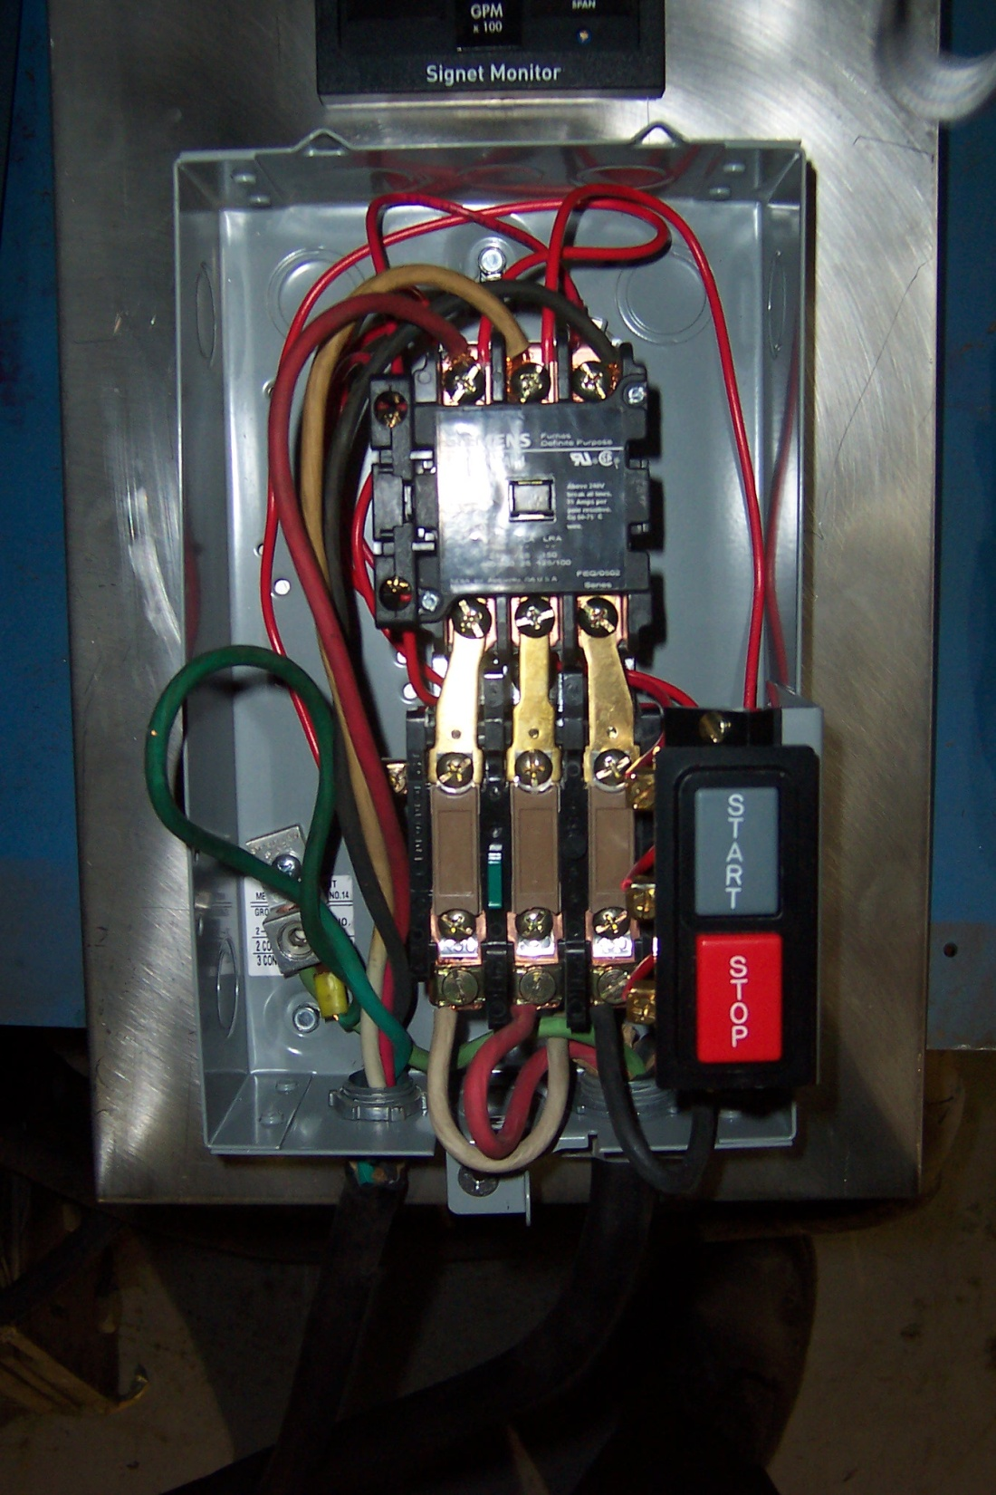
(3) K-50 Bi-Metallic Overload Heaters
From in plant power source
(pigtail not included)
PSC-100 Power Cord (to pump)
Notes:
Advantages – simple and sailor proof.
Disadvantage of this control box:
No longer supported by Tri Nuclear – in 2005 the Motor starter mfg moved to Mexico then to China – lead times became too long and unpredictable for our line of business.
Housed in a Nema 1 box (not water or moisture tight)
480V through the start/stop push buttons
Because of the manufacturing issues and the increased concern in the nuclear industry over electrical safety, we re-designed the control box.

Slide 28
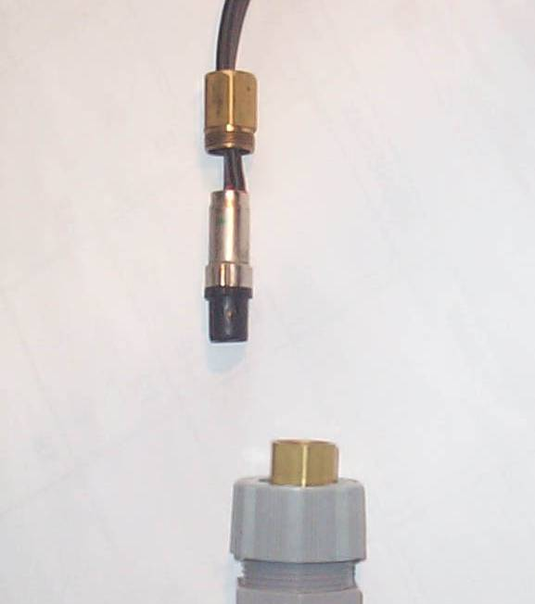
Detailed Description: Power Cable (before 2001)
PCX-100 Power Cable
100ft 12ga “flat yellow” ribbon cable
Pump power cord connector was discontinued in 2001
Uses 19mm wrench to install
Power cord itself was discontinued in mid 2009
Notes:
Show and pass around mock up of the old power cable
(check and see if the plant has any of the old pumps left in service that use them)

Slide 29
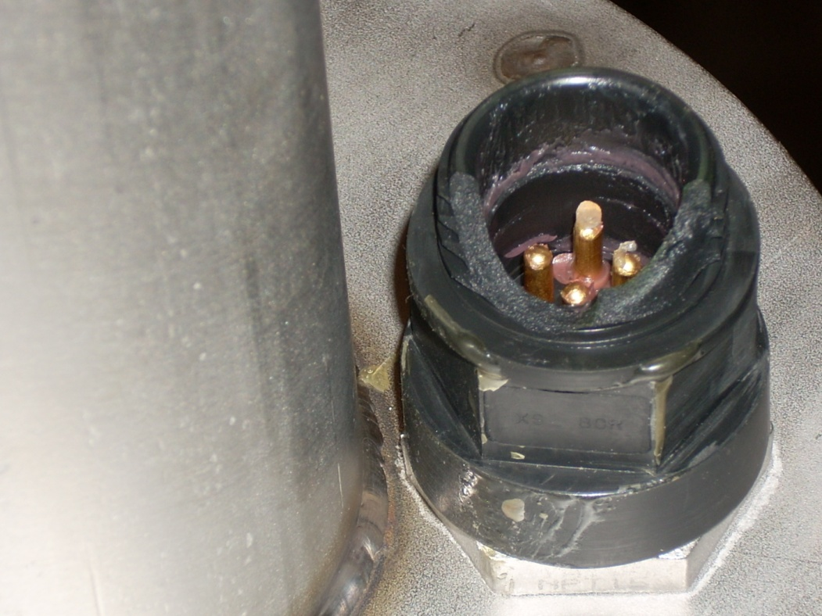
UFV Operations Setup
Pre Start up:
DAMAGE to the pump sea con connector could occur .
Broken SC connector due to over-torque or excessive bending motion on the power cable
All SC connectors on pumps shipped since Jan 2009 have been made from SS to eliminate this problem.

Slide 30
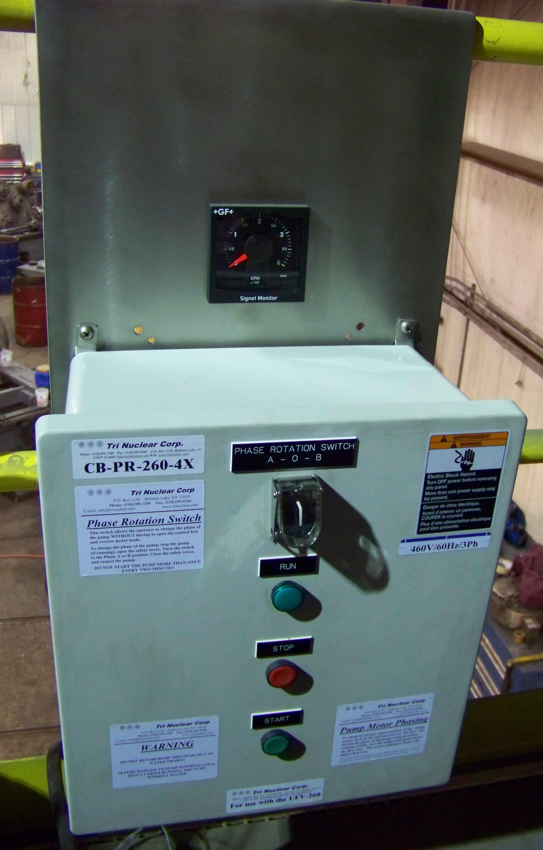
Detailed Description: Phase Reversing Control Box, CB-PR-260-4XP
NEMA 4X Control Box
NEMA 4X type enclosure
460V/3Ph/60Hz solid state controller
Adjustable over current trip.
120V controls
start/stop pushbuttons
Green “run” indicating light
Can change motor phases with one switch – WITHOUT opening the box
Notes:
Advantages:
Do not have to have an electrician come swap leads for the phase rotation check.
Can be done by the operator with the switch.
Noting but positive feedback from plants. Ginna & Robinson were instrumental in getting this box approved for use in the field.
In August of 2009 Tri Nuclear introduced an upgraded version of our standard control box that allows the operator to change the phase rotation of the pump WITHOUT having to open the control box and swap two of the three motor leads.
This is accomplished by a switch on the front of the control box and two motor starters inside the control box. These two motor starters are wired such that when the “Phase Rotation Switch” is in the “A” position the pump motor rotates one direction, and when the “Phase Rotation Switch” is in the “B” position the pump motor rotates in the opposite direction. If the “Phase Rotation Switch” is in the center position, neither motor starter will be energized and the pump will not start.
The CB-PR-260-4X is a NEMA 4X type enclosure (14x16) and has two 460V/3Ph/60Hz solid state controllers with an single adjustable over current trip. The control box has a “Phase Rotation Switch” with safety cover, start/stop pushbuttons and a green “run” indicating light on the front of the panel.

Slide 31
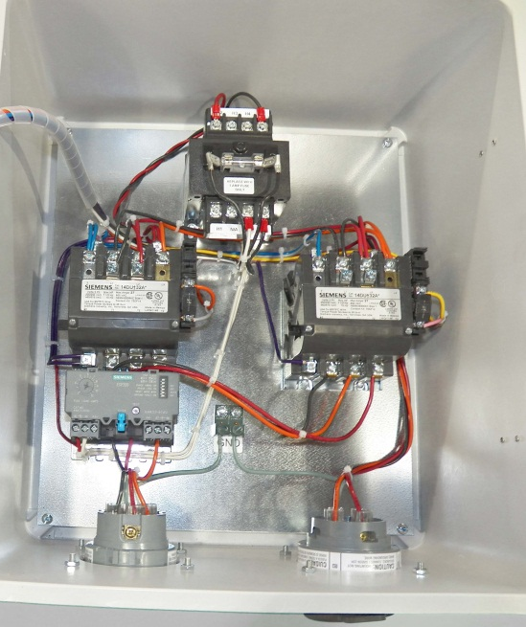
Detailed Description: Phase Reversing Control Box with twistlock plugs, CB-PR-260-4XP
460V/3Ph/30 amp, Nema 4X, twistlock plug for line in from in plant power supply
460V/3Ph/30 amp Nema 4X, twistlock connector for line out to pump
Notes:
-XP box identical to the PR control box with the exception of having twistlock plugs
The 460V / 3ph / AC 30amp Nema 4X Twist Lock plugs allow the operator to quickly and easily install the PC-50 drop cable and PSC-100P pump power cable to the control box without drilling and connecting bare cables to internal terminal blocks in the control box.

Slide 32
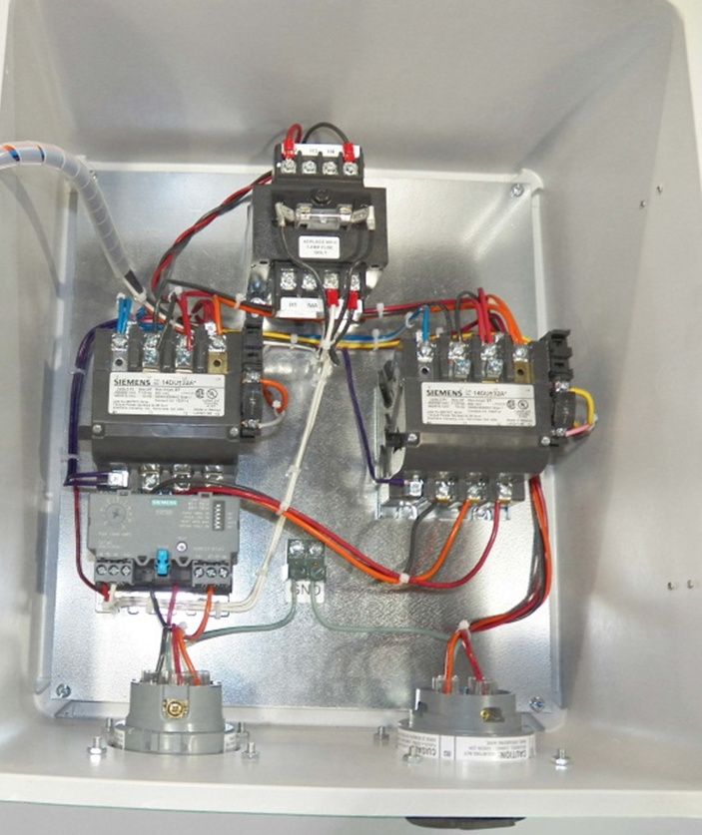
Detailed Description: Phase Reversing Control Box, CB-PR-260-4X Aug 2009 – Dec 2012
120 V controls
(not shown)
460V / 120 V Transformer
Solid State Motor starter
Adj. overload trip
Line IN 30 amp twistlock plug
Line OUT 30 amp twistlock connector

Slide 33
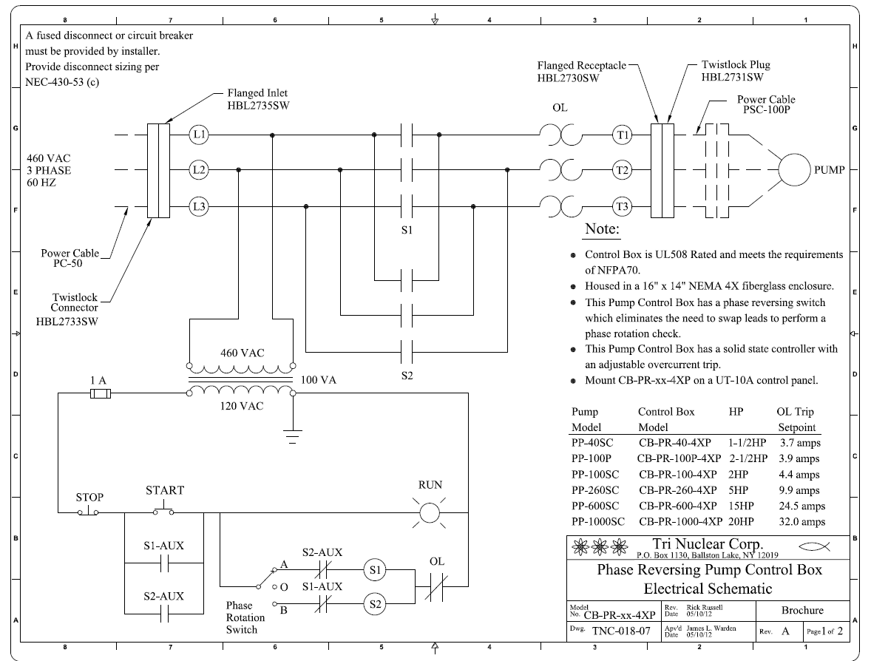

Slide 34
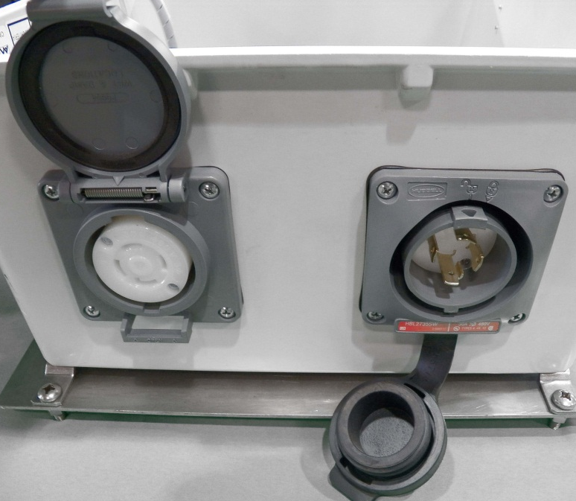
Detailed Description: Phase Reversing Control Box with twistlock plugs, CB-PR-260-4XP
Line OUT 30 amp twistlock connector
Line IN 30 amp twistlock plug
Notes:
Twist Lock plugs are located on the bottom of the control box.
The plug to the right (with the male Twist Lock connections) is the line in / power in plug.
The plug to the left (with the female Twist Lock connections) is the power out to the pump.

Slide 35
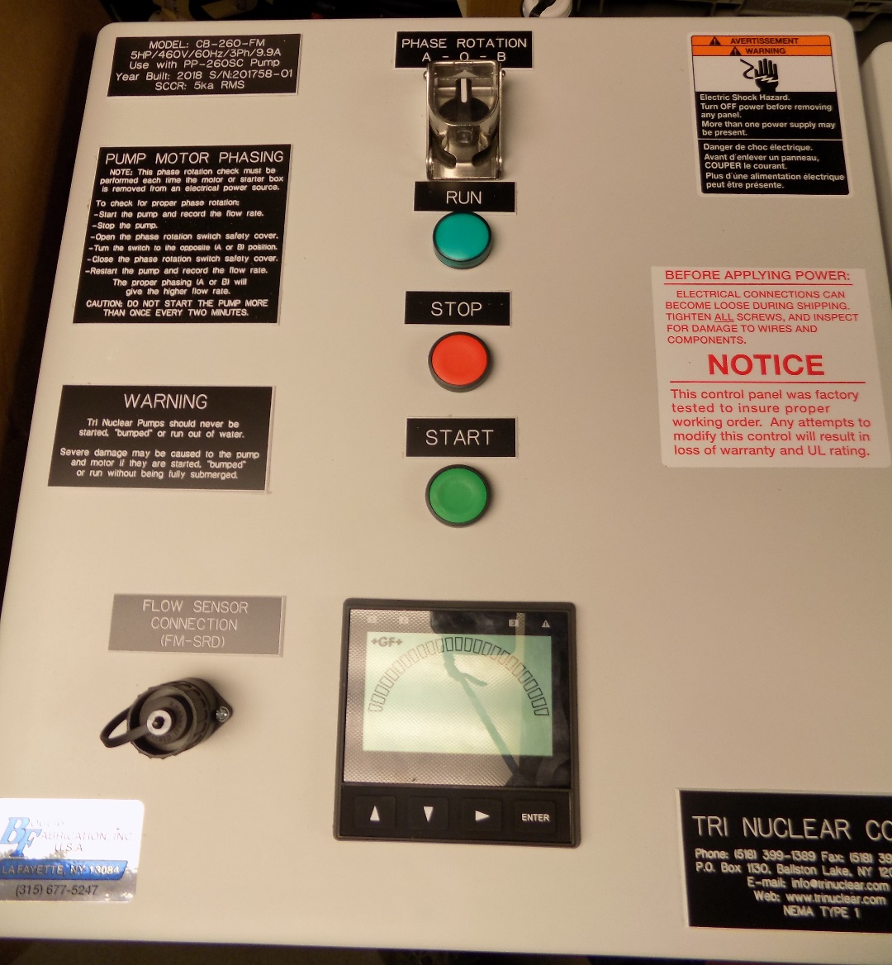
Detailed Description: Phase Reversing Control Box with twistlock plugs and integrated flow meter, CB-260-FM
Flow Sensor Connection port (Amphenol)
Integrated Digital Flow Meter Readout
Notes:
Twist Lock plugs are located on the bottom of the control box.
The plug to the right (with the male Twist Lock connections) is the line in / power in plug.
The plug to the left (with the female Twist Lock connections) is the power out to the pump.

Slide 36
Detailed Description: PSC-100P Power Cable
PSC- 100p Power Cable
100ft 10/4 SO Cable
Molded “Seacon” connector on one end
Male twistlock plug on other
Notes:
The PSC-100P Pump Power cable is a 100ft 10/4 SO cable with a male Nema 4x Twist Lock plug x Sea Con Connector. This Pump Power cable is to supply power to the pump from the Phase Reversing Control Box.

Slide 37
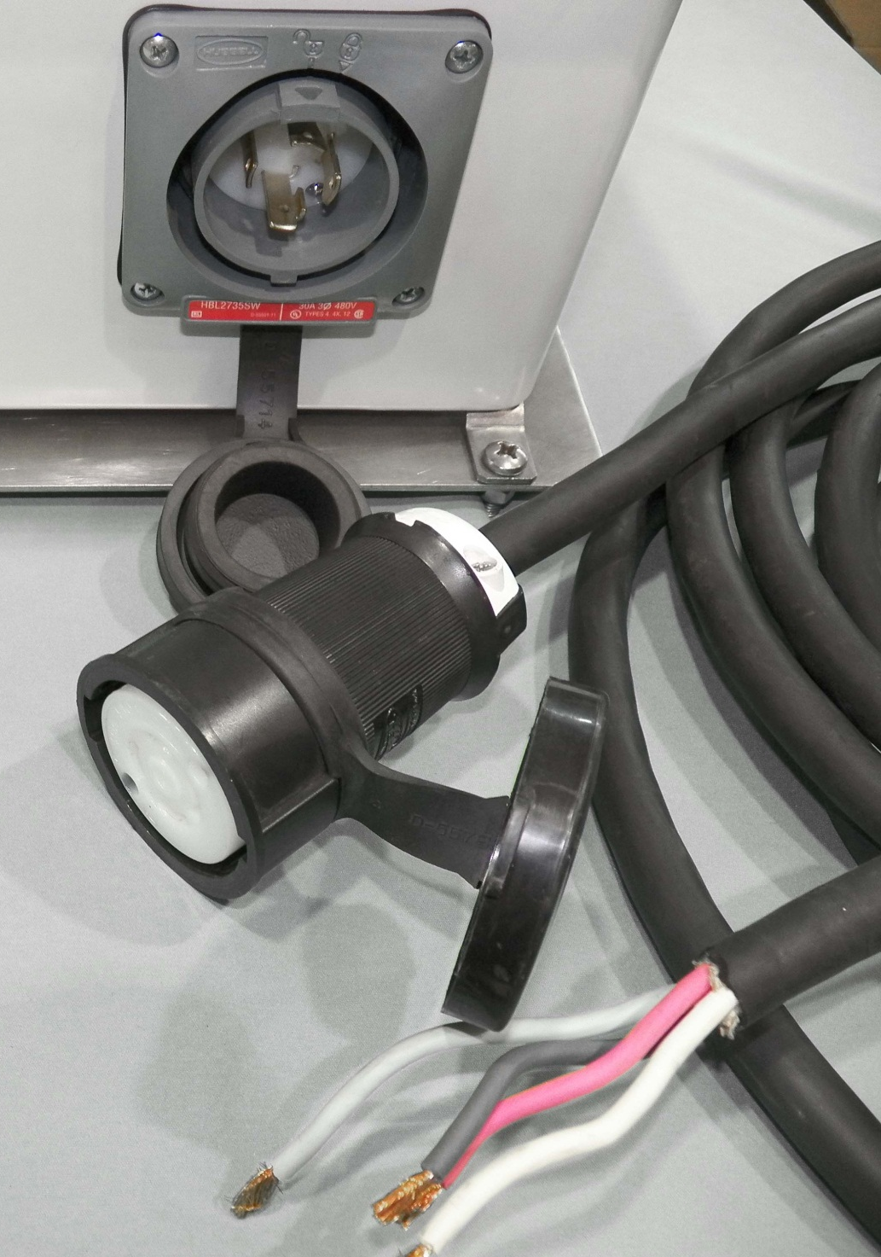
Detailed Description: PC-50 Drop Cable
PC-50 Drop Cable
Supplies power from in plant power supply to the control box.
50ft 10/4 SO Cable
Female twistlock plug on one end x bare wire on other
Notes:
The PC-50 Control Box Drop Cable is a 50’ 10/4 SO cable with a female Nema 4X twist lock plug x bare wire. This drop cable is to supply the control box from the in plant power source / motor control center / welding outlets etc.

Slide 38
Detailed Description: Flow Meter & Flow Sensor
FM-260
0-400 GPM Analog Flow Meter, Milliammeter instrument that provides gross indication of system flow
FM-SR
Paddlewheel, magnetic self-induced type flow meter, sealed and waterproof with 100ft of instrument cable
FM-SRD
Same as FM-SR but with Amphenol connection for the CB-260-FM control box
Notes:
The UFV-260 flow meter is installed to provide a gross indication of system flow. System flow rate is a gauge for determining change in pressure drop through the filters. Under normal operations a filter would be changed out when system flow rate drops to ~50% of clean filter value.
The flow meter used for the UFV-260 is a self-powered analog meter that provides flow indication from 0-400 GPM. The flow meter uses the amplitude of the flow sensor signal to drive the 100-microamp meter movement.
The flow sensor for the UFV-260 is a paddlewheel type flow sensor. The paddlewheel has a re-enforced sleeve that covers the titanium shaft and is designed to minimize wear of the rotor. When water flows past the paddlewheel and it rotates, the flow sensor produces a sinusoidal waveform with frequency and amplitude directly proportional to the flow rate. The sensor comes equipped with 100ft of instrument cable.

Slide 39
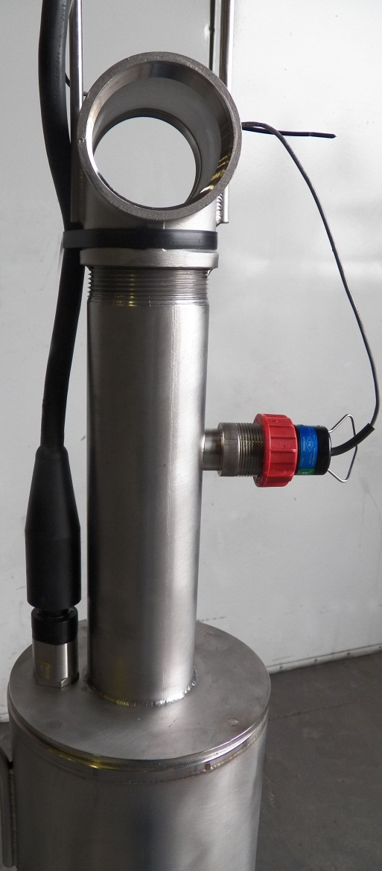
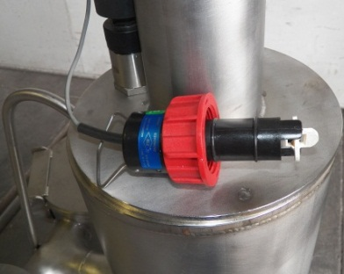
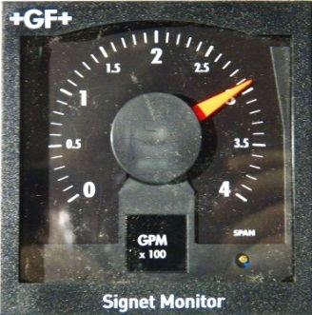
Tri Nuclear Flow Meter
Flow Sensor installed in pump
Flow Sensor
Model FM-SR
Flow Meter
Model FM-260M

Slide 40
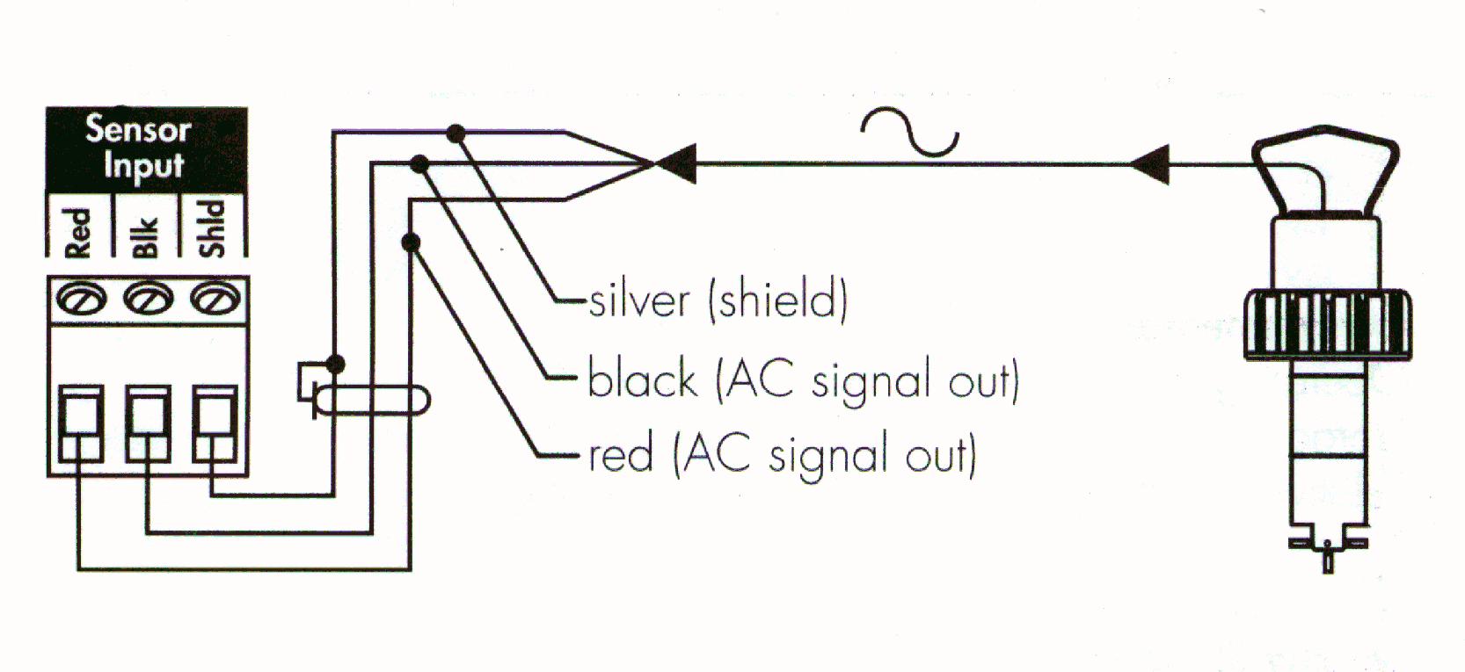
Tri Nuclear Flow Meter
Typical Flow Sensor/Meter connection

Slide 41
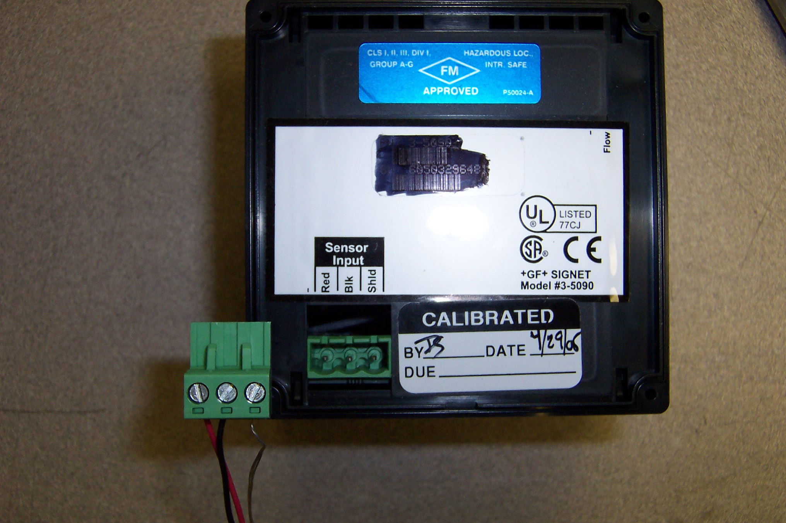
Tri Nuclear Flow Meter

Slide 42
Tooling/Accessories for the UFV-260

Slide 43
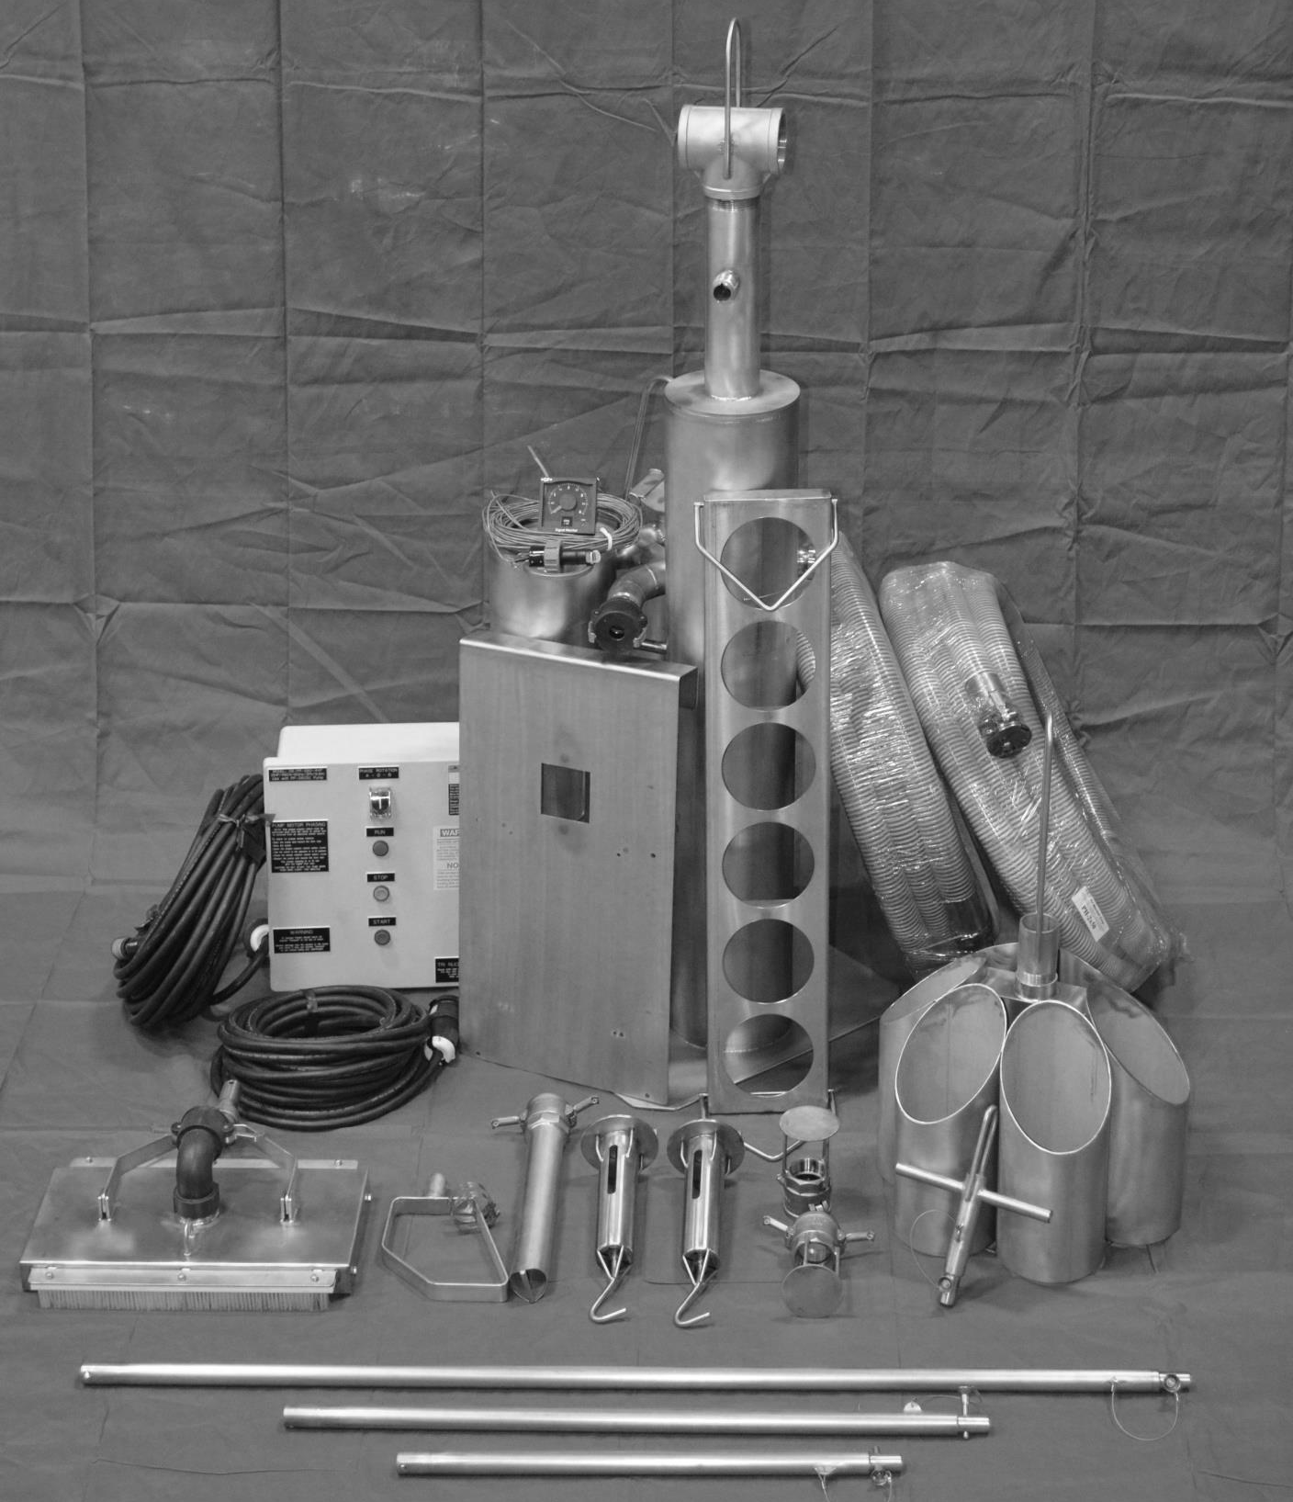

Slide 44
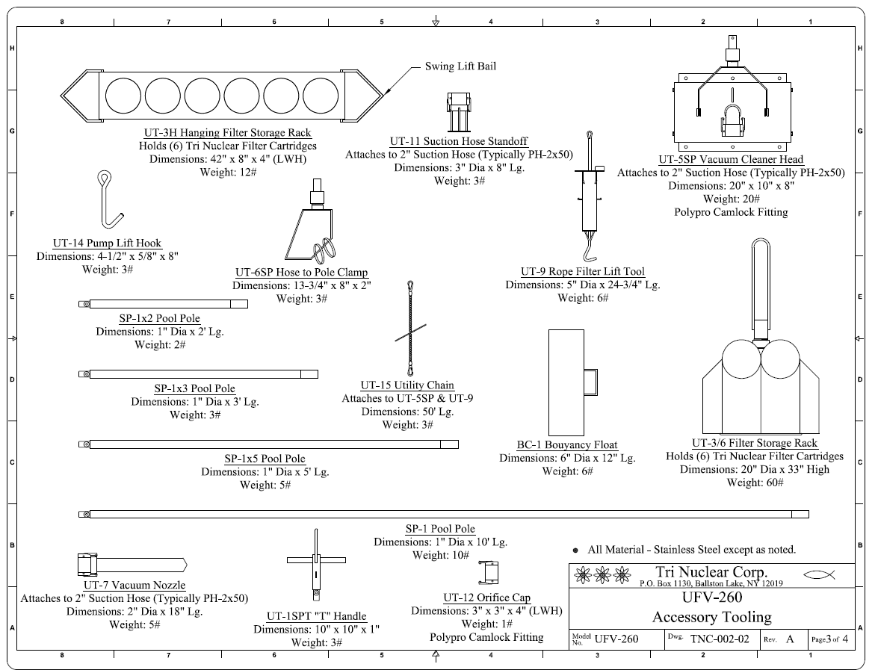
Notes:
Tri Nuclear Corp. has designed special 10ft stainless steel pole sections for deep submergence pool work at nuclear power stations. The required total length of pole is obtained by coupling together (without tools) multiple 10ft sections using a quick release, "recessed button type", positive locking pull pin.
This provides for a strong rigid connection for transmission of high torque and loading. The same connection is used to attach special tooling fixtures to the bottom end of the assembled pole sections for performing various types of underwater remote hand operations.
Material: all Stainless Steel
Weight: 10 lbs per 10ft Section
Pool Poles are floodable
Poles connected together with a quick release, "recessed button type", Stainless Steel, positive locking pull pin
Pull pins are lanyard to pool poles with stainless steel wire rope
T-handle has a top lift bail for crane lifting operations or tying off to cavity wall

Slide 45
UFV-260 Tooling
Stainless Steel Pool Pole, SP-1
Material: all Stainless Steel
1 in pipe (1.31 in OD) x 10ft long
Weight: 10 lbs per 10ft Section
Pool Poles are floodable
Poles connected together with a quick release, "recessed button type", Stainless Steel, positive locking pull pin
Pull pins are lanyard to pool poles with stainless steel wire rope
Notes:
Tri Nuclear Corp. has designed special 10ft stainless steel pole sections for deep submergence pool work at nuclear power stations. The required total length of pole is obtained by coupling together (without tools) multiple 10ft sections using a quick release, "recessed button type", positive locking pull pin.
This provides for a strong rigid connection for transmission of high torque and loading. The same connection is used to attach special tooling fixtures to the bottom end of the assembled pole sections for performing various types of underwater remote hand operations.
Material: all Stainless Steel
Weight: 10 lbs per 10ft Section
Pool Poles are floodable
Poles connected together with a quick release, "recessed button type", Stainless Steel, positive locking pull pin
Pull pins are lanyard to pool poles with stainless steel wire rope
T-handle has a top lift bail for crane lifting operations or tying off to cavity wall

Slide 46
UFV-260 Tooling
New in 2013: Variable Length Pool Poles
Same connection / design as SP-1 Pool Poles
SP-1x5
5 ft long pool pole
SP-1x3
3 ft long pool pole
SP-1x2
2 ft long pool pole
These allow for the operator to adjust the overall height of the pool poles for optimum operations
Notes:
The SP-1x5 Pole is identical to the SP-1 pool pole with the exception that it is only 5 ft long instead of 10 ft long. Its purpose is to provide an overall adjustment in height for the operator on a bridge or wall.
The SP-1x3 Pole is identical to the SP-1 pool pole with the exception that it is only 3 ft long instead of 10 ft long. Its purpose is to provide an overall adjustment in height for the operator on a bridge or wall.
The SP-1x2 Pole is identical to the SP-1 pool pole with the exception that it is only 2 ft long instead of 10 ft long. Its purpose is to provide an overall adjustment in height for the operator on a bridge or wall.

Slide 47
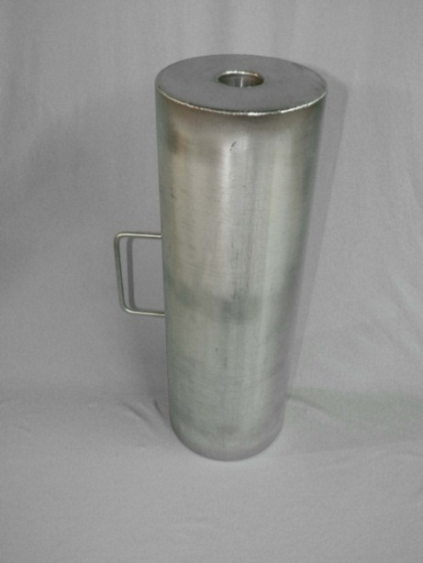
UFV-260 Tooling
Buoyancy Chamber
Slides over pool poles
6in dia x 18in long
Material: Stainless Steel
Provides positive buoyancy to reduce the overall weight of pool poles. Same connection / design as SP-1 Pool Poles
Reduces the weight of the pool pole by approximately half.
Notes:
Tri Nuclear has developed a Buoyancy Chamber that slides over the pool pole. It is a 6in x 18in long stainless steel chamber that provides positive buoyancy for the pool poles. The effect of this positive buoyancy is to reduce the overall weight of the assembled pool poles for the operator. Each Buoyancy Chamber reduces the weight of the pool by approximately half. The BC-1 Buoyancy Chamber has a handle for ease of moving and installing on the pool pole.
.

Slide 48
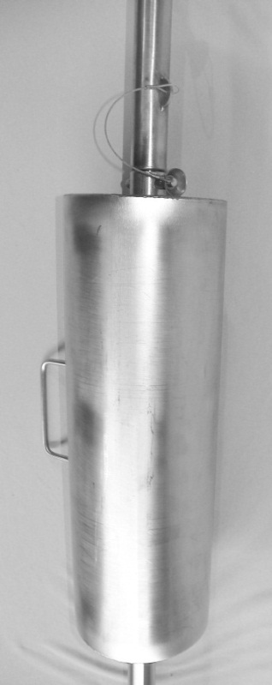
UFV-260 Tooling
Buoyancy Chamber
Slides over pool poles
6in dia x 18in long
Material: Stainless Steel
Provides positive buoyancy to reduce the overall weight of pool poles. ame connection / design as SP-1 Pool Poles
Reduces the weight of the pool pole by approximately half.
Notes:
Tri Nuclear has developed a Buoyancy Chamber that slides over the pool pole. It is a 6in x 18in long stainless steel chamber that provides positive buoyancy for the pool poles. The effect of this positive buoyancy is to reduce the overall weight of the assembled pool poles for the operator. Each Buoyancy Chamber reduces the weight of the pool by approximately half. The BC-1 Buoyancy Chamber has a handle for ease of moving and installing on the pool pole.

Slide 49
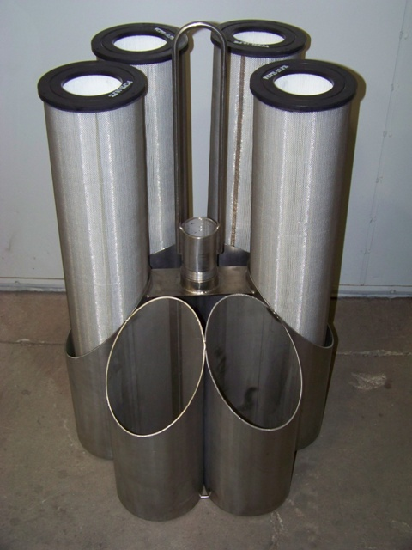
UFV-260 Tooling
Floor Storage Rack, UT-3/6
Holds 6 Filter Cartridges
20” Dia
33” height
Designed to fit into a standard 55gal drum
Notes:
FILTER STORAGE RACK (UT-3/6)
A six (6) tube 20” dia. rack for holding filter cartridges underwater adjacent to the Underwater Filter Unit to facilitate the speedy underwater change-out and replacement of filter cartridges.
This rack has a center lift bale (33” OAH) above the filter cartridges for easy lifting and can easily be stored in a standard 55 gal. waste drum.
It is designed hold one set of spare or expended filters from an operating UFV-260 & UF-600.

Slide 50
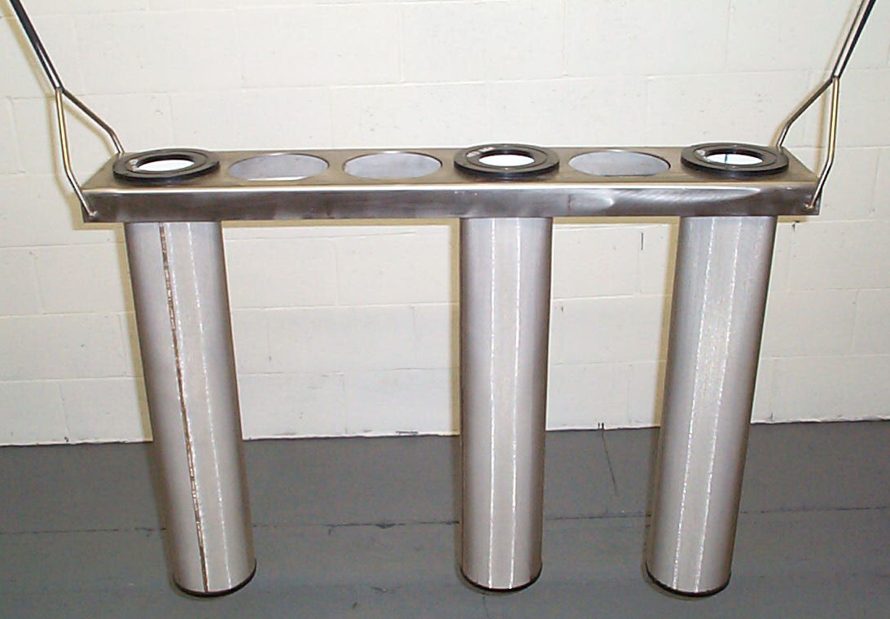
UFV-260Tooling
UT-3H, Hanging Filter Storage Rack
Holds 6 filter cartridges
42”L x 8” W
Notes:
A 42"L x 8"W x 4"H hanging rack for holding six (6) spare or spent filter cartridges. This rack can be hung from the railing around the pool or the fuel bridge and allows for more efficient filter change out.

Slide 51
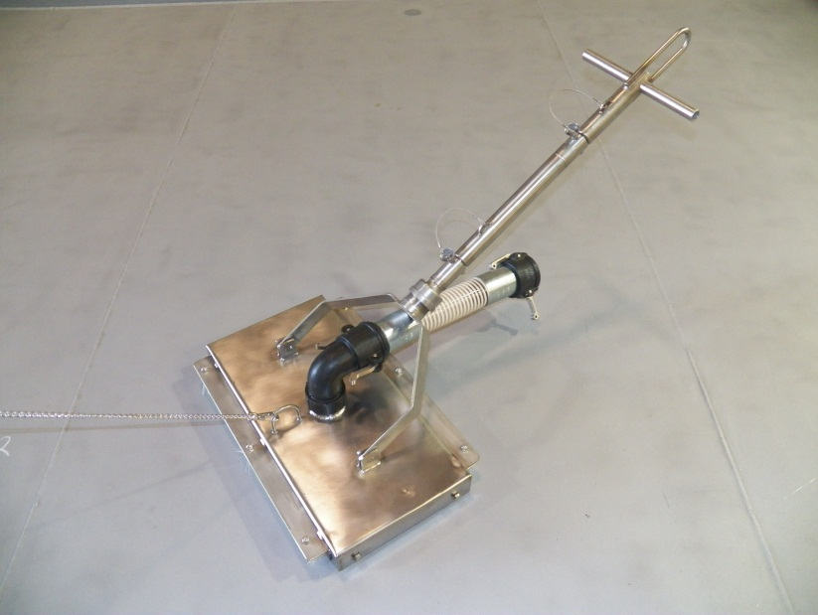
UFV-260 Tooling
Floor Vacuum Head, UT-5SP
attached to suction hose, pool pole training aid & UT-1SPT tee handle
10” x 20”
4 wheels
2 brushes
UT-15 Utility Chain
Notes:
A 10"x 20" four wheel vacuum cleaner head equipped with two brushes, which attaches to the bottom pool pole and to the suction end of a vacuum hose leading to the UFV Unit.

Slide 52
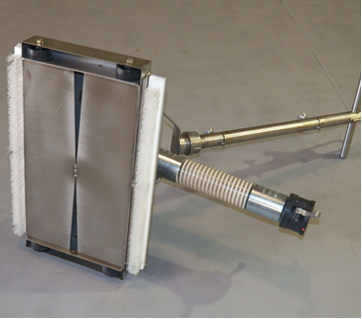
UFV-260 Tooling
Floor Vacuum Head, UT-5SP
Underside of vac head
Notes:
A 10"x 20" four wheel vacuum cleaner head equipped with two brushes, which attaches to the bottom pool pole and to the suction end of a vacuum hose leading to the UFV Unit.

Slide 53
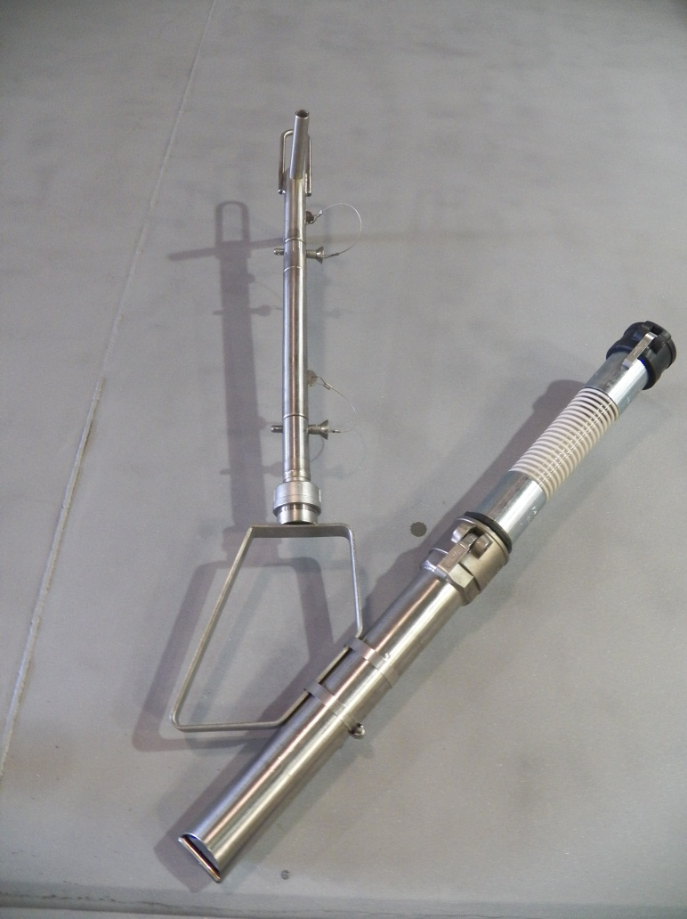
UFV-260 Tooling
UT-7, Vacuum Nozzle with the UT-6SP, Hose to Pole clamp.
Nozzle positions:
Vertical
Horizontal
45 deg.
Notes:
HOSE TO POLE CLAMP (UT-6SP)
This fixture attaches to the bottom pool pole, and holds the suction end of a vacuum hose or nozzle with two clamps at one of three orientations. (vertical, 45 deg., or horizontal)
VACUUM NOZZLE (UT-7)
A 2"dia.x 18"lg. vacuum nozzle is connected to the end of a vacuum hose. The vacuum nozzle is used for vacuuming small areas requiring high water velocity for lifting. This is used with the UT-6 Hose To Pole Clamp.

Slide 54
UFV-260 Tooling
UT-7 Vacuum Nozzle is 2” dia x 18” long SS
nozzle w/ 30 degree cutout at vacuuming end.
3/8” round bar at end prevents large objects from fouling the nozzle.
Notes:
VACUUM NOZZLE (UT-7)
A 2"dia.x 18"lg. vacuum nozzle is connected to the end of a vacuum hose. The vacuum nozzle is used for vacuuming small areas requiring high water velocity for lifting. This is used with the UT-6 Hose To Pole Clamp.

Slide 55
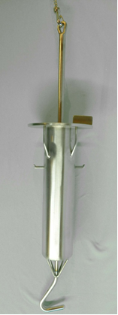
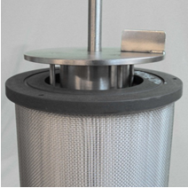
UFV-260 Tooling
UT-9, Rope Filter Lift tool
Notes:
ROPE-FILTER LIFT TOOL (UT-9)
A special 18in high tool is used for changing out filter cartridges remotely underwater using the UT-15 Utility Chain. This tool uses a "positive latch" mechanism allowing for a very simple, effective, and quick method for filter change-out.

Slide 56
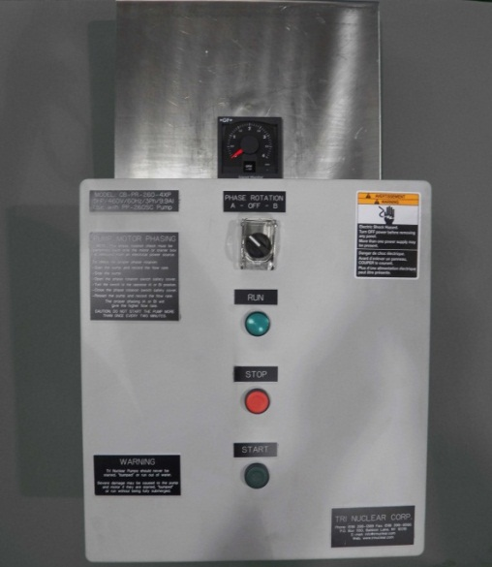
UFV-260 Tooling
Mounting Panel,
UT-10A for mounting Pump Control Box and Flow Meter
Note: UT-10C is available for use with the FM series of Control Boxes.
Notes:
CONTROL PANEL (UT-10)
The UT-10A control panel mounts the flow meter and control box in one convenient location. The control panel is designed to hang from a typical hand rail.

Slide 57
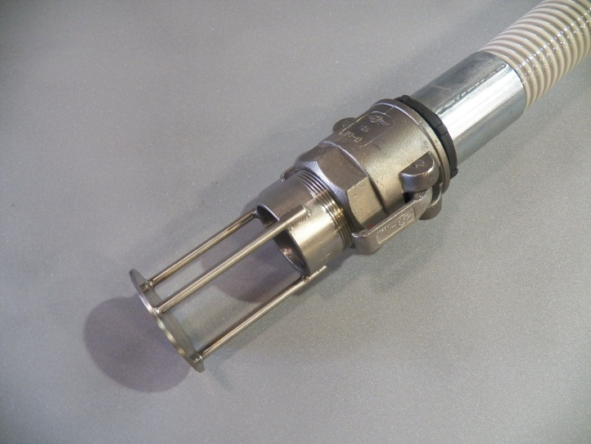
UFV-260 Tooling
Suction Hose Standoff, UT-11
Prevents suction hose from “deadheading” on wall or floor.
Notes:
SUCTION HOSE STAND-OFF (UT-11)
The suction hose stand-off is a stainless steel, 2in camlock adapter that is attached to the end of a 2in suction hose. The suction hose stand-off prevents the hose from “dead heading” on the wall or floor.

Slide 58
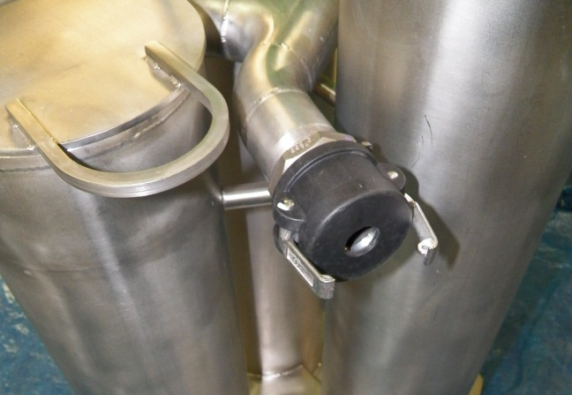
UFV-260 Tooling
Orifice Cap,
UT-12
A 1-in orifice suction cap
installed on a suction port during single hose operations
The orifice provide sufficient flow to the pump to prevent cavitation
Notes:
SUCTION HOSE STAND-OFF (UT-11)
The suction hose stand-off’s are attached to the end of the 2” suction hoses. The suction hose stand-off prevents the hose from “dead heading” on the wall or floor.

Slide 59
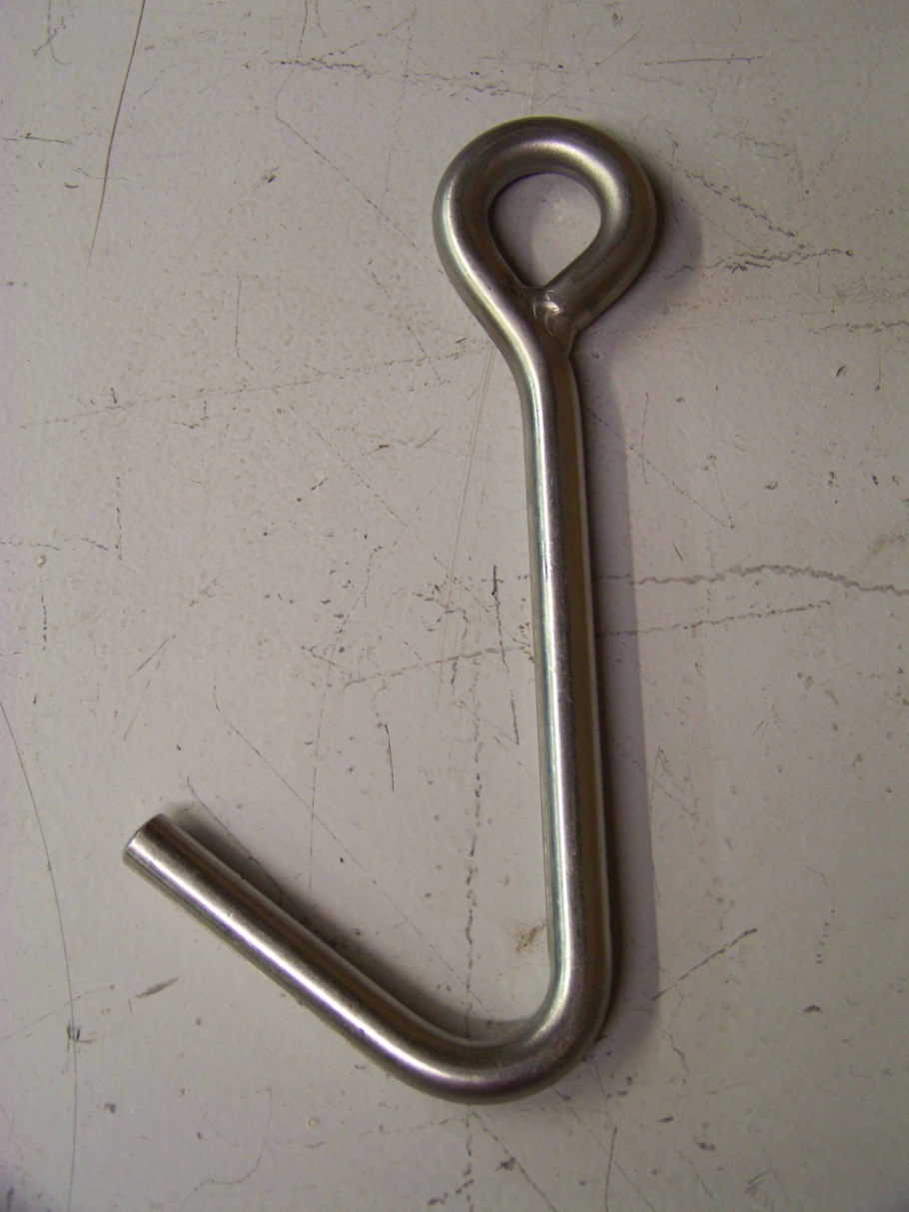
UFV-260 Tooling
UT-14 Pump Lift Hook
Material: Stainless Steel
Used with a cable (supplied by customer)
Notes:
PUMP LIFTING TOOL (UT-14)
This stainless steel grapple hook is used with a cable (supplied by customer) to install or remove the pump assembly from the UFV-260 housing.

Slide 60
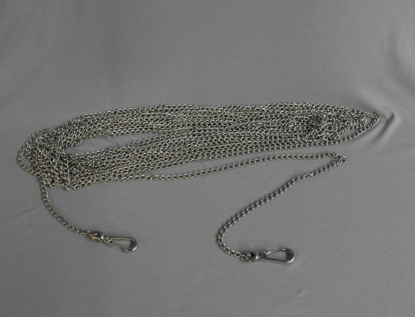
UFV-260 Tooling
Utility Chain,
UT-15
50ft long SS utility chain
Designed to work with the UT-9 Rope Filter Lift Tool and UT-5SP Vacuum Cleaner Head
Notes:
The Stainless Steel Utility Chain (UT-15) is a 50ft [12.24m] lightweight stainless steel chain with a swivel clip on each end. It is designed to be used with the UT-9 Rope Filter Lift Tool and the UT-5SP vac head.
When used with the UT-9, it provides a means for actuating the Rope Filter Lift Tool from the bridge or pool wall.
When used with the UT-5SP it aids the operator in moving the vac head across the pool floor.

Slide 61
Tri Nuclear Corp. Assembly & Installation in the Pool

Slide 62
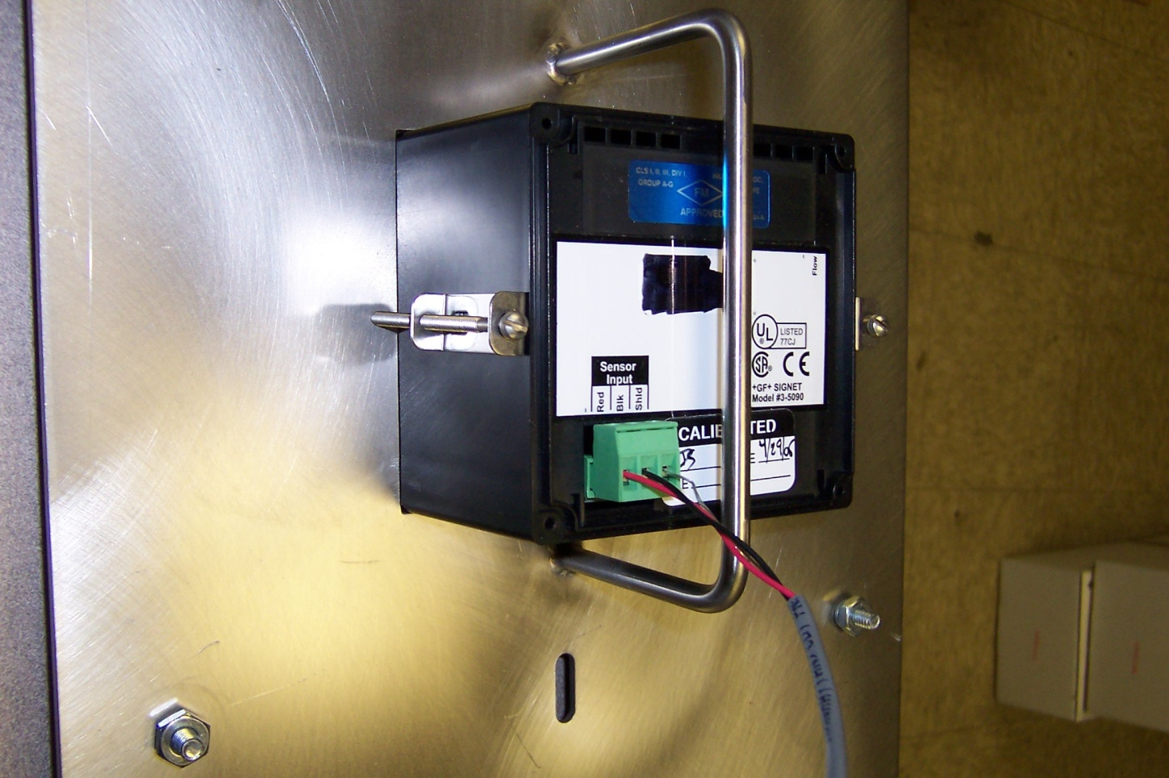
UFV Operations Setup
Pre Start up:
Install Flow Meter in UT-10 or UT-10A Mounting Panel (pre 2017)
(2) Brackets
hold flow meter
in place
Notes:
The flow meter dial read-out gauge is a delicate instrument (milliammeter) and should be protected from rough handling. It will probably be broken if dropped on the floor. It should be mounted to the UT-10 control panel and hung on a suitable railing for protection.

Slide 63
Tri Nuclear Flow Meter

Slide 64
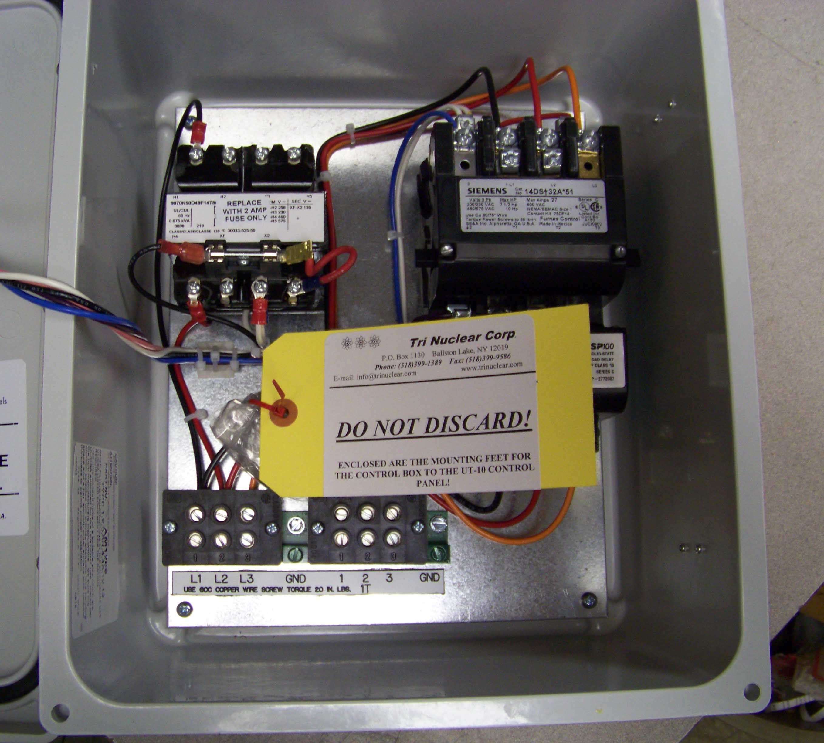
UFV Operations Setup
Pre Start up:
Locate the mounting feet to the back of the Control Box. The (4) mounting feet and hardware are wrapped and tagged inside the box.
CB-260-4x shown, CB-PR-260-4XP and CB-260-FM similar

Slide 65
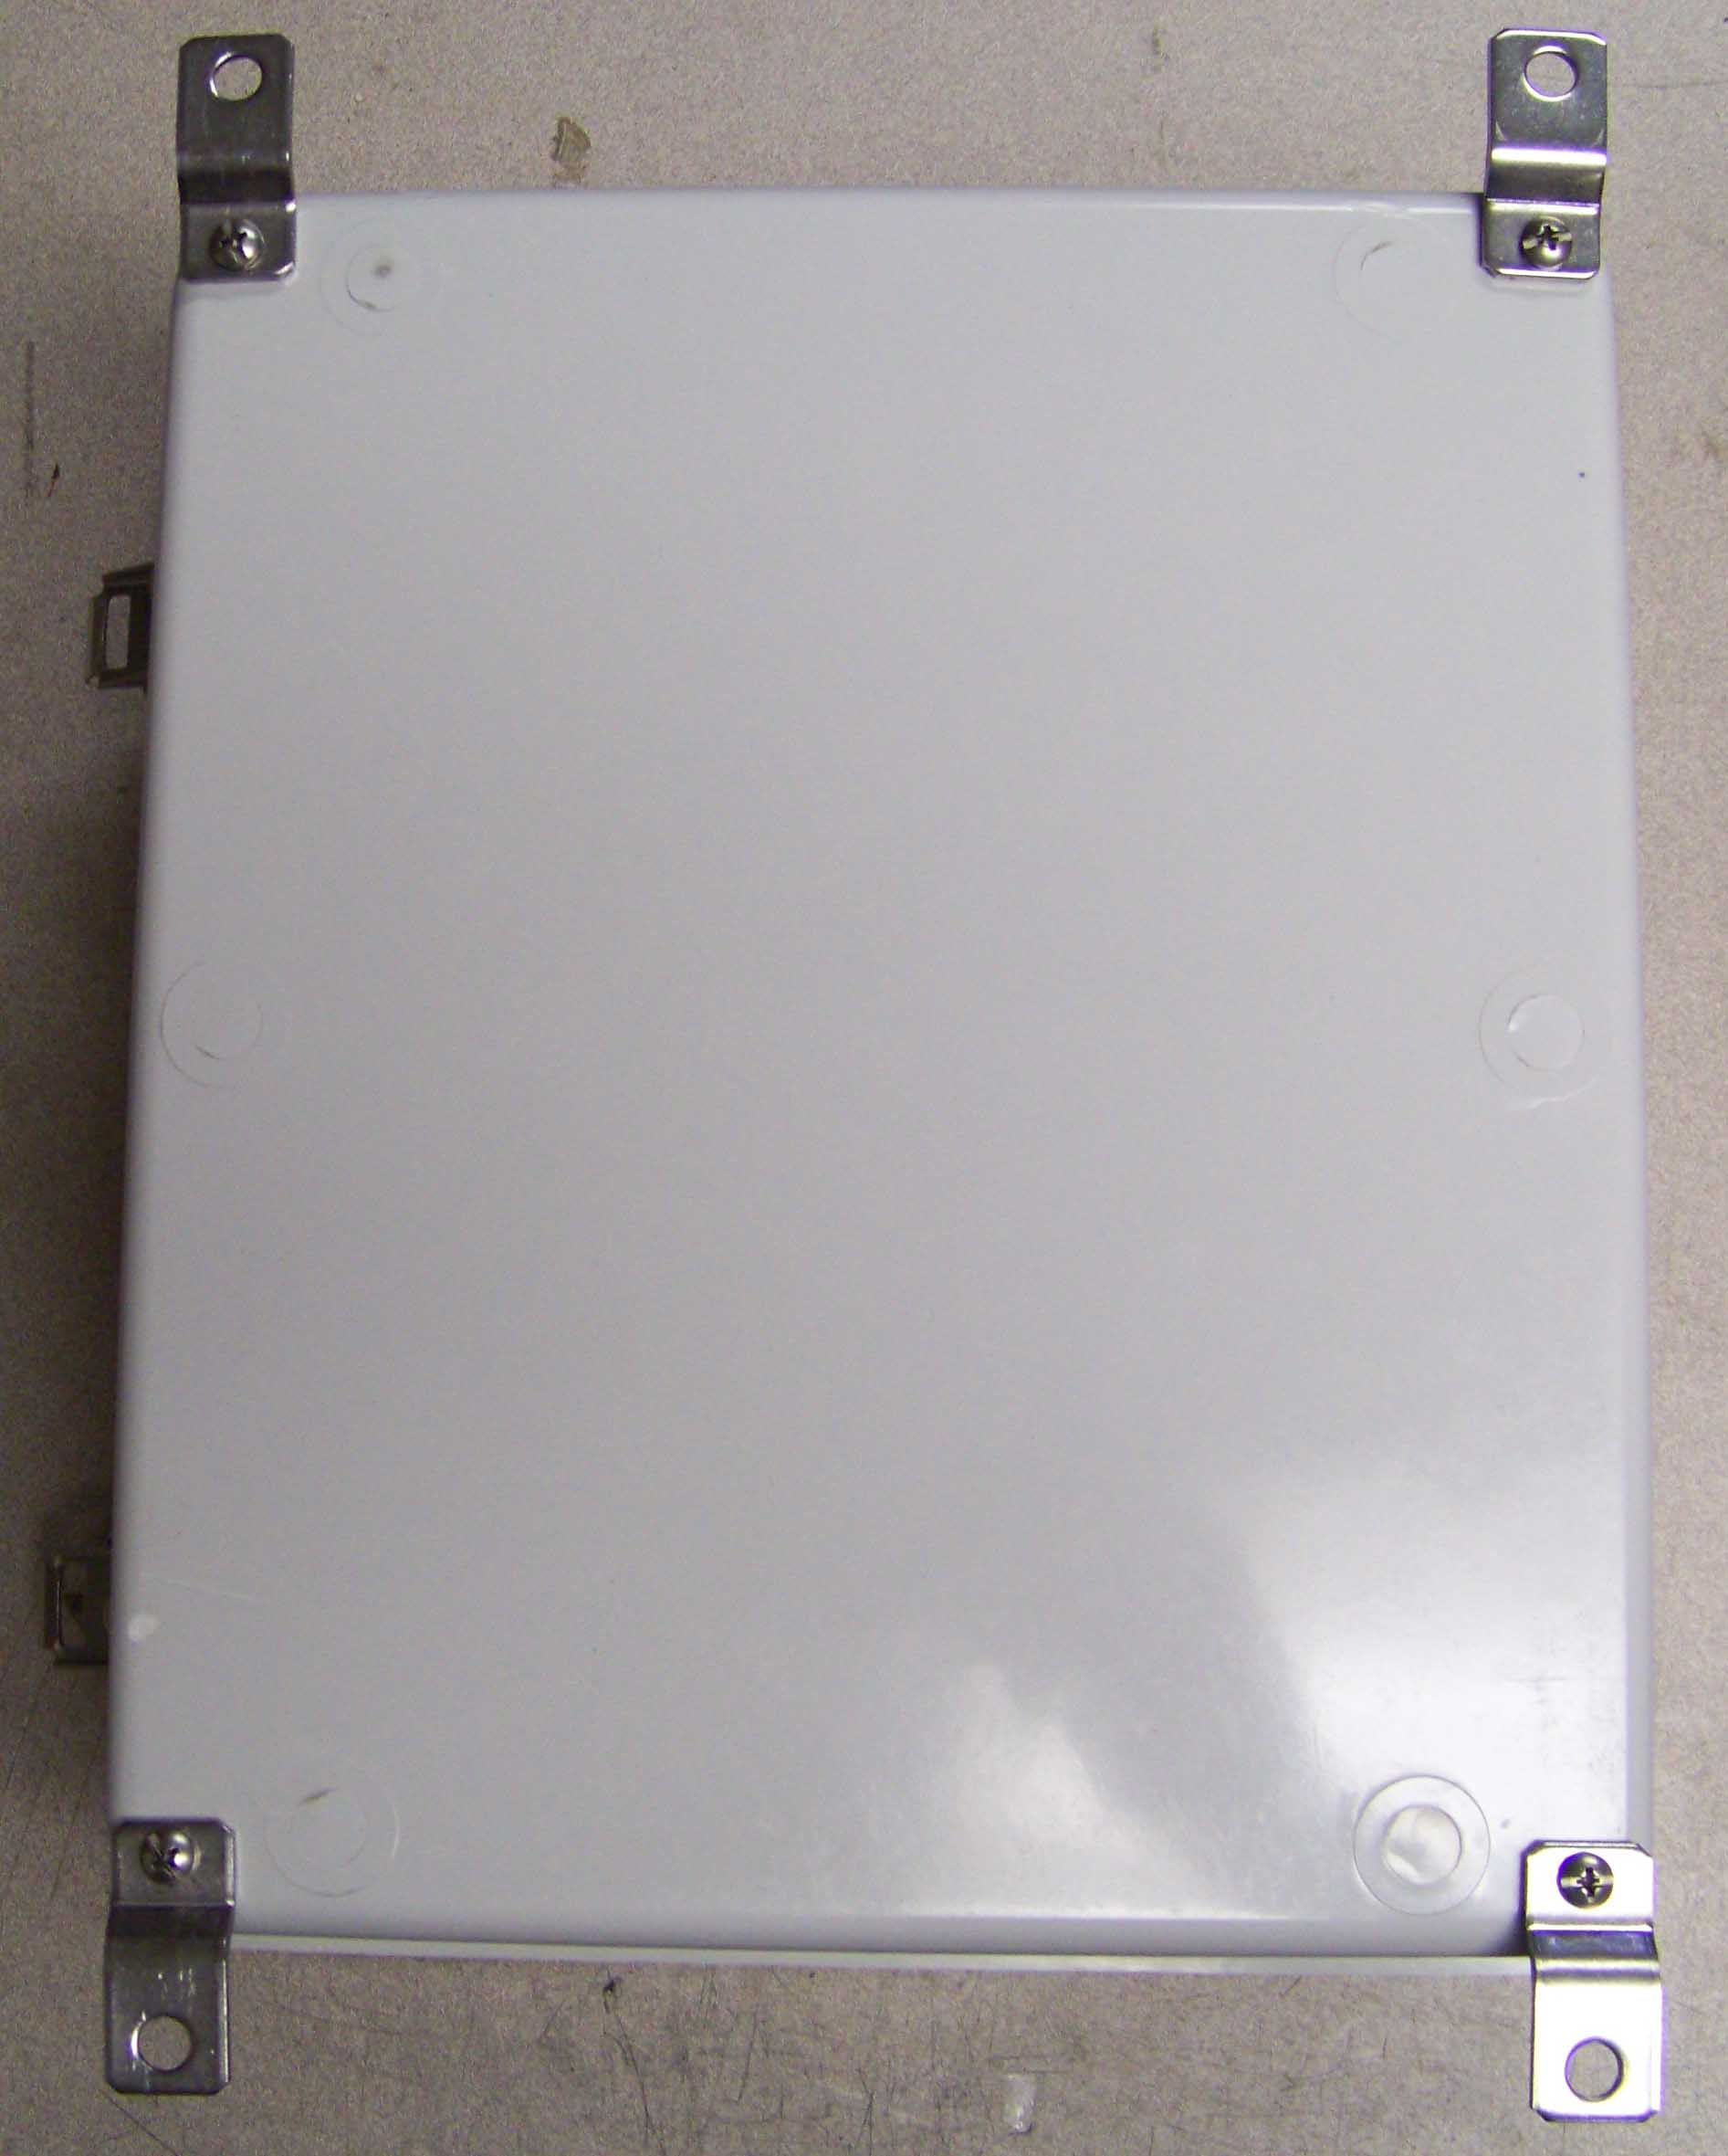
UFV Operations Setup
Pre Start up:
Screw the mounting feet to the back of the Control Box using the hardware given.

Slide 66
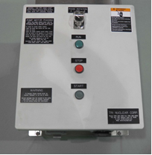
UFV Operations Setup
Pre Start up:
Mount Control Box onto the Tri Nuclear Mounting Panel (freestanding or hanging) via the hardware provided with the panel

Slide 67
UFV Operations Setup
Pre Start up:
Perform operational check of flow meter/sensor
After connecting the flow meter & sensor, flip the flow sensor with your finger. You should be able get 2/3 – 3/4 deflection on the meter. The Control Box will need to be energized for this step if using a CB-260-FM.

Slide 68
UFV Operations Setup
Pre Start up:
Perform operational check of flow meter/sensor
This ensures that the flow meter and sensor are working properly prior to placing unit into the pool.

Slide 69
UFV Operations Setup
Pre Start up:
Perform operational check of flow meter/sensor
Verify the two o-rings are installed on shaft of the Flow Sensor. The flow sensor may not operate properly without the o-rings installed.

Slide 70
UFV Operations Setup
Pre Start up:
Perform operational check of flow meter/sensor
Prior to installing the flow sensor in the pump, lubricate the o-rings with DI water or other approved lubricant

Slide 71
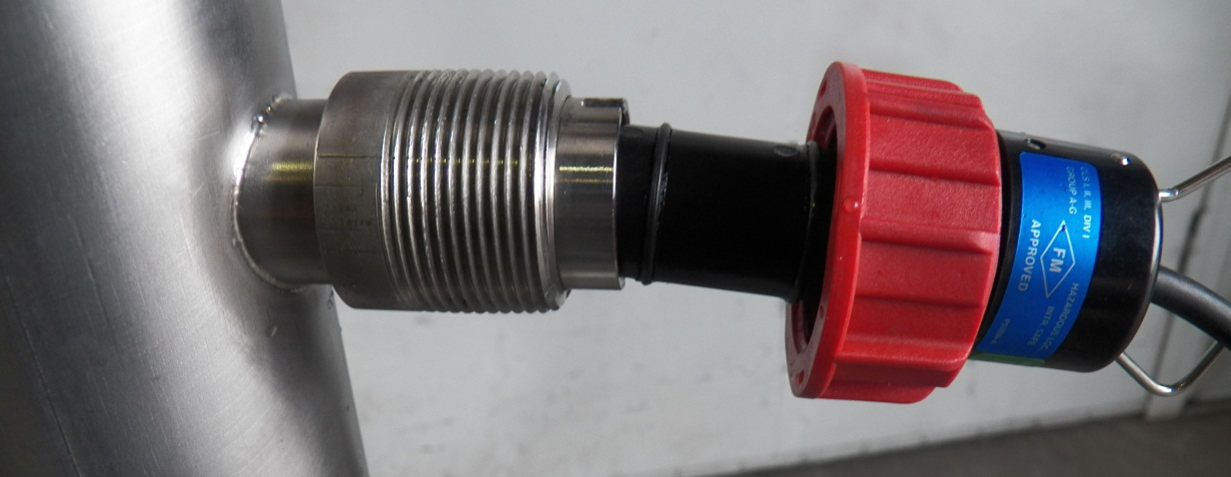
UFV Operations Setup
Pre Start up:
After op check of flow meter/sensor, install in pump
Align the two notches on the flow sensor to the flow meter fitting.
This ensures the paddlewheel is perpendicular to flow.
Tighten hand tight.

Slide 72
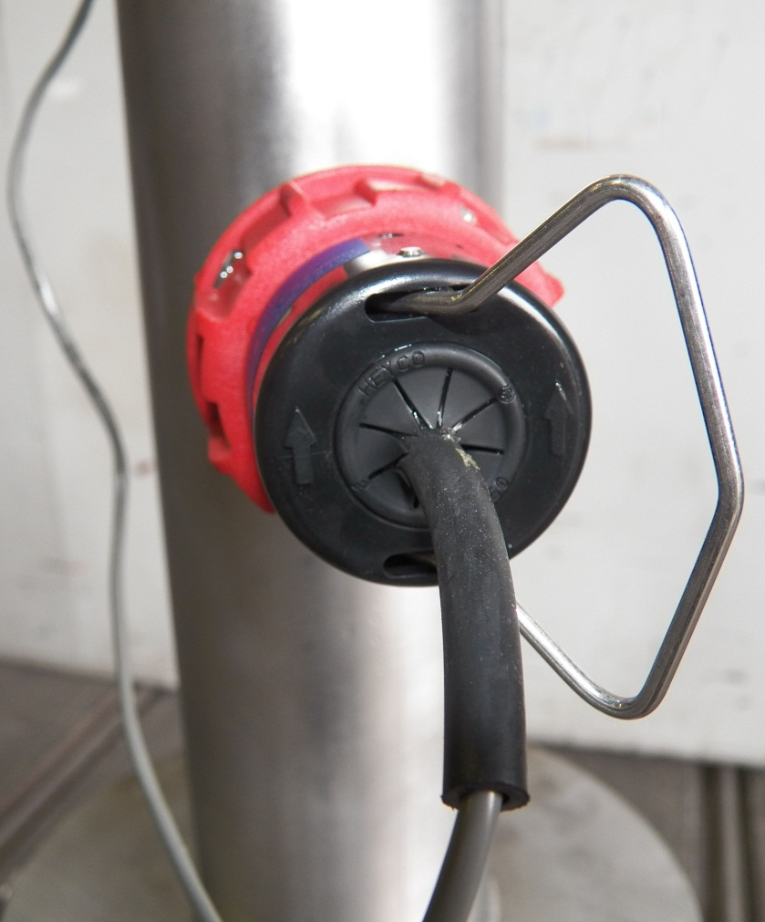
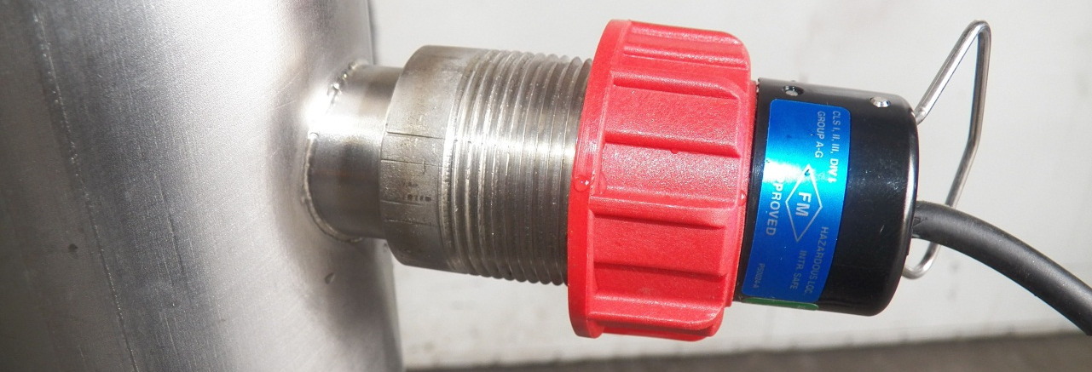
UFV Operations Setup
Pre Start up:
After op check of flow meter/sensor, install in pump

Slide 73
UFV Operations Setup
Pre Start up:
Remove the Sea Con seal plug (P/N: SC-P) from the pump power connector.
This plug should be installed whenever the power cable is removed for proper protection.

Slide 74
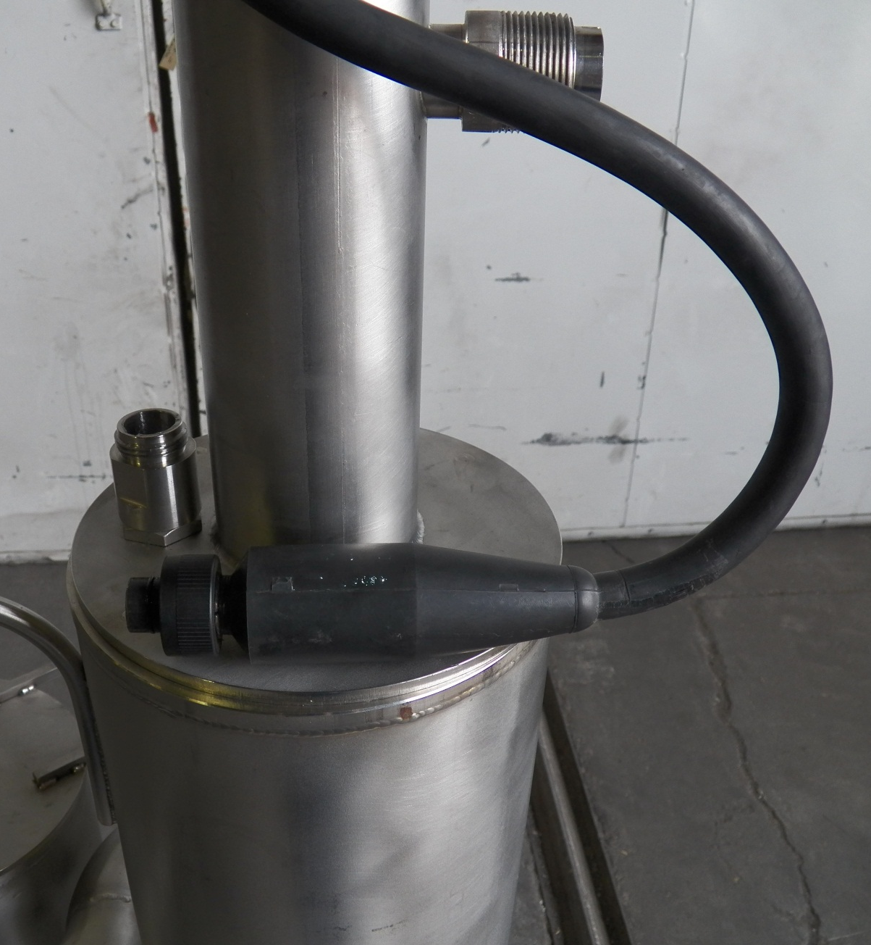
UFV Operations Setup
Pre Start up:
Install the power cord to the pump.
Ensure the power cord is lubricated with a non conductive lubricant (Dow Corning #4)

Slide 75
UFV Operations Setup
Pre Start up:
WARNING:
Install the power cord to pump pigtail HAND TIGHT ONLY.
Do NOT use any tools (pliers, channel locks etc.) to tighten the connection.
Notes:
When installing and removing the power cord, do not move the power cable connector with side to side motion in an attempt to install or remove it.
If difficulty is encountered during installation ensure the keyway is oriented properly and that the male end of the PSC-100P power cord is properly lubricated with a non-conductive electrical lubricant (Dow Corning #4).
If difficulty is encountered during removal ensure the power cable has been unthreaded fully and pull in the vertical direction ONLY to remove the power cable from the pump.
Install the power cord to pump pigtail HAND TIGHT ONLY. DO NOT use any tools (pliers, channel locks etc.) to tighten the connection.

Slide 76
UFV Operations Setup
Pre Start up:
WARNING:
Install the power cord to pump pigtail HAND TIGHT ONLY.
Do NOT use any tools (pliers, channel locks etc.) to tighten the connection.
Notes:
When installing and removing the power cord, do not move the power cable connector with side to side motion in an attempt to install or remove it.
If difficulty is encountered during installation ensure the keyway is oriented properly and that the male end of the PSC-100P power cord is properly lubricated with a non-conductive electrical lubricant (Dow Corning #4).
If difficulty is encountered during removal ensure the power cable has been unthreaded fully and pull in the vertical direction ONLY to remove the power cable from the pump.
Install the power cord to pump pigtail HAND TIGHT ONLY. DO NOT use any tools (pliers, channel locks etc.) to tighten the connection.

Slide 77
UFV Operations Setup
Pre Start up:
Once the power cord is installed, zip tie it to the vertical section of the pump discharge.
Notes:
Eliminate the possibility of a bending force on the connector by using the cable ties provided to fasten the pump power cable to the vertical discharge pipe of the pump. (see photograph below)
Connect the other end of the power cable to the pump control box.

Slide 78
UFV Operations Setup
Pre Start up CB-260:
Mount CB-260 Control Box to UT-10 control panel (3 mounting screws)
Connect the pump power cable and the line power to the control box

Slide 79
UFV Operations Setup
Pre Start up of CB-PR-260-4XP or CB-260-FM:
Install the PC-50 line in Twist Lock Plug to the control box (shown on right)
Install the PSC-100P Pump Power Cable Twist Lock Plug to the control box (shown on left)

Slide 80
UFV Operations Setup
Pre Start up:
Lay-out the 100 ft. of pump power cable and flow meter cable in a straight line. Tie the two cables together with "zip-ties" every 2 feet starting at the pump end.
Approx. 50 zip-ties are in a small plastic bag in the flow meter box. These “zip-ties” are black in color and are made out of polypropylene. They will float if accidentally dropped in the water.
Notes:
Ask about FME concerns with the zip ties -

Slide 81
UFV Operations Setup
Pre Start up:
Install Pump in Housing
After the pre start up checks of section have been performed, lower the PP-260SC pump into the housing using the UT-14 Pump Lift Hook.
NOTE: The pump can be installed AFTER the unit is lowered into the pool.

Slide 82
Pump entering the UFV-260 housing
UD-48A similar

Slide 83
(4) Pump Guides help self center the pump during instillation

Slide 84
(4) Pump Guides help self center the pump during instillation

Slide 85
Pump in pump tube

Slide 86
UFV Operations Setup
Pre Start up:
Couple the two 50 ft. long by 2” diameter suction hoses to the suction ports on the UFV-260 housing. Ensure that the suction hose stand-offs (UT-11) are installed on the end of the hoses when vacuuming attachments are not used. This will prevent the hose from “deadheading” on the pool floor or wall.
NOTE:
Running the unit without hoses will not produce desired results in pool filtration or water clarity.

Slide 87
UFV Operations Setup
Pre Start up:
If only one hose is required for operation, the 1in orifice cap (P/N UT-12) MUST be installed on the other suction port.

Slide 89
UFV Operations Setup
Pre Start up:
Install Filter cartridges in the UFV-260 unit
Filters may be installed after unit is lowered into the pool
Pre Soaking filter for ~10 minutes in clean water greatly minimizes time spent changing out filters.

Slide 90
UFV Operations Setup
Pre Start up:
Proper Filter Selection is “a must” in order to achieve desired results.
Guidelines for filter selection:
The 10 micron filter VCPH-10PE is normally chosen for high dirt loading when vacuuming settled particulate.
The 5 micron filter VCPH-5PE will capture material that might bypass the 10 micron during vacuuming.
The 1 micron filter VCPH-1PE is excellent for water clarity issues.
The 0.3 micron VCPH-0.3PE filter is used for “polishing” when water clarity is “a must”.

Slide 91
UFV Operations Setup
Pre Start up:
Attach rigging lines (supplied by purchaser) to the main unit, and carefully lower the assembly to the bottom of the pool and tie-off the lifting line to the side of the pool.
The pump assembly may be lowered and installed separately from the main unit using the pump lifting tool, or it may be installed in the unit before lowering it into the water.

Slide 92
UFV Operations Phase Rotation Check – with CB-260 control boxes
Start the pump and record the flow rate.
Reverse two of the three motor leads in the control box to reverse the phase.
Start the pump and record again the flow rate.
The proper phasing will give the higher flow rate.
Notes:
With clean filters pump phased correctly you will see about 260-300 gpm

Slide 93
UFV Operations Phase Rotation Check – with the CB-PR-260-4X, CB-PR-260-4XP and CB-260-FM control boxes
Start the pump and record the flow rate.
Stop the pump, open the safety cover on the Phase Reversing Switch
Turn the Phase Reversing Switch to the opposite Phase “A” or “B”
Restart the pump and record flow rate
Do not start the pump more than 1x every 2 minutes to prevent damage to the motor windings.
The proper phasing will give the higher flow rate.
Notes:
With clean filters pump phased correctly you will see about 260-300 gpm

Slide 94
UFV Operations Phase Rotation Check
Phased correctly the UFV-260 flow meter should read around 260 GPM with clean filters installed.
Phased incorrectly (backwards) the flow can be as low as 100 GPM
Notes:
With the pump phased backwards the flow will be about 100 gpm.
Even with the pump phased backwards – the flow will still be the same through the unit – WATER WILL NOT FLOW BACKWARDS THROUGH THE UNIT.

Slide 95
UFV Operations Phase Rotation Check
A Phase Rotation Check is necessary because a 3 phase AC pump can run both backwards & forwards.
Running the pump backwards for long periods of time will damage the pumps upper thrust bearing and cause premature failure.
Perform a Phase Rotation Check whenever a pump is disconnected from its electrical power source!

Slide 96
UFV Operations Installing Filter Cartridges
Rope Filter Lift Tool (RFLT) Model UT-9
Operating Instructions
The UT-9 Rope Filter Lift tool is designed
to remotely change out expended filter cartridges.
Use the 50ft lg SS UT-15 Utility Chain to operate the UT-9 Rope Filter Lift Tool
Notes:
ROPE-FILTER LIFT TOOL (UT-9)
A special18" high tool used for changing out filter cartridges remotely underwater using a rope or hand line. This tool uses a "positive latch" mechanism allowing for a very simple, effective, and quick method for filter change-out.

Slide 97
UFV Operations Installing Filter Cartridges
Rope Filter Lift Tool (RFLT) Model UT-9
Operating Instructions
Open the filter tube cover using the bottom hook on the RFLT
Only one cover may be opened at a time
Notes:
ROPE-FILTER LIFT TOOL (UT-9)
A special18" high tool used for changing out filter cartridges remotely underwater using a rope or hand line. This tool uses a "positive latch" mechanism allowing for a very simple, effective, and quick method for filter change-out.

Slide 98
UFV Operations Installing Filter Cartridges
Notes:
Use the filter tube mock up for show and tell on this.

Slide 99
UFV Operations Installing Filter Cartridges
Rope Filter Lift Tool (RFLT) Model UT-9
Operating Instructions
As the top pull rod is operated up or down in the tool housing, the hinged arms rotating on an internal cam will extend either in or out through the two open slots. The hinged arms will capture the filter for lifting, or release it for withdrawal of the tool.
Notes:
ROPE-FILTER LIFT TOOL (UT-9)
A special18" high tool used for changing out filter cartridges remotely underwater using a rope or hand line. This tool uses a "positive latch" mechanism allowing for a very simple, effective, and quick method for filter change-out.

Slide 101
UFV Operations Installing Filter Cartridges
Rope Filter Lift Tool (RFLT) Model UT-9
Operating Instructions
After the filter tube cover has been opened, lower the RFLT down into the open top of the filter cartridge until the top plate of the rope tool seats on the top of the filter cartridge.
This is determined by a sudden decrease in the weight of the tool on the SS chain.
Notes:
ROPE-FILTER LIFT TOOL (UT-9)
A special18" high tool used for changing out filter cartridges remotely underwater using a rope or hand line. This tool uses a "positive latch" mechanism allowing for a very simple, effective, and quick method for filter change-out.

Slide 102
UFV Operations Installing Filter Cartridges
Rope Filter Lift Tool (RFLT) Model UT-9
Operating Instructions
Continue to partially lower the SS chain ONLY another 4 or 5 inches. This will allow the side arms of the tool to extend out through the open slots on the side of the tool housing and engage the underside of the filter top cap.
Notes:
ROPE-FILTER LIFT TOOL (UT-9)
A special18" high tool used for changing out filter cartridges remotely underwater using a rope or hand line. This tool uses a "positive latch" mechanism allowing for a very simple, effective, and quick method for filter change-out.

Slide 103
UFV Operations Installing Filter Cartridges
Notes:
ROPE-FILTER LIFT TOOL (UT-9)
A special18" high tool used for changing out filter cartridges remotely underwater using a rope or hand line. This tool uses a "positive latch" mechanism allowing for a very simple, effective, and quick method for filter change-out.

Slide 104
UFV Operations Installing Filter Cartridges
Rope Filter Lift Tool (RFLT) Model UT-9
Operating Instructions
Pull up on the tool to raise the filter out of the filter housing or filter storage rack.
Notes:
ROPE-FILTER LIFT TOOL (UT-9)
A special18" high tool used for changing out filter cartridges remotely underwater using a rope or hand line. This tool uses a "positive latch" mechanism allowing for a very simple, effective, and quick method for filter change-out.

Slide 105
UFV Operations Installing Filter Cartridges
Rope Filter Lift Tool (RFLT) Model UT-9
Operating Instructions
Once the filter cartridge is placed in the UFV-260 or storage rack,
Slack-off the SS Chain until the rope tool slide rod hits the bottom and all of the weight of the rope tool is transferred to the filter cartridge.
This will rotate the internal cam fitting so the hinged arms will no longer extend out through the side slots in the tool housing.
Notes:
ROPE-FILTER LIFT TOOL (UT-9)
A special18" high tool used for changing out filter cartridges remotely underwater using a rope or hand line. This tool uses a "positive latch" mechanism allowing for a very simple, effective, and quick method for filter change-out.

Slide 106
UFV Operations Installing Filter Cartridges
Rope Filter Lift Tool (RFLT) Model UT-9
Operating Instructions
Once the filter cartridge is placed in the UFV-260 or storage rack,
Raise the SS chain and lift the rope tool out of the filter cartridge.
Repeat as necessary for filter change out and instillation.
Notes:
ROPE-FILTER LIFT TOOL (UT-9)
A special18" high tool used for changing out filter cartridges remotely underwater using a rope or hand line. This tool uses a "positive latch" mechanism allowing for a very simple, effective, and quick method for filter change-out.

Slide 107
Tri Nuclear Corp. General UFV-260 Operations

Slide 108
UFV Operations
The UFV-260 can be operated in three different “Modes”
Water Clarity
Vacuuming
Single Hose Operations
“Water Clarity mode” provides a way to clean/polish water in the Rx Cavity or SFP.
“Vacuuming Mode” provides a way to vacuum loose material off of any surface under water in the Rx Cavity or SFP
“Single Hose Operations” is used when only one suction hose is needed.

Slide 110
UFV Operations Water Clarity
Successful water clarity operations hinge on two things:
Correct Filter selection
Effective cross flow in the pool
Operating an UFV-260 without hoses will not provide desired results.

Slide 111
UFV Operations Water Clarity
Run unit with 2 hoses at opposite ends of pool for most effective water turnover
Never allow a hose to become deadheaded against the wall or floor
UT-11 Suction hose standoff prevents this

Slide 112
UFV Operations Vacuuming
Vacuuming accomplished with two different tools:
Floor Vacuum Head (UT-5SP)
Vacuum Nozzle (UT-7)
Vacuum nozzle is used in conjunction with the Hose to pole clamp UT-6.

Slide 113
UFV Operations Vacuuming
Floor Vacuum Head, UT-5SP
attached to suction hose & pool pole & UT-15 Utility Chain
Notes:
A 10"x 20" four wheel vacuum cleaner head equipped with two brushes, which attaches to the bottom pool pole and to the suction end of a vacuum hose leading to the UFV Unit.

Slide 114
UFV Operations Vacuuming
UT-7 Vacuum Nozzle attached to a UT-6 Hose to pole clamp and SS pool pole.
Notes:
HOSE TO POLE CLAMP (UT-6SP)
This fixture attaches to the bottom pool pole, and holds the suction end of a vacuum hose or nozzle with two clamps at one of three orientations. (vertical, 45 deg., or horizontal)
VACUUM NOZZLE (UT-7)
A 2"dia.x 18"lg. vacuum nozzle is connected to the end of a vacuum hose. The vacuum nozzle is used for vacuuming small areas requiring high water velocity for lifting. This is used with the UT-6 Hose To Pole Clamp.

Slide 115
UFV Operations Vacuuming
Pool Poles
The pool poles come in 4 different lengths – 10ft, 5ft, 3ft & 2ft long. Determine the depth the vacuuming will take place and assemble the appropriate number of pool poles for optimal operation interaction with the pool poles and tee handle.
Notes:
A 10"x 20" four wheel vacuum cleaner head equipped with two brushes, which attaches to the bottom pool pole and to the suction end of a vacuum hose leading to the UFV Unit.

Slide 116
UFV Operations Vacuuming
Buoyancy Chambers (BC-1)
The Buoyancy Chamber (BC-1) is designed to reduce the weight of the pool pole by about half. After determining the number of pool poles to be used, install the same number of Buoyancy Chambers on the uppermost, fully submerged pool pole. The placement of the Buoyancy Chambers at the top end of the of the Pool Pole sections helps the operator manipulate the tooling, especially the UT-5SP Vacuum Cleaner Head.
Notes:
A 10"x 20" four wheel vacuum cleaner head equipped with two brushes, which attaches to the bottom pool pole and to the suction end of a vacuum hose leading to the UFV Unit.

Slide 117
Slides over pool poles
6in dia x 18in long
Material: Stainless Steel
Provides positive buoyancy to reduce the overall weight of pool poles. Same connection / design as SP-1 Pool Poles
Reduces the weight of the pool pole by approximately half.
Notes:
Tri Nuclear has developed a Buoyancy Chamber that slides over the pool pole. It is a 6in x 18in long stainless steel chamber that provides positive buoyancy for the pool poles. The effect of this positive buoyancy is to reduce the overall weight of the assembled pool poles for the operator. Each Buoyancy Chamber reduces the weight of the pool by approximately half. The BC-1 Buoyancy Chamber has a handle for ease of moving and installing on the pool pole.

Slide 118
UFV Operations Vacuuming Strategy
Depending on particle size that is trying to be filtered out, the use of large micron filters may not show desired results due to filter bypass.
Filter Selection
10 micron filters best “all purpose” vacuuming filter.
If water clarity becomes an issue during vacuuming, a smaller size micron filter may be needed

Slide 119
UFV Operations Single Hose Operations
There are times with it is useful to operate the UFV-260 with a single hose. In order to provide adequate flow through the unit during Single Hose Operations, install the UT-12 Orifice Cap on one of the suction ports of the UFV-260.

Slide 120
UFV Operations Single Hose Operations
DO NOT INSTALL MORE THAN 50FT OF SUCTION HOSE TO A SINGLE SUCTION PORT ON A UFV-260.
THIS WILL ENSURE THERE IS ADAQUATE FLOW VELOCITY AT THE VACUUM NOZZLE FOR VACUUMING OPERATIONS.

Slide 121
UFV Operations Filter Change Out
Filters should be changed out on one of two conditions:
50% clean filter flow
If initial flow was 260 gpm, then filters should be changed out at ~130 gpm
The filter cartridge is ‘expended’ at this point and running it further does not increase dirt loading/holding of the filter by very much at all.
Pre-determined radiation levels
Each plant determines this level

Slide 122
Tri Nuclear Corp. UFV Precautions & Limitations

Slide 123
UFV Operations Precautions & Limitations
10⁶ Rad Accumulated dose limitation on the following equipment:
Filter Cartridges
Hoses
Power Cables
Motor’s
Chemical breakdown of the plastic hydrocarbon chain can occur causing material embrittlement.

Slide 124
UFV Precautions & Limitations
WARNING:
Do not run/bump the pump dry or out of the water! Severe damage to the pump may occur!

Slide 125
UFV Precautions & Limitations
WARNING:
Install the power cord to pump pigtail HAND TIGHT ONLY. Do NOT use any tools (pliers, channel locks etc.) to tighten the connection.

Slide 126
UFV Precautions & Limitations
CAUTION:
When installing and removing the power cord, do not move the power cable connector with side to side motion in an attempt to install or remove it.
If difficulty is encountered during installation ensure that the keyway is lined up and that the male end of the PSC-100P power cord is properly lubricated with a non conductive electrical lubricant (Dow Corning #4).
If difficulty is encountered during removal ensure the power cable has been unthreaded fully and pull in the vertical direction ONLY to remove the power cable from the pump.

Slide 127
UFV Precautions & Limitations
Do not start the pump more than once every 2 minutes or 300 starts/day. Damage to the motor winding insulation may occur.
Max operating temp 140F
Time operating above 105F should be minimized

Slide 128
UFV Precautions & Limitations
CAUTION:
Do not run the pump until a proper phase rotation check is made! Running the pump in reverse for any long duration will damage the pump!
The CB-PR-260-4XP and CB-260-FM are rated for 460V/3ph/60Hz ONLY. Any other voltage/frequency supplied to these control boxes will prevent it from operating properly.

Slide 129
UFV Precautions & Limitations
Perform the flow meter check:
before installing the Underwater Filter units into the pool for the first time
whenever the flow meter or sensor is replaced
anytime the flow sensor is suspected of being damaged.

Slide 130
UFV Precautions & Limitations
Operating the UFV-260 without suction hoses attached minimizes pool cross circulation and will lead to inefficient water filtration that may cause water turbidity problems.

Slide 131
UFV Precautions & Limitations
Slowly lower the UFV-260 housing into the water. This allows water to fill the housing from the 1/2in drain hole in the base plate. Lowering the unit too fast may cause it to become unstable until it fills with water.

Slide 132
UFV Precautions & Limitations
Do not install more than 50ft of suction hose to a single suction port on a UFV-260. This will ensure there is adequate flow velocity at the vacuum nozzle for vacuuming operations.

Slide 133
UFV Precautions & Limitations
Dense granular material less than .125” dia, may pass through the SB-.125 strainer basket and could collect in the bottom of a filter housing.
For effective straining operations, two (2) SB-.125 Strainer Baskets must be used.
For effective straining operations, two (2) UCB-1 Underwater Catch Baskets must be used.

Slide 134
UFV Precautions & Limitations
Filter cartridges can take several minutes to flood while trying to submerge them in the pool. The flooding time can be minimized by pre-soaking the filters.

Slide 135
Tri Nuclear Corp. UFV Recommended Spare Parts

Slide 136
UFV Recommended Spare Parts
Pump Assembly (PP-260SC)
Pump/motor assembly, power cable & Control Box
CB-260-FM; Qty (1)
PSC-100P; Qty (1)
Suction Hose (PH-2x50); Qty (2)
Filter cartridges
Strainer Baskets / Underwater Catch Baskets

Slide 137
Review / Training Objectives
The trainees at the end of this session will be able to describe:
the Principals of Operation
UFV-260 Equipment Description
Assembly & Installation in pool
System Operations
Storage Requirements
UFV-260 Precautions & Limitations

Slide 138
Questions?

