Slide 1
Underwater Filter/Vacuum Model UFV-600
Tri Nuclear Corp.
Notes:
Material to hand out:
PP Notes, CD-Rom, OI-3,5 & 6
Training Aids needed:
-PP-600SC pigtail -PP-600SC pigtail
-Filter Cartridges -UT-1SPT
-Tube Sheet -Flow meter fitting
-FM-600 -SC-P
-PSC-100 -Franklin Pigtail connector
-Filter Tube mock up -CB-PR-600-4X
-UT-10A with CB-PR-600-4x -UT-10 with CB-600-4x

Slide 2
Training Objectives
The trainees at the end of this session will be able to describe:
Principals of Operation for the UFV-600
UFV-600 Equipment Description
Assembly & Installation in pool
System Operations
Storage Requirements
UFV-600 Precautions & Limitations

Slide 3
References
Tri Nuclear OI-4 UFV-600 Operating Instructions
Tri Nuclear OI-5 Pump Trouble Shooting Guidelines
Tri Nuclear OI-6 Rope Filter Lift Tool Operating Instructions

Slide 4
UFV-600 Principals of Operation
System designed to operate remotely underwater
System designed to operate under negative pressure
This means that the Filter cartridges on suction side of pump
Notes:
The UFV-600 system operates under negative pressure. This design feature eliminates the need for special bolted pressure closures on the filter and pump housings requiring tooling for operation. Each filter and pump seals with a simple flat cover plate held in place by negative pressure during operation.
One of the many benefits of this design is that it requires no special tooling to install or remove a pump underwater. With the pump installed correctly in the pump tube, the weight of the pump keeps it in place during normal operation.

Slide 5
UFV-600 Principals of Operation
Advantages of the Tri Nuclear UF/UFV’s
Eliminates the need for pressure closures on the filter and pump housings along with special tooling required to operate them.
Allows for quick, easy change out of filter cartridges
Allows for the Pump and filters to be seated by gravity/negative pressure
Filtered water passes through the pump, minimizing internal contamination & resultant hot spots
Notes:
The UFV-600 system operates under negative pressure. This design feature eliminates the need for special bolted pressure closures on the filter and pump housings requiring tooling for operation. Each filter and pump housing seals with a simple flat cover plate held in place by negative pressure during operation.
One of the many benefits of this design is that it requires no special tooling to install or remove a pump underwater. With the pump installed correctly in the pump tube, the weight of the pump keeps it in place during normal operation.

Slide 6
UFV-600 Principals of Operation
Notes:
The UFV-600 system operates under negative pressure. This design feature eliminates the need for special bolted pressure closures on the filter and pump housings requiring tooling for operation. Each filter and pump housing seals with a simple flat cover plate held in place by negative pressure during operation.
One of the many benefits of this design is that it requires no special tooling to install or remove a pump underwater. With the pump installed correctly in the pump tube, the weight of the pump keeps it in place during normal operation.

Slide 7
UFV-600 Principals of Operation
Multi-Purpose Unit
Can be used for water clarification and vacuuming operations
Two (2) – 2-1/2” x 50ft suction hoses
MxF camlock couplers
Two (2) – 3” x 25ft discharge hoses
MxF camlock couplers
Four (4) - Filter Cartridges
System Flow Rate : 600 GPM

Slide 8
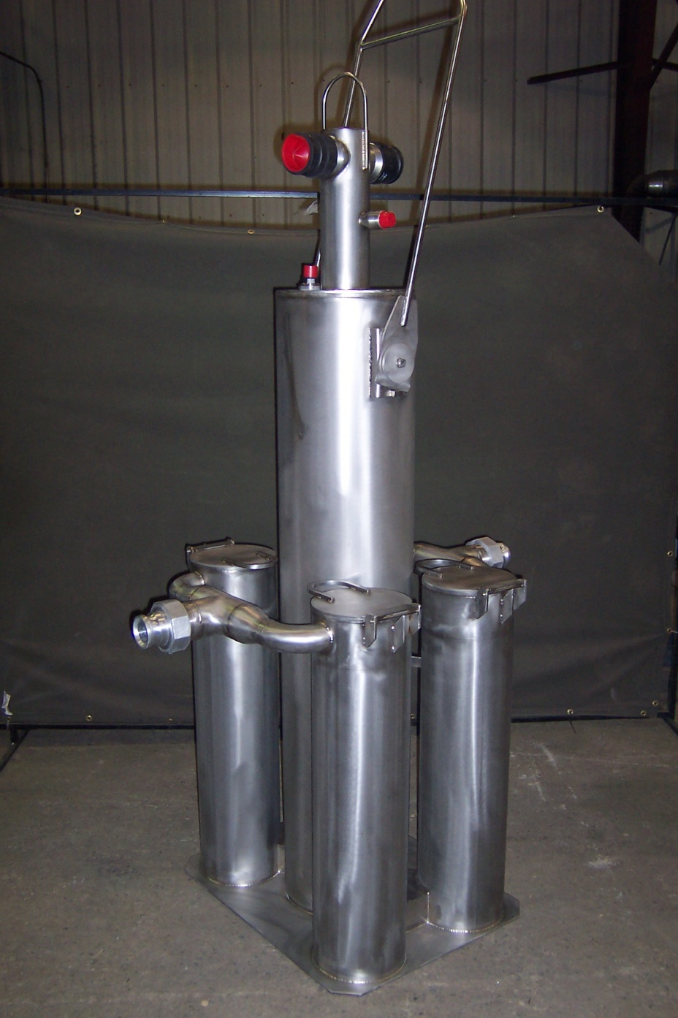
UFV-600
Base: 24" x 30"
Height:
80” - to top of pump 99” - to top of lift bale
Weight: 500 lbs
System flow rate: 600 GPM
Material:
Main Housing:
304 Stainless steel
2-1/2” camlock connectors:
316 Stainless Steel
Filter tube sheet o-ring: Buna-N

Slide 9
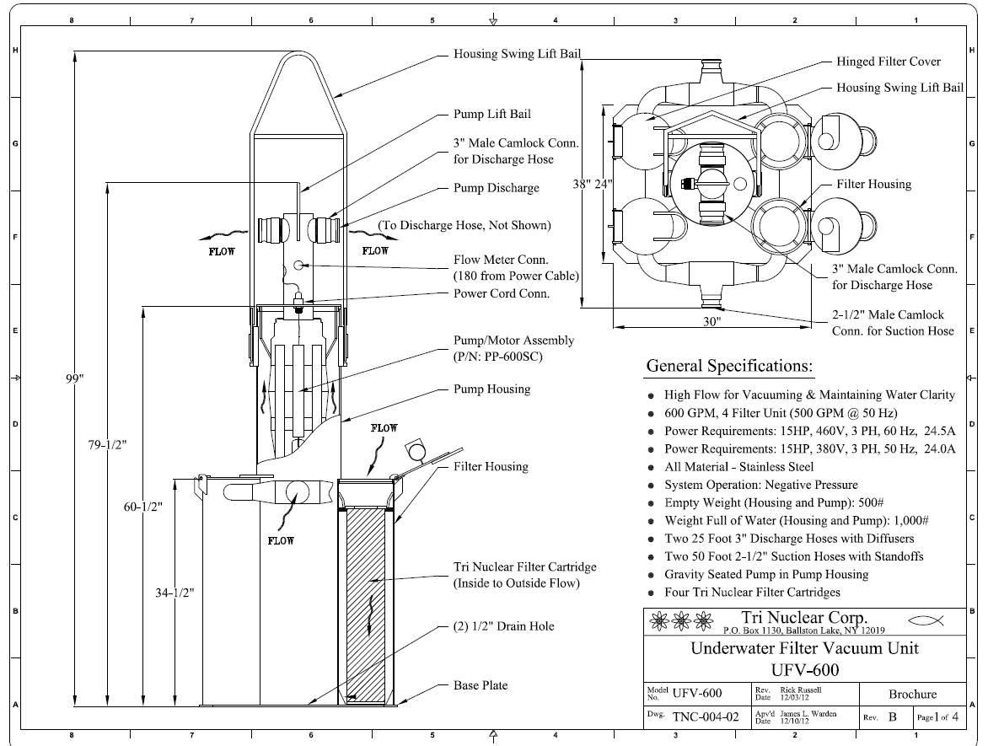

Slide 10
Detailed Description:UFV-600
Filter Housing
4 filter guides prevent filter from “hanging up” on the top of the tube sheet
Tube sheet shown without O-Ring

Slide 11
Detailed Description: UFV-600
4 Filter housings
8” Pipe
Overall Height 34.5”
Filter cartridges are held in place by the negative pressure of the pump
Filter cartridges are positively sealed on an internal tube sheet with O-Ring.

Slide 12
Detailed Description: UFV-600 Housing
Pump suction tube tunnel prior to filter tubes being welded to it.

Slide 13
Detailed Description: UFV-600
One pump tube
Pump Tube Height 60”
Contains the Pump/Motor assembly
Provides a path for the “clean” water to the pump.
(2) 1/2” drain holes located in the pump tube base plate to allow water to drain out when unit is removed from pool.

Slide 14
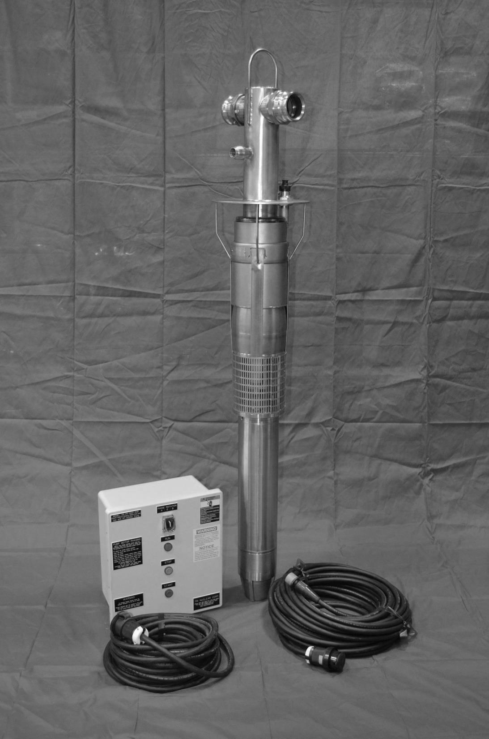
PP-600SC Pump/Motor Assembly

Slide 15
Detailed Description: PP-600SC Pump & Motor
Grundfos Submersible Motor
Stainless Steel
15 HP, Constant Speed
460V, 3 Phase, 60Hz AC,
Squirrel Cage Induction Motor
24.5 amps Max running, 115amps starting
Approx. 20amps @ 600 gpm
Max operating temp 140F
Time operating above 105F should be minimized

Slide 16
PP-600C
15HP Grundfos Motor Cut Away View

Slide 17
Detailed Description: PP-600SC Pump & Motor
Grundfos Submersible Pump
Stainless Steel
15 HP, Single Stage Centrifugal Pump
600 GPM Design Flow (460/60)
Pump Cover
4in discharge pipe with 3” discharge male camlock fittings
Flow meter fitting
Power cable disconnect
Machined for metal to metal contact to pump tube
4 pump guides help “self center” the pump in the pump tube as the pump is installed

Slide 18
Pump Lift Bale
3in male camlock Discharge hose connections
Flow Meter fitting
Power Cable connection

Slide 19
6” NPT Discharge to pump cover (bushed down to 4”)
Check valve w/1” hole drilled in it.
Upper radial & thrust bearings
1st stage impellor
Suction Strainer

Slide 20
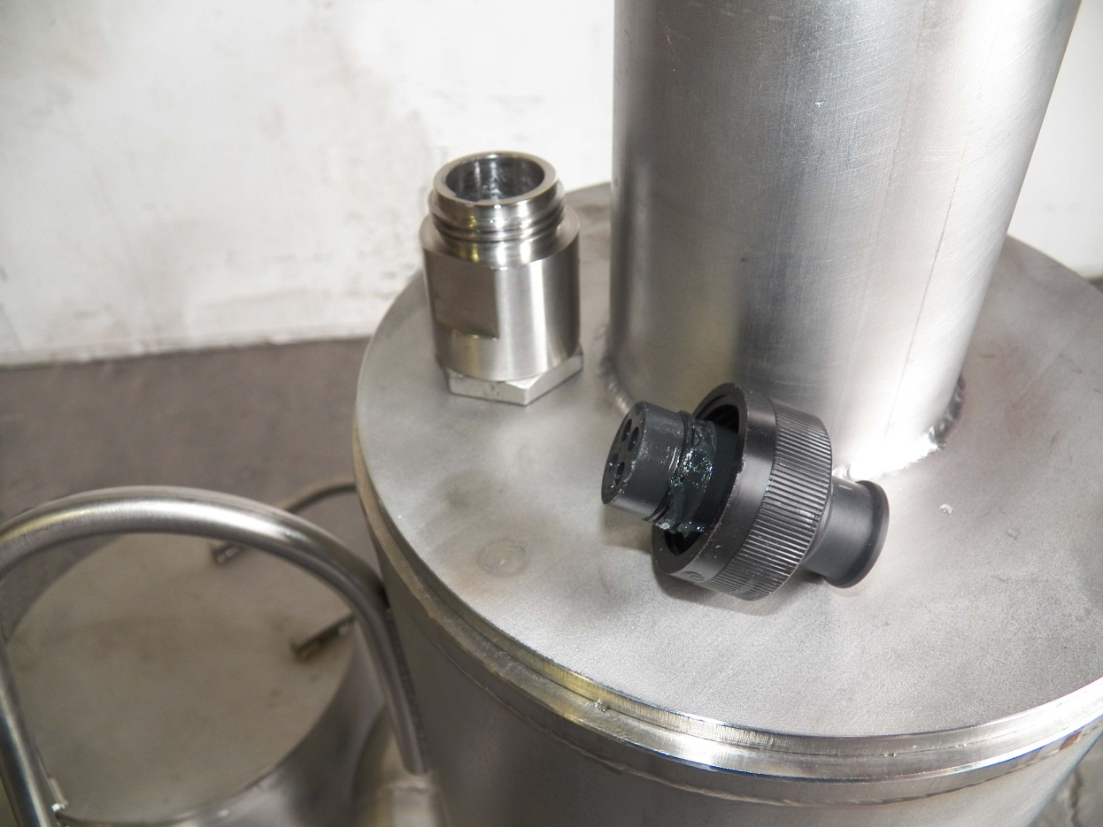
Seal Plug P/N SC-P
Installed whenever the a power cord is removed from the pump
Protects the threads of the sea con connector
Prevents FME from entering the sea con connector

Slide 21
Detailed Description: Pump Control Boxes
5 versions in the field
CB-600 (pre May 2005)
2 button Start/Stop Control Box, (3) K-50 Thermal Overload Heaters installed for overload protection, Nema 1 box
CB-600-4X (May 2005 – Aug 2009)
2 button Start/Stop Control Box w/green run light, Adjustable overcurrent trip, Nema 4X fiberglass box
CB-PR-600-4X (Aug 2009 – Dec 2012)
Same as CB-600-4x, but can reverse pump motor phase
CB-PR-600-4XP (Dec 2012 – Feb 2017)
Same as CB-PR-600-4x, but has twist lock plugs for power cable and drop cable.
CB-600-FM (Feb 2017 - Pres.)
Same as CB-PR-600-4XP, but with integrated flow meter.

Slide 22
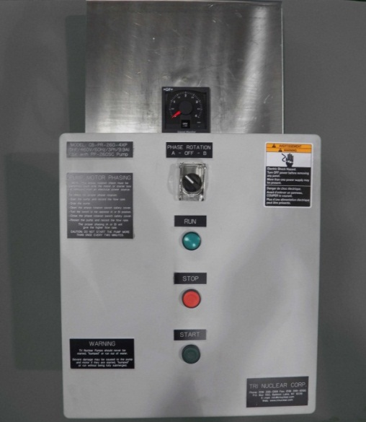
Detailed Description: Phase Reversing Control Box with twistlock plugs, CB-PR-600-4XP
NEMA 4X Control Box
NEMA 4X type enclosure
460V/3Ph/60Hz solid state controller
Adjustable over current trip.
120V controls
start/stop pushbuttons
Green “run” indicating light
Can change motor phases with one switch – WITHOUT opening the box
Twistlock plugs
Notes:
Advantages:
Do not have to have an electrician come swap leads for the phase rotation check.
Can be done by the operator with the switch.
Noting but positive feedback from plants. Ginna & Robinson were instrumental in getting this box approved for use in the field.
In August of 2009 Tri Nuclear introduced an upgraded version of our standard control box that allows the operator to change the phase rotation of the pump WITHOUT having to open the control box and swap two of the three motor leads.
This is accomplished by a switch on the front of the control box and two motor starters inside the control box. These two motor starters are wired such that when the “Phase Rotation Switch” is in the “A” position the pump motor rotates one direction, and when the “Phase Rotation Switch” is in the “B” position the pump motor rotates in the opposite direction. If the “Phase Rotation Switch” is in the center position, neither motor starter will be energized and the pump will not start.
The CB-PR-600-4X is a NEMA 4X type enclosure (14x16) and has two 460V/3Ph/60Hz solid state controllers with an single adjustable over current trip. The control box has a “Phase Rotation Switch” with safety cover, start/stop pushbuttons and a green “run” indicating light on the front of the panel.

Slide 23
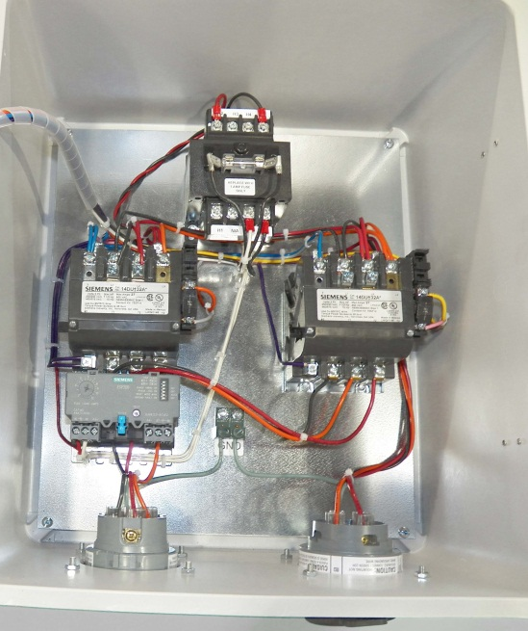
Detailed Description: Phase Reversing Control Box with twistlock plugs, CB-PR-600-4XP
Control Box identical to the CB-PR-600-4XP Control Box with the exception of the addition of twistlock plugs for the line in & line out.
460V/3Ph/30 amp, Nema 4X, twistlock plug for line in from in plant power supply
460V/3Ph/30 amp Nema 4X, twistlock connector for line out to pump
Notes:
-XP box identical to the PR control box with the exception of having twistlock plugs
The 460V / 3ph / AC 30amp Nema 4X Twist Lock plugs allow the operator to quickly and easily install the PC-50 drop cable and PSC-100P pump power cable to the control box without drilling and connecting bare cables to internal terminal blocks in the control box.

Slide 24
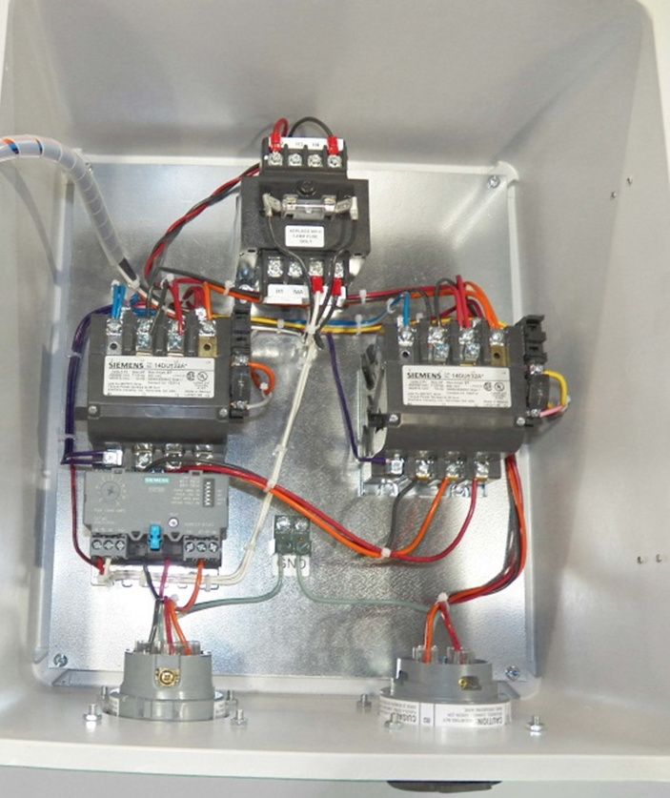
Detailed Description: Phase Reversing Control Box with twistlock plugs, CB-PR-600-4XP
120 V controls
(not shown)
460V / 120 V Transformer
Solid State Motor starter
Adj. overload trip
Line IN 30 amp twistlock plug
Line OUT 30 amp twistlock connector

Slide 25
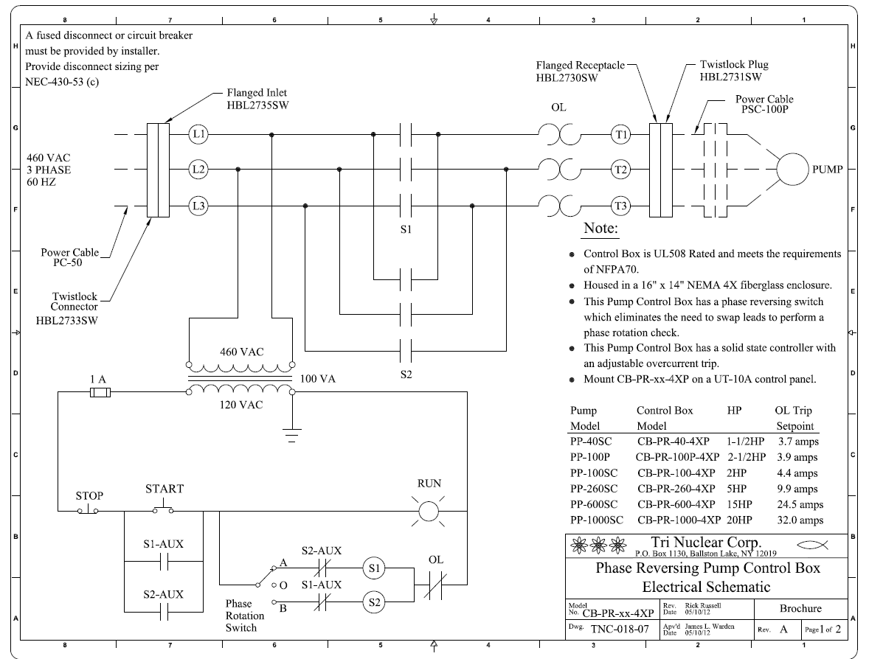

Slide 26
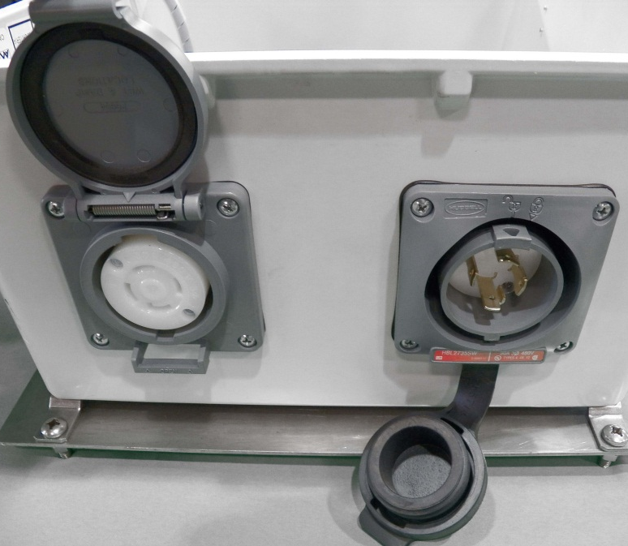
Detailed Description: Phase Reversing Control Box with twistlock plugs, CB-PR-600-4XP
Line OUT 30 amp twistlock connector
Line IN 30 amp twistlock plug
Notes:
Twist Lock plugs are located on the bottom of the control box.
The plug to the right (with the male Twist Lock connections) is the line in / power in plug.
The plug to the left (with the female Twist Lock connections) is the power out to the pump.

Slide 27
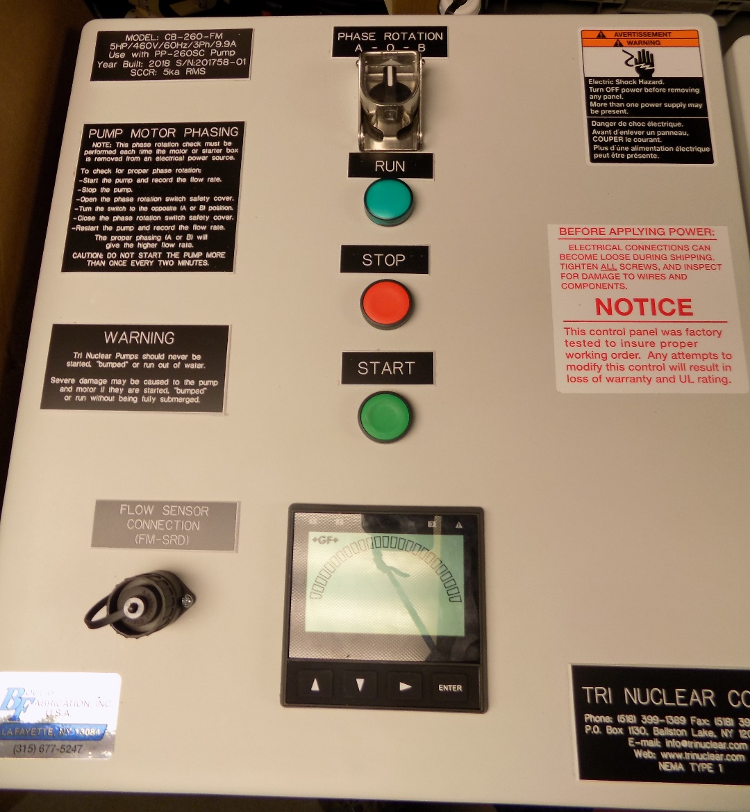
Detailed Description: Phase Reversing Control Box with twistlock plugs and integrated flow meter, CB-600-FM
Flow Sensor Connection port (Amphenol)
Integrated Digital Flow Meter Readout
Notes:
Twist Lock plugs are located on the bottom of the control box.
The plug to the right (with the male Twist Lock connections) is the line in / power in plug.
The plug to the left (with the female Twist Lock connections) is the power out to the pump.

Slide 28
Detailed Description: PSC-100P Power Cable
PSC- 100pPower Cable
100ft 10/4 SO Cable
Molded “Sea Con” connector on one end
Male twistlock plug on other
Notes:
The PSC-100P Pump Power cable is a 100ft 10/4 SO cable with a male Nema 4x Twist Lock plug x Sea Con Connector. This Pump Power cable is to supply power to the pump from the Phase Reversing Control Box.

Slide 29
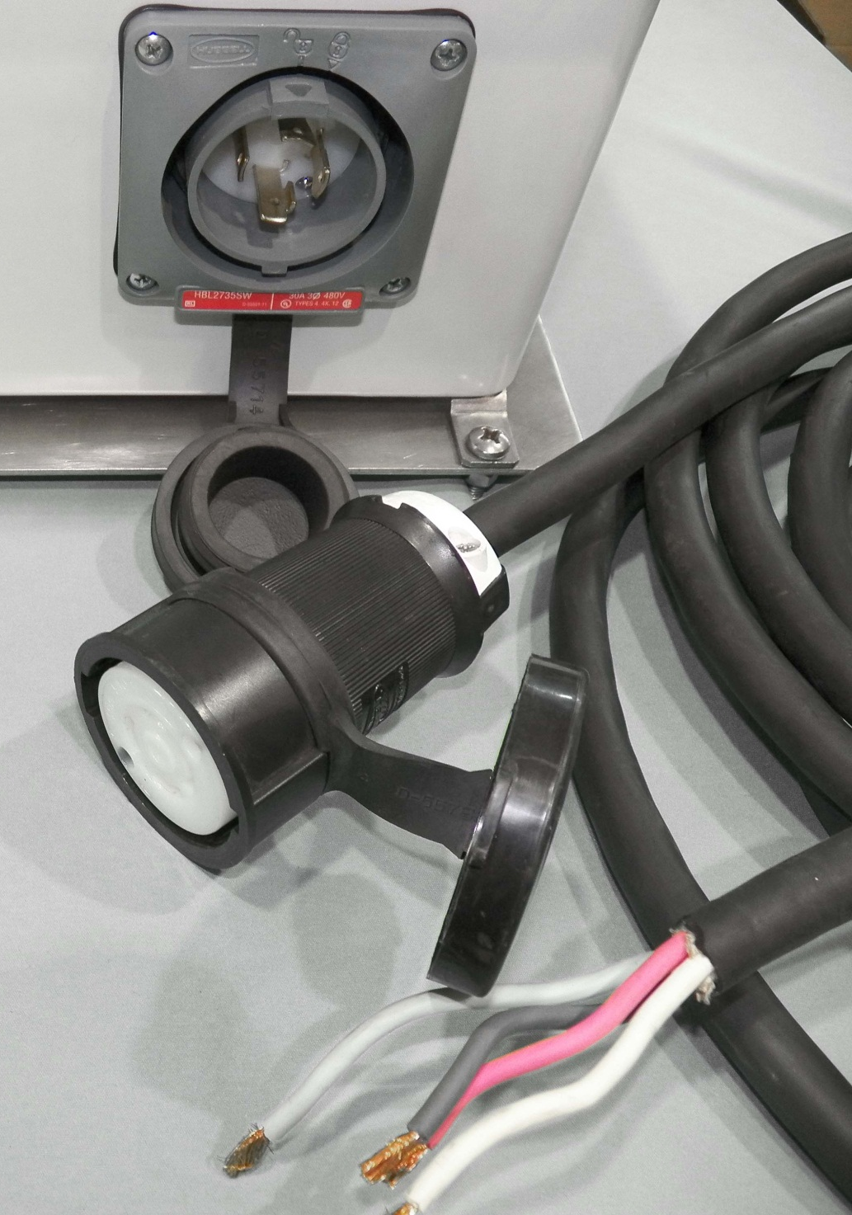
Detailed Description: PC-50 Drop Cable
PC-50 Drop Cable
Supplies power from in plant power supply to the control box.
50ft 10/4 SO Cable
Female twistlock plug on one end x bare wire on other
Notes:
The PC-50 Control Box Drop Cable is a 50’ 10/4 SO cable with a female Nema 4X twist lock plug x bare wire. This drop cable is to supply the control box from the in plant power source / motor control center / welding outlets etc.

Slide 30
Detailed Description: Flow Meter & Flow Sensor
FM-600
0-1000 GPM Analog Flow Meter, Milliammeter instrument that provides gross indication of system flow
FM-SR
Paddlewheel, magnetic self-induced type flow meter, sealed and waterproof with 100ft of instrument cable
FM-SRD
Same as FM-SR but with Amphenol connection for the CB-600-FM control box
Notes:
The UFV-600 flow meter is installed to provide a gross indication of system flow. System flow rate is a gauge for determining change in pressure drop through the filters. Under normal operations a filter would be changed out when system flow rate drops to ~50% of clean filter value.
The flow meter used for the UFV-600 is a self-powered analog meter that provides flow indication from 0-400 GPM. The flow meter uses the amplitude of the flow sensor signal to drive the 100-microamp meter movement.
The flow sensor for the UFV-600 is a paddlewheel type flow sensor. The paddlewheel has a re-enforced sleeve that covers the titanium shaft and is designed to minimize wear of the rotor. When water flows past the paddlewheel and it rotates, the flow sensor produces a sinusoidal waveform with frequency and amplitude directly proportional to the flow rate. The sensor comes equipped with 100ft of instrument cable.

Slide 31
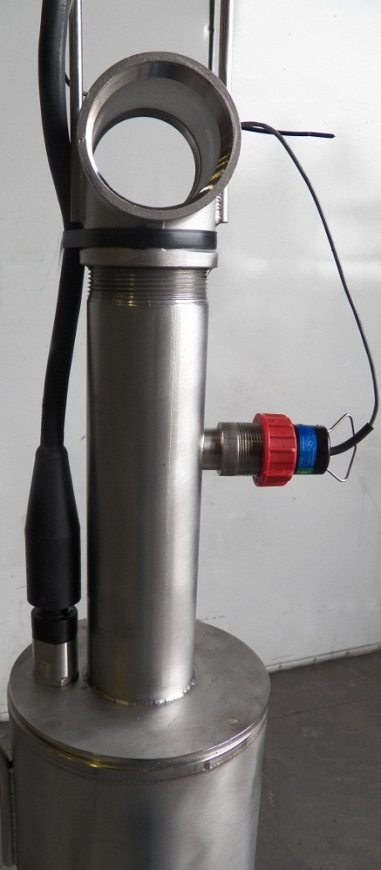
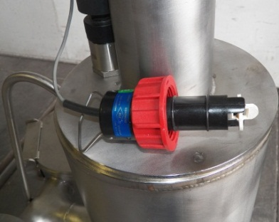
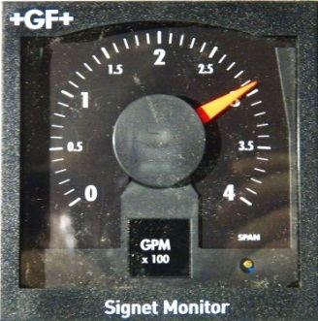
Tri Nuclear Flow Meter
Flow Sensor installed in pump
PP-260SC shown, PP-600SC similar
Flow Meter
Model FM-600M
FM-260M shown, FM-600M similar
Flow Sensor
Model FM-SR

Slide 32
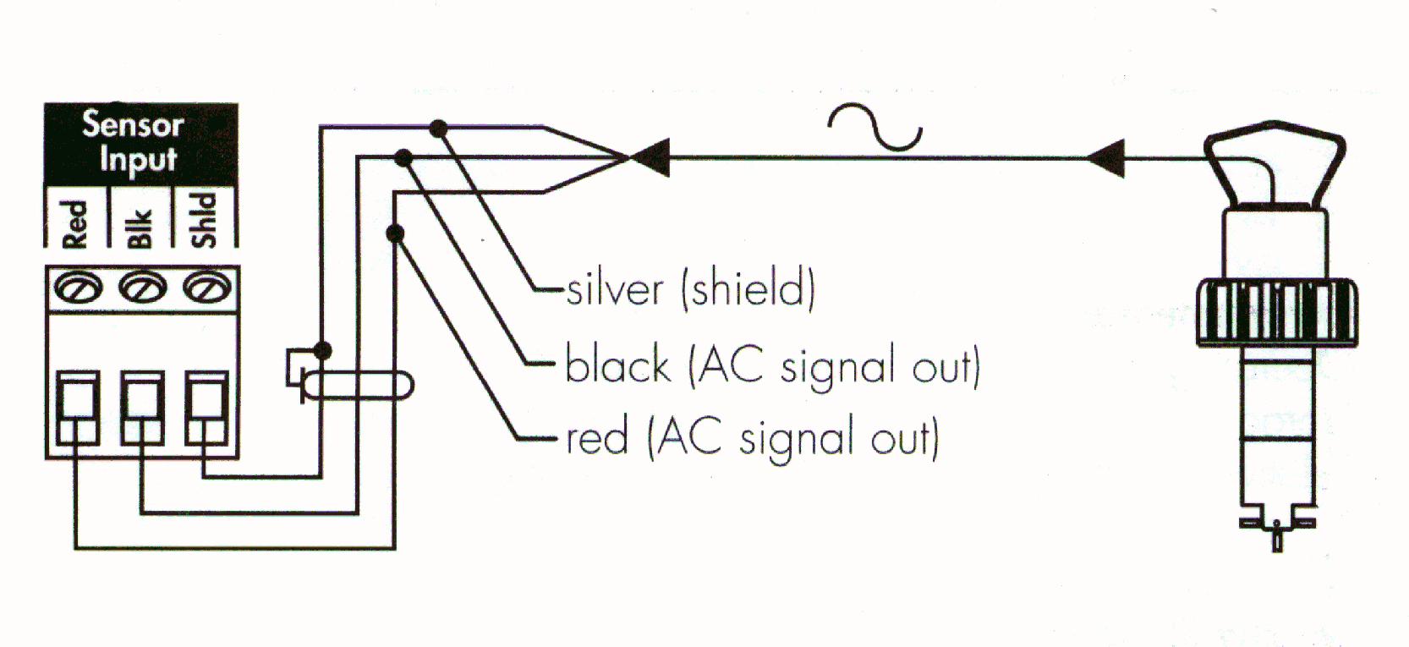
Tri Nuclear Flow Meter
Typical Flow Sensor/Meter connection

Slide 33
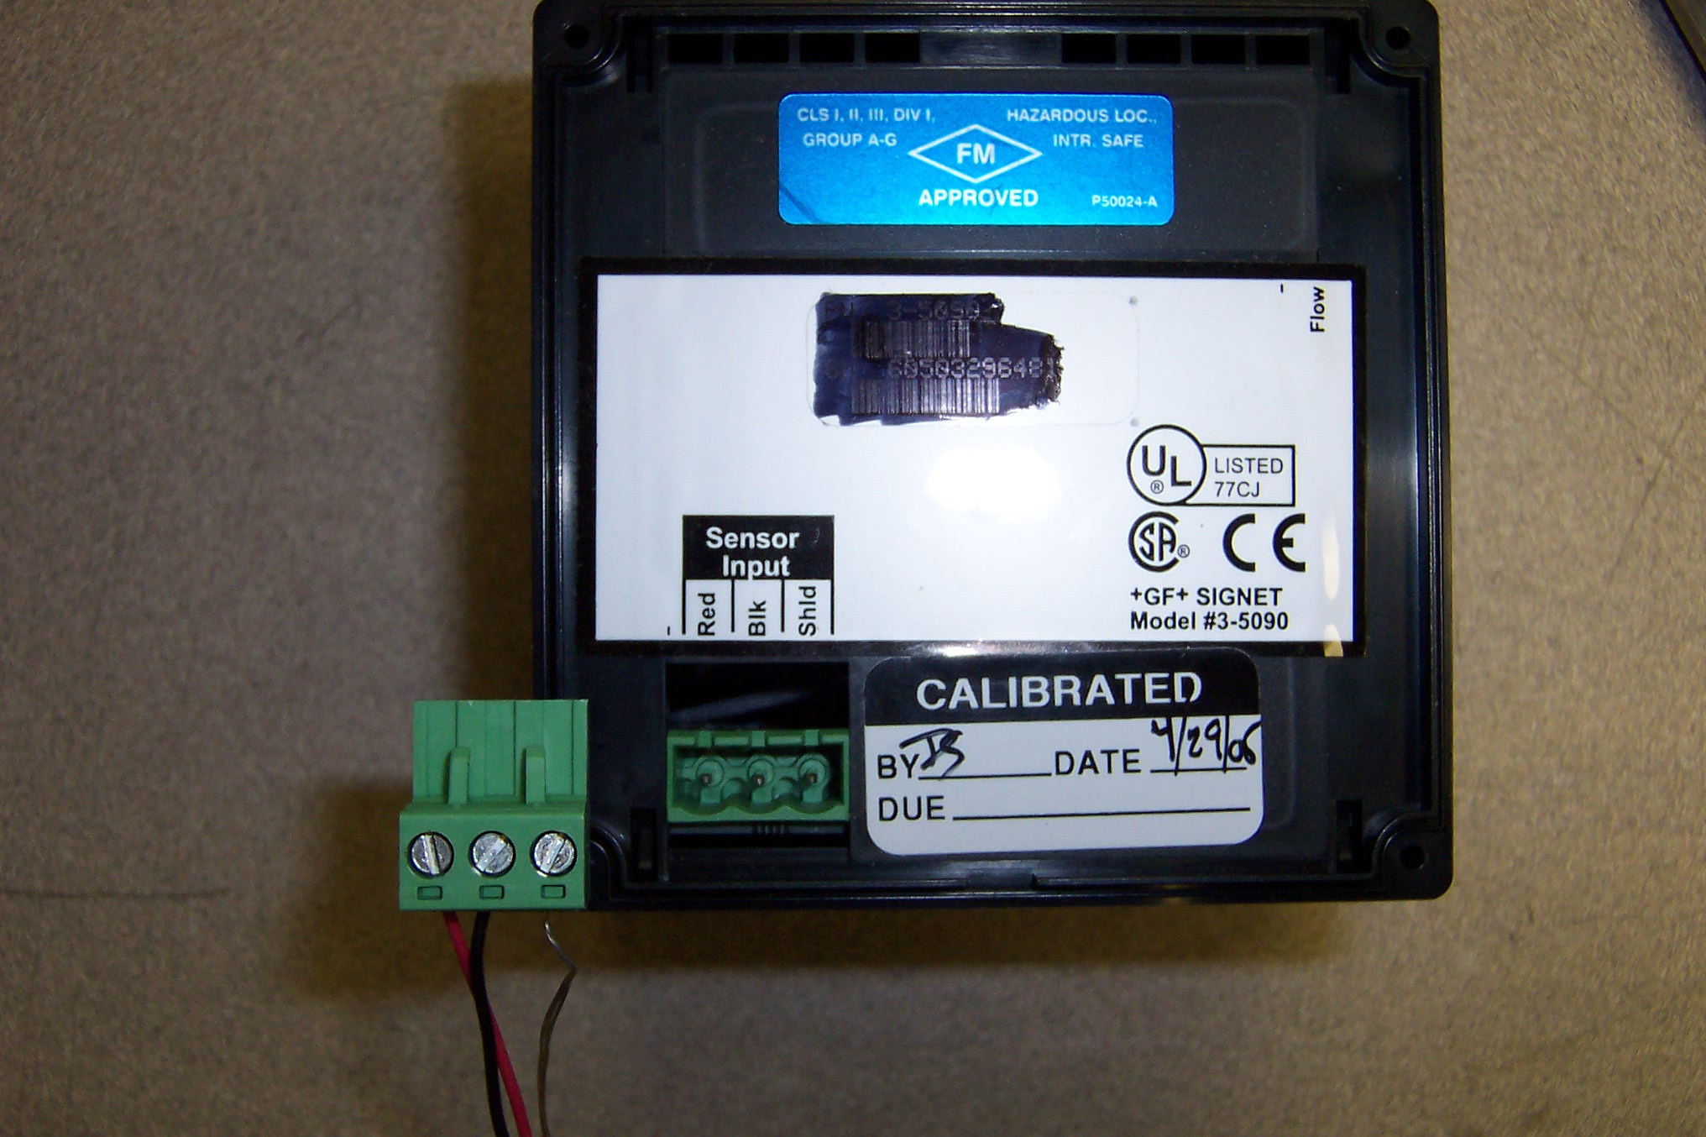
Tri Nuclear Flow Meter

Slide 34
Tooling/Accessories for the UFV-600

Slide 35
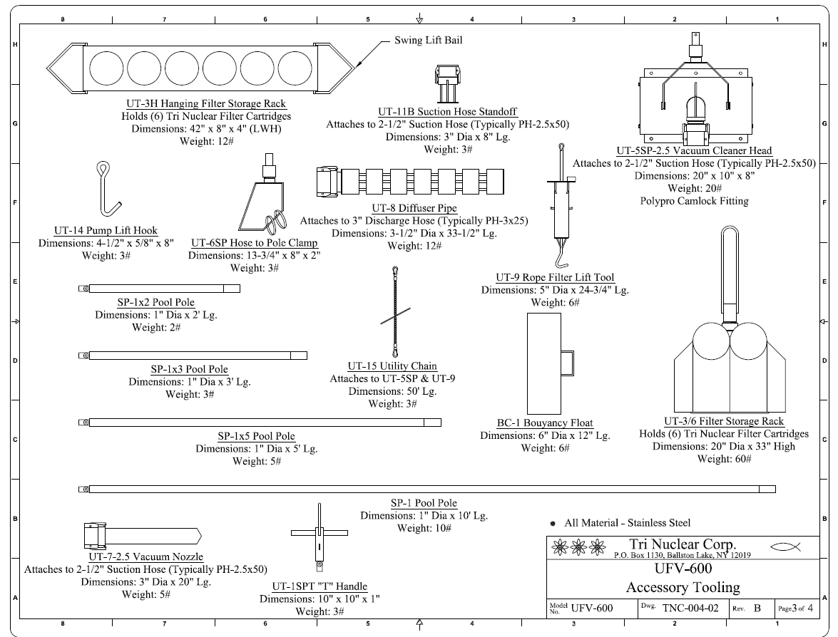

Slide 36
UFV-600 Tooling
Stainless Steel Pool Pole, SP-1
Material: all Stainless Steel
1 in pipe (1.31 in OD) x 10ft long
Weight: 10 lbs per 10ft Section
Pool Poles are floodable
Poles connected together with a quick release, "recessed button type", Stainless Steel, positive locking pull pin
Pull pins are lanyard to pool poles with stainless steel wire rope
Notes:
Tri Nuclear Corp. has designed special 10ft stainless steel pole sections for deep submergence pool work at nuclear power stations. The required total length of pole is obtained by coupling together (without tools) multiple 10ft sections using a quick release, "recessed button type", positive locking pull pin.
This provides for a strong rigid connection for transmission of high torque and loading. The same connection is used to attach special tooling fixtures to the bottom end of the assembled pole sections for performing various types of underwater remote hand operations.
Material: all Stainless Steel
Weight: 10 lbs per 10ft Section
Pool Poles are floodable
Poles connected together with a quick release, "recessed button type", Stainless Steel, positive locking pull pin
Pull pins are lanyard to pool poles with stainless steel wire rope
T-handle has a top lift bail for crane lifting operations or tying off to cavity wall

Slide 37
UFV-600 Tooling
Variable Length Pool Poles
Same connection / design as SP-1 Pool Poles
SP-1x5
5 ft long pool pole
SP-1x3
3 ft long pool pole
SP-1x2
2 ft long pool pole
These allow for the operator to adjust the overall height of the pool poles for optimum operations
Notes:
The SP-1x5 Pole is identical to the SP-1 pool pole with the exception that it is only 5 ft long instead of 10 ft long. Its purpose is to provide an overall adjustment in height for the operator on a bridge or wall.
The SP-1x3 Pole is identical to the SP-1 pool pole with the exception that it is only 3 ft long instead of 10 ft long. Its purpose is to provide an overall adjustment in height for the operator on a bridge or wall.
The SP-1x2 Pole is identical to the SP-1 pool pole with the exception that it is only 2 ft long instead of 10 ft long. Its purpose is to provide an overall adjustment in height for the operator on a bridge or wall.

Slide 38
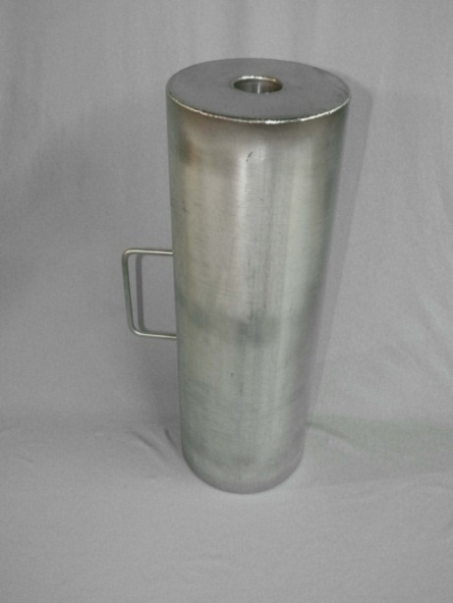
UFV-600 Tooling
Buoyancy Chamber
Slides over pool poles
6in dia x 18in long
Material: Stainless Steel
Provides positive buoyancy to reduce the overall weight of pool poles. Same connection / design as SP-1 Pool Poles
Reduces the weight of the pool pole by approximately half.
Notes:
Tri Nuclear has developed a Buoyancy Chamber that slides over the pool pole. It is a 6in x 18in long stainless steel chamber that provides positive buoyancy for the pool poles. The effect of this positive buoyancy is to reduce the overall weight of the assembled pool poles for the operator. Each Buoyancy Chamber reduces the weight of the pool by approximately half. The BC-1 Buoyancy Chamber has a handle for ease of moving and installing on the pool pole.
.

Slide 39
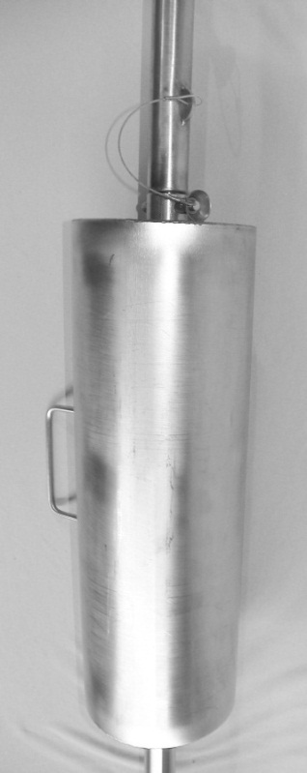
UFV-600 Tooling
Buoyancy Chamber
Slides over pool poles
6in dia x 18in long
Material: Stainless Steel
Provides positive buoyancy to reduce the overall weight of pool poles. ame connection / design as SP-1 Pool Poles
Reduces the weight of the pool pole by approximately half.
Notes:
Tri Nuclear has developed a Buoyancy Chamber that slides over the pool pole. It is a 6in x 18in long stainless steel chamber that provides positive buoyancy for the pool poles. The effect of this positive buoyancy is to reduce the overall weight of the assembled pool poles for the operator. Each Buoyancy Chamber reduces the weight of the pool by approximately half. The BC-1 Buoyancy Chamber has a handle for ease of moving and installing on the pool pole.

Slide 40
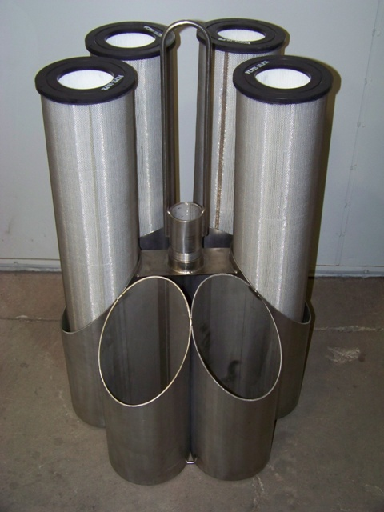
UFV-600 Tooling
Floor Storage Rack, UT-3/6
Holds 6 Filter Cartridges
20” Dia
33” height
Designed to fit into a standard 55gal drum
Notes:
FILTER STORAGE RACK (UT-3/6)
A six (6) tube 20” dia. rack for holding filter cartridges underwater adjacent to the Underwater Filter Unit to facilitate the speedy underwater change-out and replacement of filter cartridges.
This rack has a center lift bale (33” OAH) above the filter cartridges for easy lifting and can easily be stored in a standard 55 gal. waste drum.
It is designed hold one set of spare or expended filters from an operating UFV-600 & UFV-600.

Slide 41
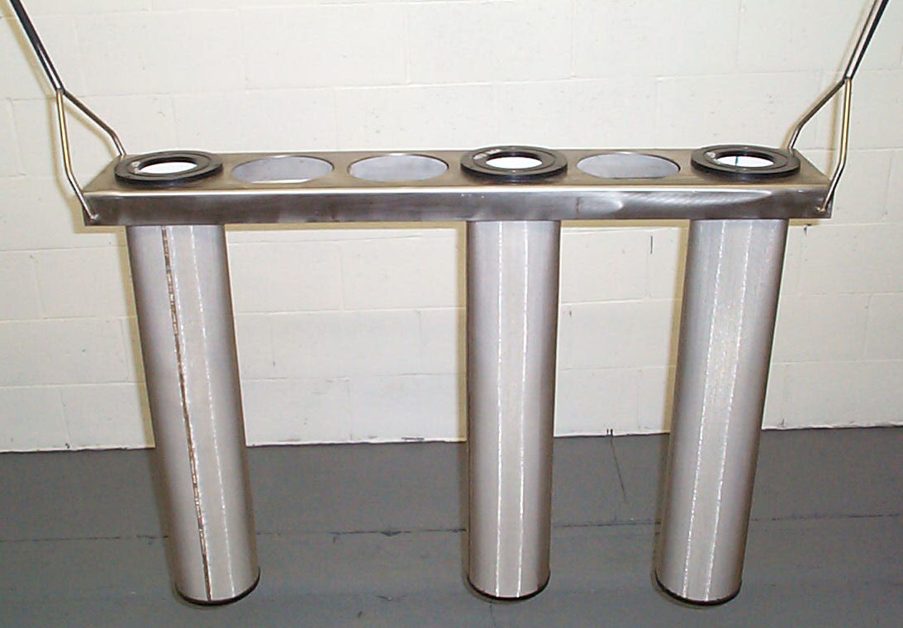
UFV-600 Tooling
UT-3H, Hanging Filter Storage Rack
Holds 6 filter cartridges

Slide 42
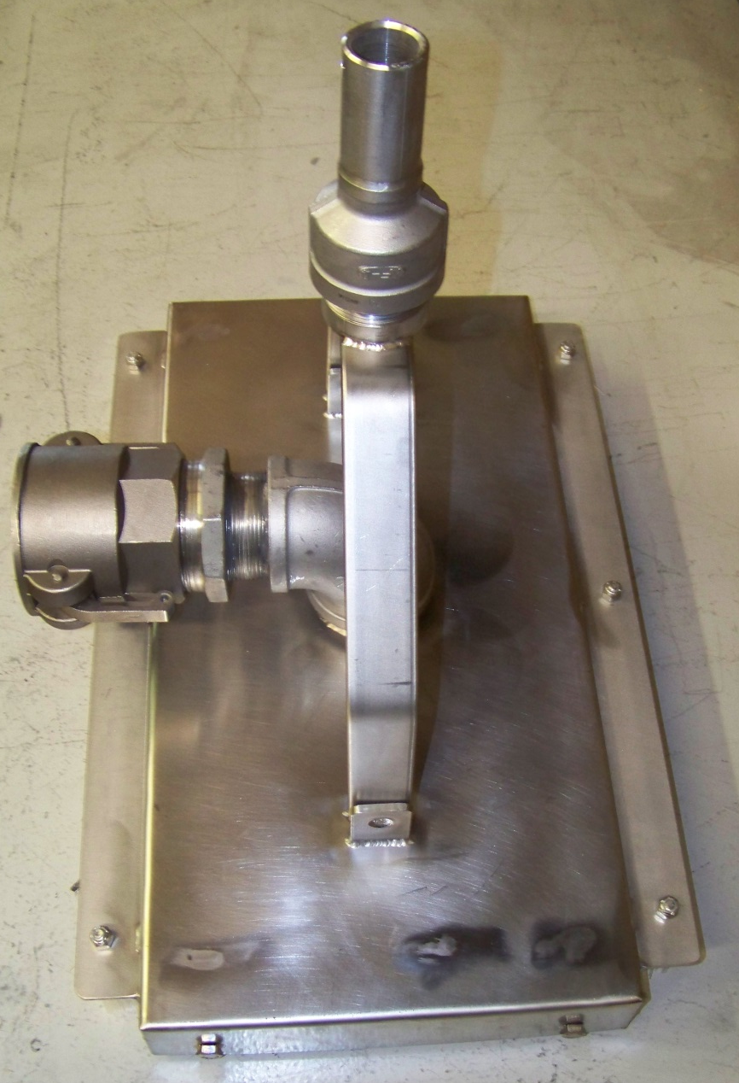
UFV-600 Tooling
Floor Vacuum Head,
UT-5SP-2.5
10” x 20”
4 wheels
2 brushes
Suction connect for 2-1/2in hose
UT-15 Utility Chain (not shown)
Notes:
A 10"x 20" four wheel vacuum cleaner head equipped with two brushes, which attaches to the bottom pool pole and to the suction end of a vacuum hose leading to the UFV Unit.

Slide 43
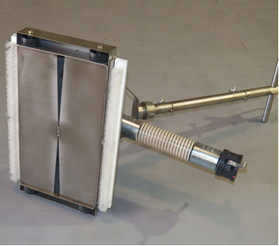
UFV-600 Tooling
Floor Vacuum Head, UT-5SP-2.5
Underside of vac head
Notes:
A 10"x 20" four wheel vacuum cleaner head equipped with two brushes, which attaches to the bottom pool pole and to the suction end of a vacuum hose leading to the UFV Unit.

Slide 44
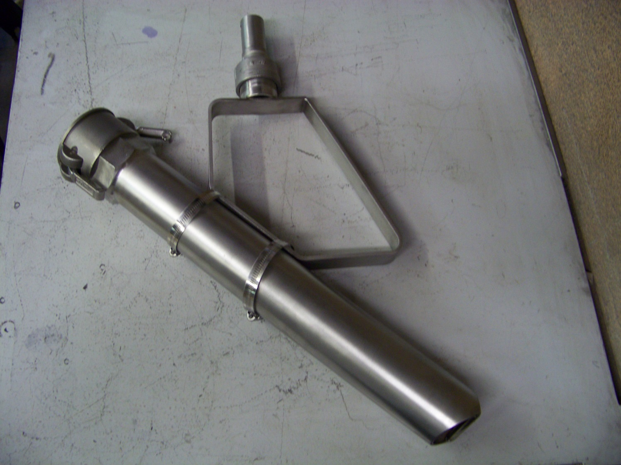
UFV-600 Tooling
UT-7-2.5 Vacuum Nozzle is 2-1/2” dia x 18” long SS nozzle w/ 30 degree cutout at vacuuming end.
3/8” round bar at end prevents large objects from fouling the nozzle.
Notes:
VACUUM NOZZLE (UT-7)
A 2"dia.x 18"lg. vacuum nozzle is connected to the end of a vacuum hose. The vacuum nozzle is used for vacuuming small areas requiring high water velocity for lifting. This is used with the UT-6 Hose To Pole Clamp.

Slide 45
UFV-600 Tooling
UT-7-2.5, Vacuum Nozzle for 2-1/2in hose with the UT-6SP, Hose to Pole clamp.
Nozzle positions:
Vertical
Horizontal
45 deg.
Notes:
HOSE TO POLE CLAMP (UT-6SP)
This fixture attaches to the bottom pool pole, and holds the suction end of a vacuum hose or nozzle with two clamps at one of three orientations. (vertical, 45 deg., or horizontal)
VACUUM NOZZLE (UT-7)
A 2"dia.x 18"lg. vacuum nozzle is connected to the end of a vacuum hose. The vacuum nozzle is used for vacuuming small areas requiring high water velocity for lifting. This is used with the UT-6 Hose To Pole Clamp.

Slide 46
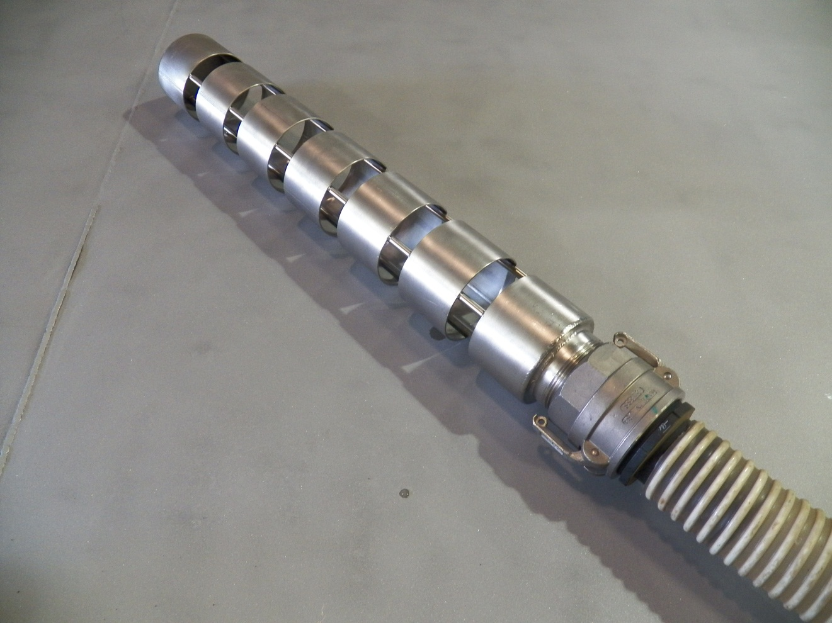
UFV-600 Tooling
UT-8, Diffuser Pipe
Prevents discharge hose “whipping”

Slide 47
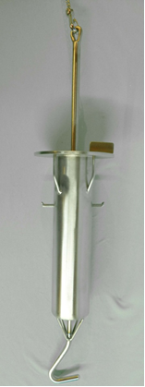
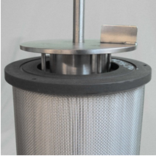
UFV-600 Tooling
UT-9, Rope Filter Lift tool
Notes:
ROPE-FILTER LIFT TOOL (UT-9)
A special 18in high tool is used for changing out filter cartridges remotely underwater using the UT-15 Utility Chain. This tool uses a "positive latch" mechanism allowing for a very simple, effective, and quick method for filter change-out.

Slide 48
UFV-600 Tooling
Mounting Panel,
UT-10A for mounting Pump Control Box and Flow Meter
Notes:
CONTROL PANEL (UT-10)
The UT-10A control panel mounts the flow meter and control box in one convenient location. The control panel is designed to hang from a typical hand rail.

Slide 49
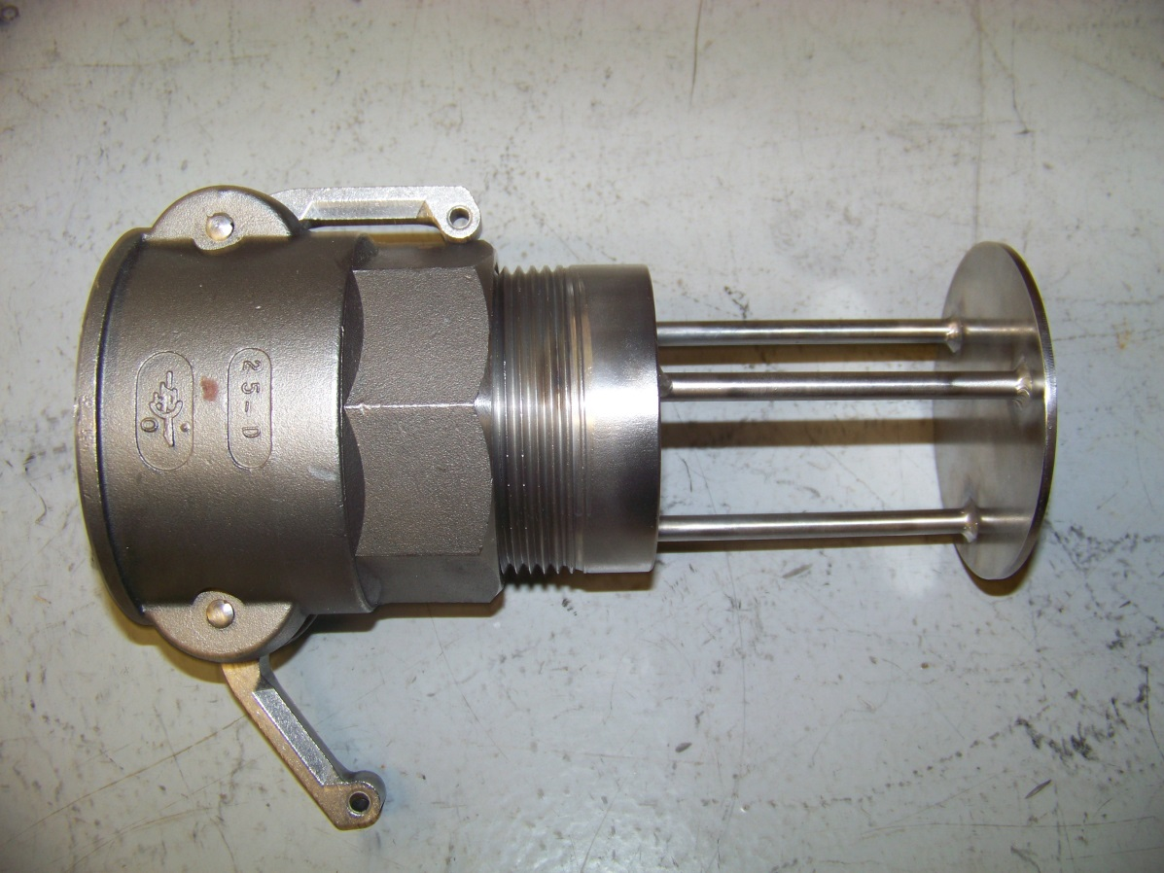
UFV-600 Tooling
Suction Hose Standoff, UT-11B
Prevents 2-1/2in suction hose from “deadheading” on wall or floor.
Notes:
SUCTION HOSE STAND-OFF (UT-11)
The suction hose stand-off is a stainless steel, 2in camlock adapter that is attached to the end of a 2in suction hose. The suction hose stand-off prevents the hose from “dead heading” on the wall or floor.

Slide 50
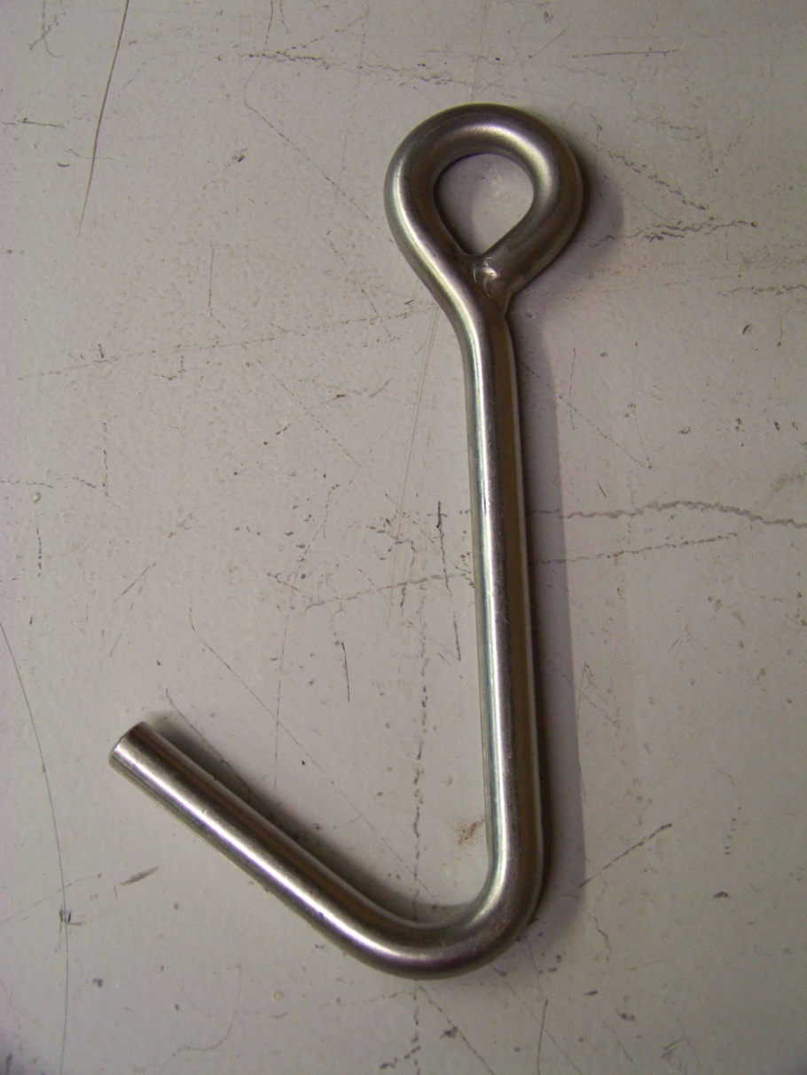
UFV-600 Tooling
UT-14 Pump Lift Hook
Material: Stainless Steel
Used with a cable (supplied by customer)
Notes:
PUMP LIFTING TOOL (UT-14)
This stainless steel grapple hook is used with a cable (supplied by customer) to install or remove the pump assembly from the UFV-260 housing.

Slide 51
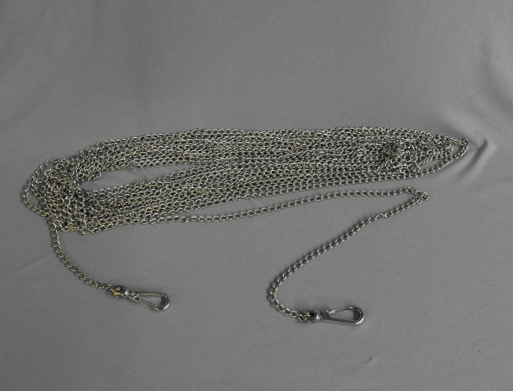
UFV-600 Tooling
Utility Chain,
UT-15
50ft long SS utility chain
Designed to work with the UT-9 Rope Filter Lift Tool
Notes:
The Stainless Steel Utility Chain (UT-15) is a 50ft [12.24m] lightweight stainless steel chain with a swivel clip on each end. It is designed to be used with the UT-9 Rope Filter Lift Tool and the UT-5SP vac head.
When used with the UT-9, it provides a means for actuating the Rope Filter Lift Tool from the bridge or pool wall.
When used with the UT-5SP it aids the operator in moving the vac head across the pool floor.

Slide 52
Tri Nuclear Corp. Assembly & Installation in the Pool

Slide 53
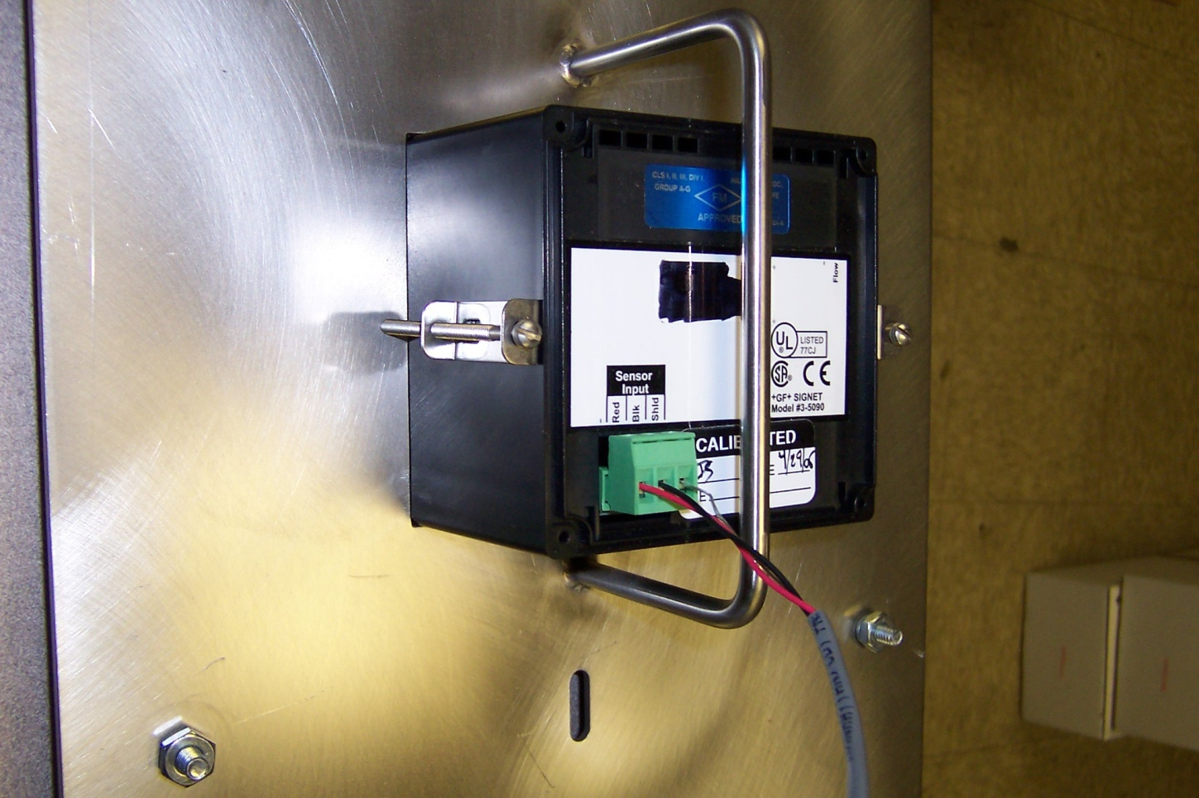
UF Operations Setup
Pre Start up:
Install Flow Meter in UT-10 or UT-10A Mounting Panel
(2) Brackets
hold flow meter
in place
Notes:
The flow meter dial read-out gauge is a delicate instrument (milliammeter) and should be protected from rough handling. It will probably be broken if dropped on the floor. It should be mounted to the UT-10 control panel and hung on a suitable railing for protection.

Slide 54
Tri Nuclear Flow Meter

Slide 55
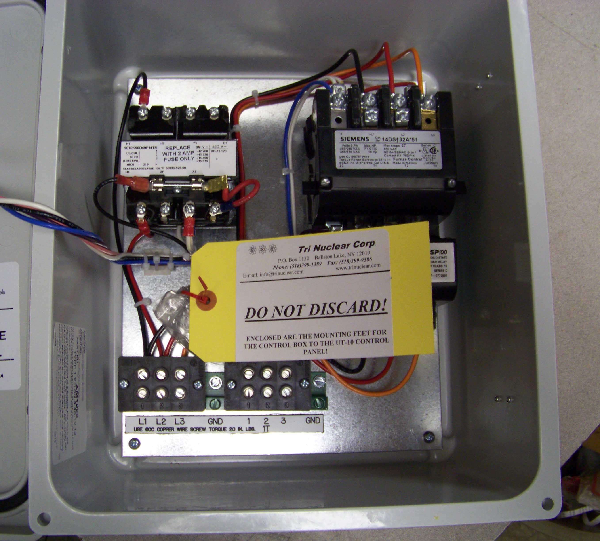
UF Operations Setup
Pre Start up:
Locate the mounting feet to the back of the Control Box. The (4) mounting feet and hardware are wrapped and tagged inside the box.
CB-260-4x shown, CB-600-4x, CB-PR-600-4XP and CB-600-FM similar

Slide 56
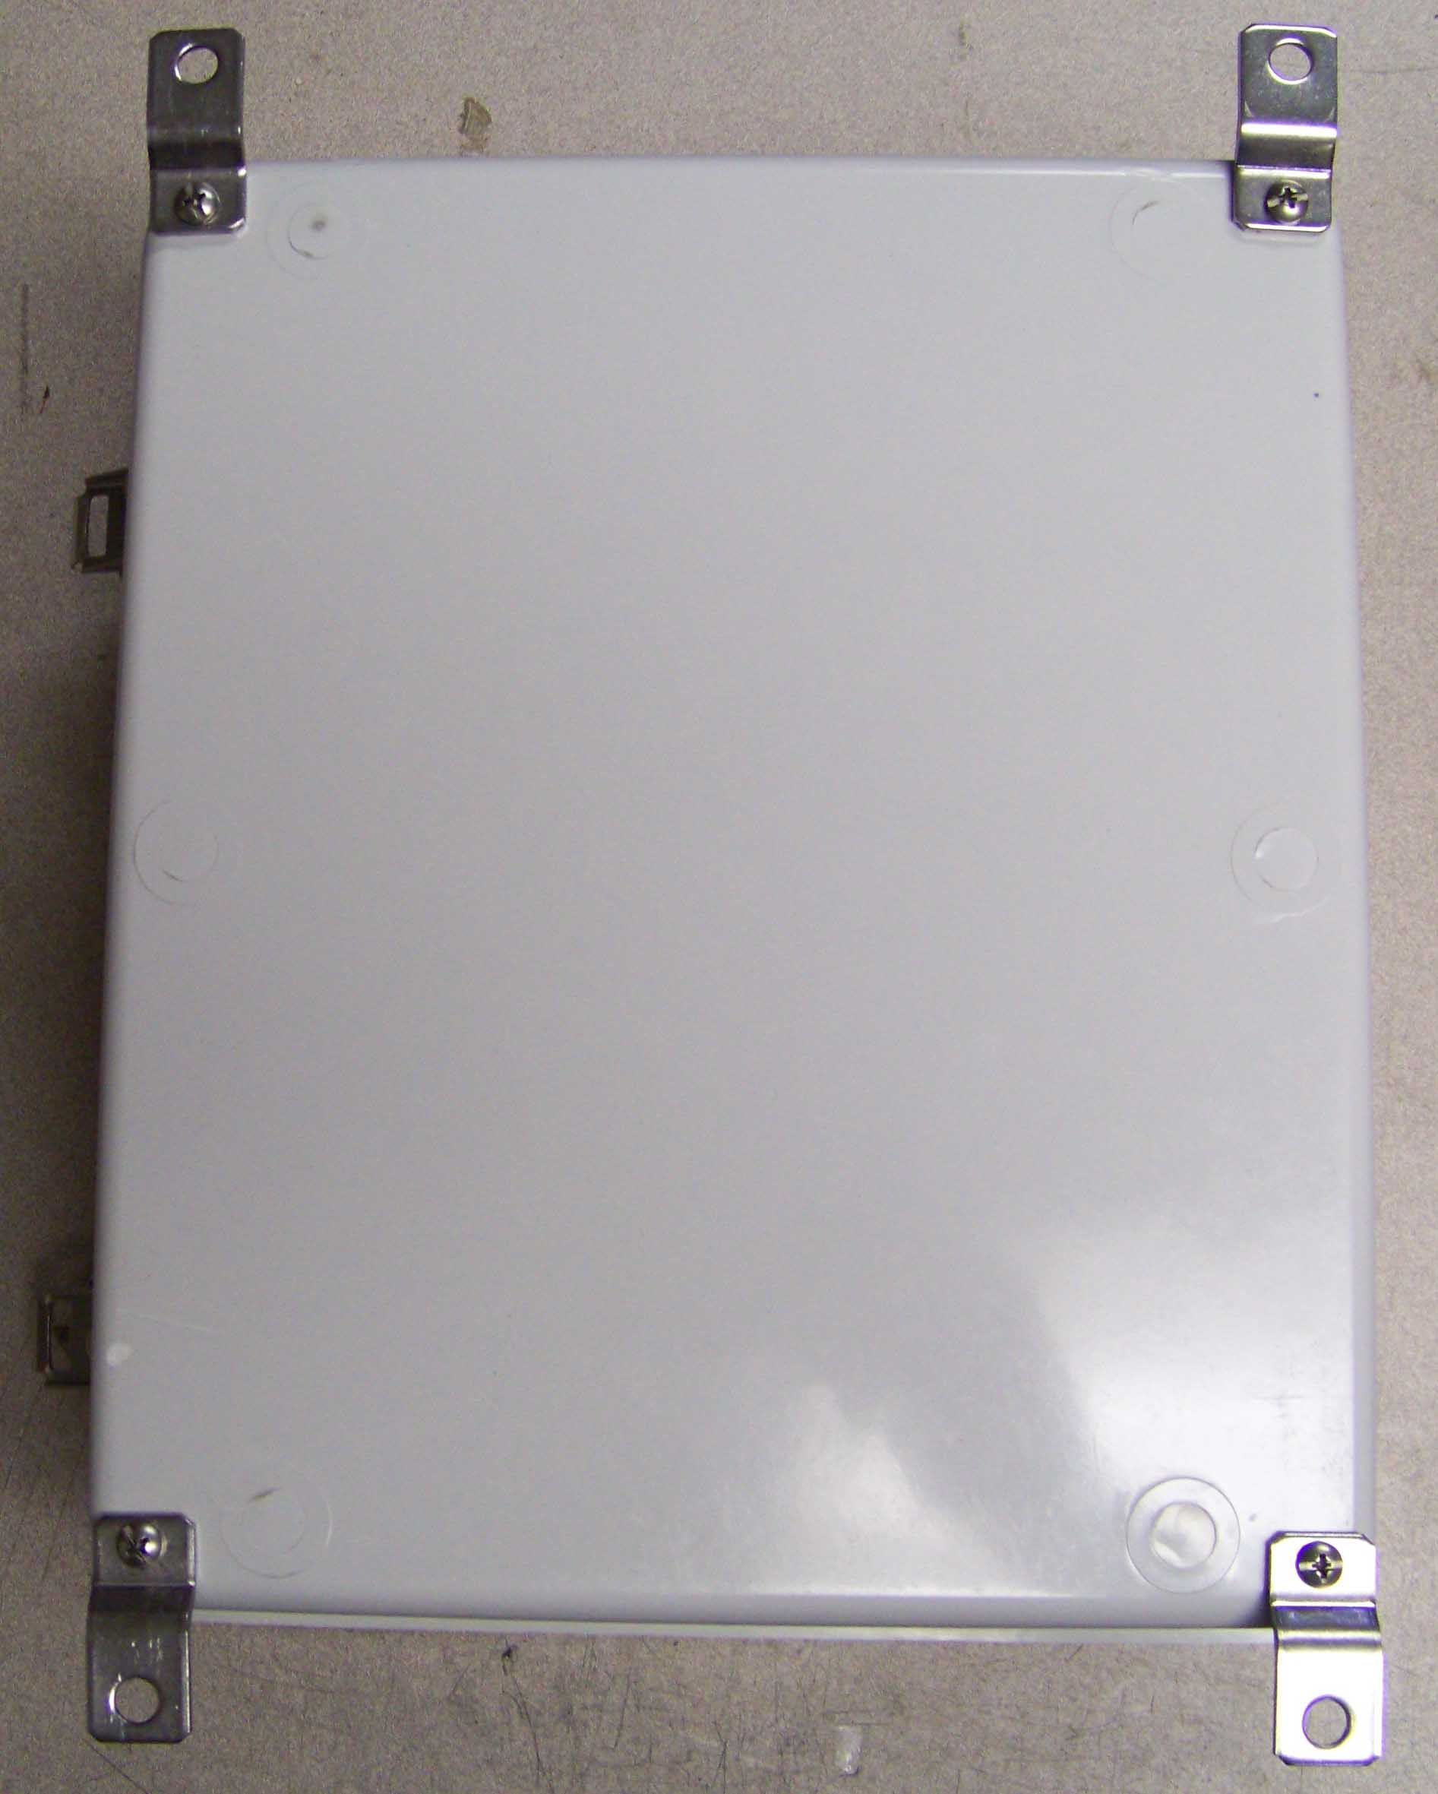
UFV Operations Setup
Pre Start up:
Screw the mounting feet to the back of the Control Box using the hardware given.

Slide 57
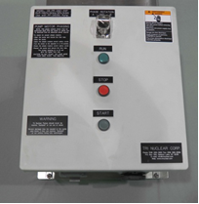
UFV Operations Setup
Pre Start up:
Mount Control Box onto the Tri Nuclear Mounting Panel (freestanding or hanging) via the hardware provided with the panel

Slide 58
UFV Operations Setup
Pre Start up:
Perform operational check of flow meter/sensor
After connecting the flow meter & sensor, flip the flow sensor with your finger. You should be able get 2/3 – 3/4 deflection on the meter

Slide 59
UFV Operations Setup
Pre Start up:
Perform operational check of flow meter/sensor
This ensures that the flow meter and sensor are working properly prior to placing unit into the pool.

Slide 60
UFV Operations Setup
Pre Start up:
Perform operational check of flow meter/sensor
Verify the two o-rings are installed on shaft of the Flow Sensor. The flow sensor may not operate properly without the o-rings installed.

Slide 61
UFV Operations Setup
Pre Start up:
Perform operational check of flow meter/sensor
Prior to installing the flow sensor in the pump, lubricate the o-rings with DI water or other approved lubricant

Slide 62
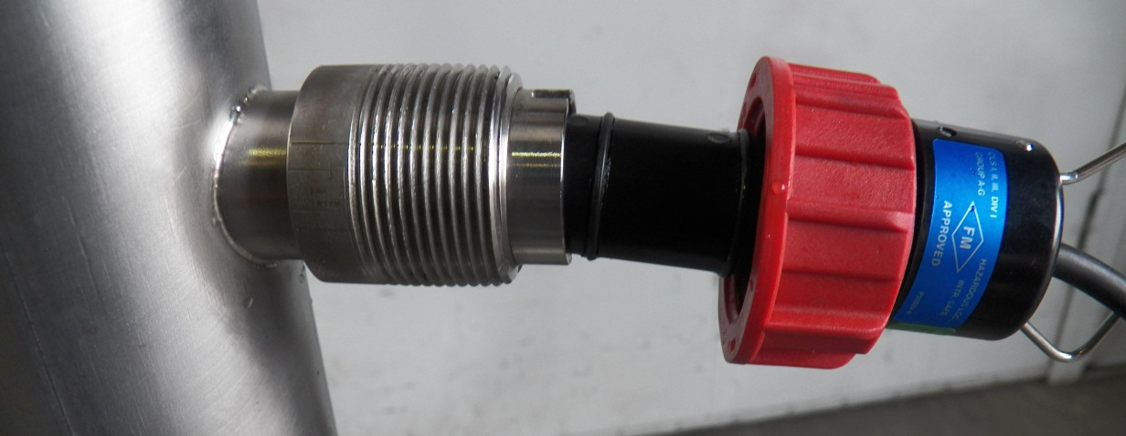
UFV Operations Setup
Pre Start up:
After op check of flow meter/sensor, install in pump
Align the two notches on the flow sensor to the flow meter fitting.
This ensures the paddlewheel is perpendicular to flow.
Tighten hand tight.

Slide 63
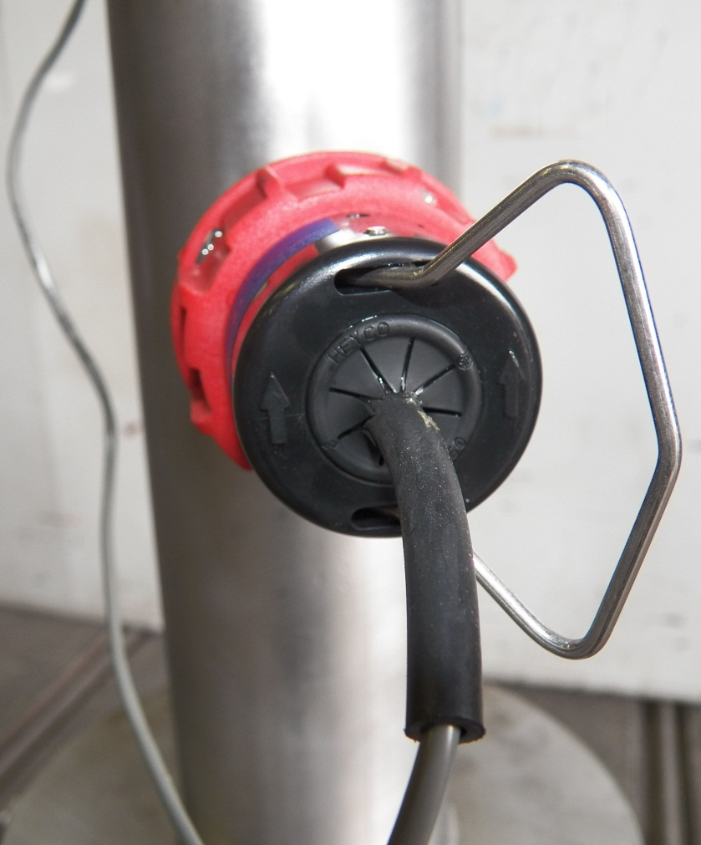
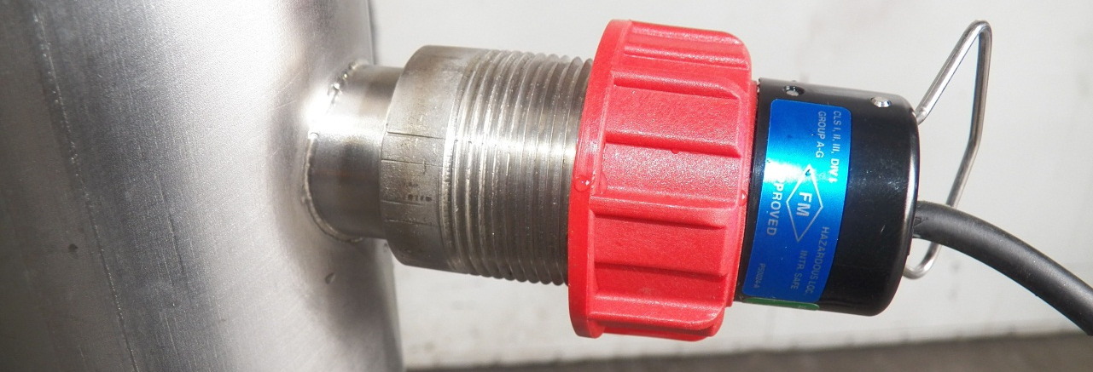
UFV Operations Setup
Pre Start up:
After op check of flow meter/sensor, install in pump

Slide 64
UFV Operations Setup
Pre Start up:
Remove the Sea Con seal plug (P/N: SC-P) from the pump power connector.
This plug should be installed whenever the power cable is removed for proper protection.

Slide 65
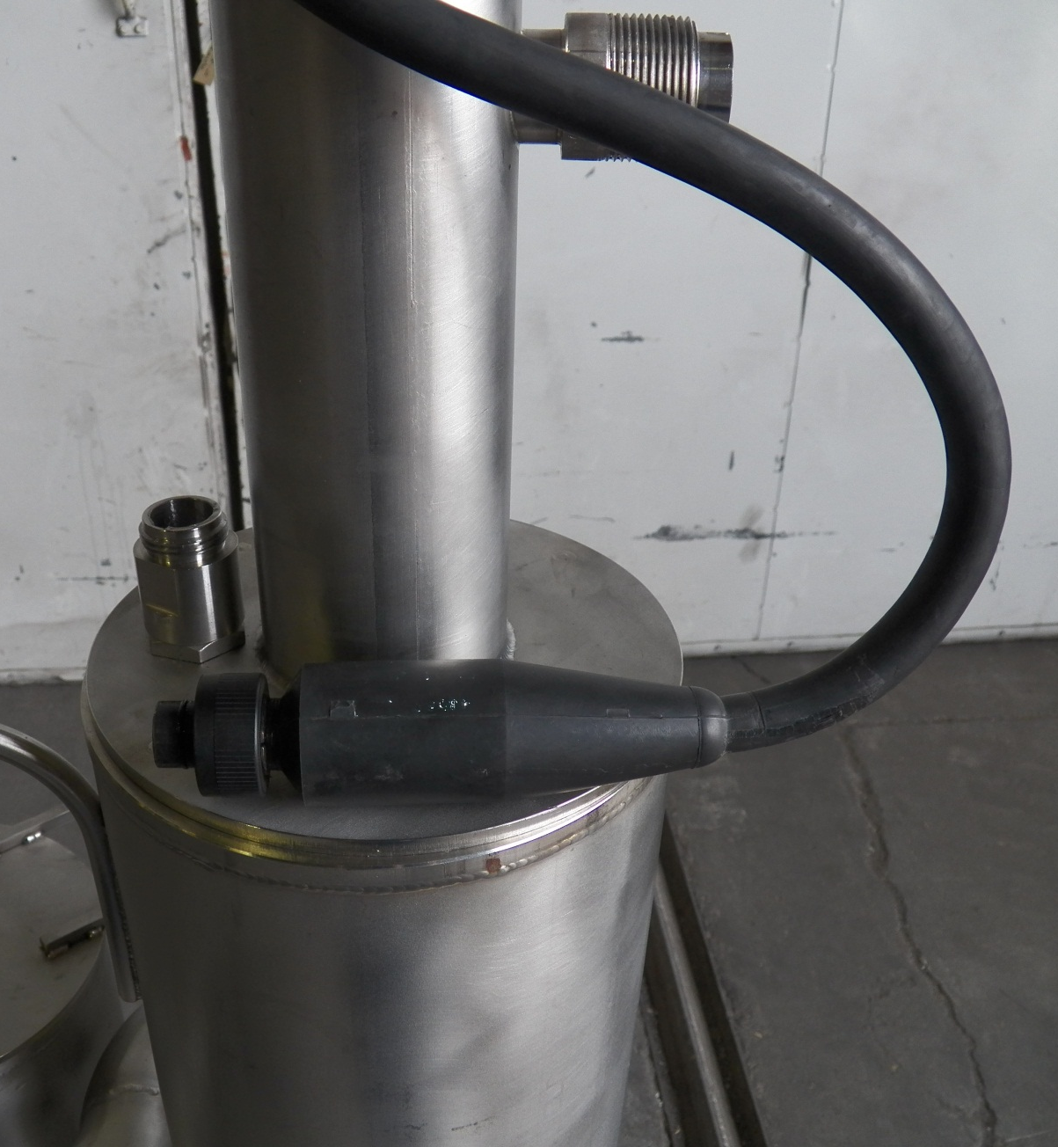
UFV Operations Setup
Pre Start up:
Install the power cord to the pump.
Ensure the power cord is lubricated with a non conductive lubricant (Dow Corning #4)
PP-260SC shown, PP-600SC similar

Slide 66
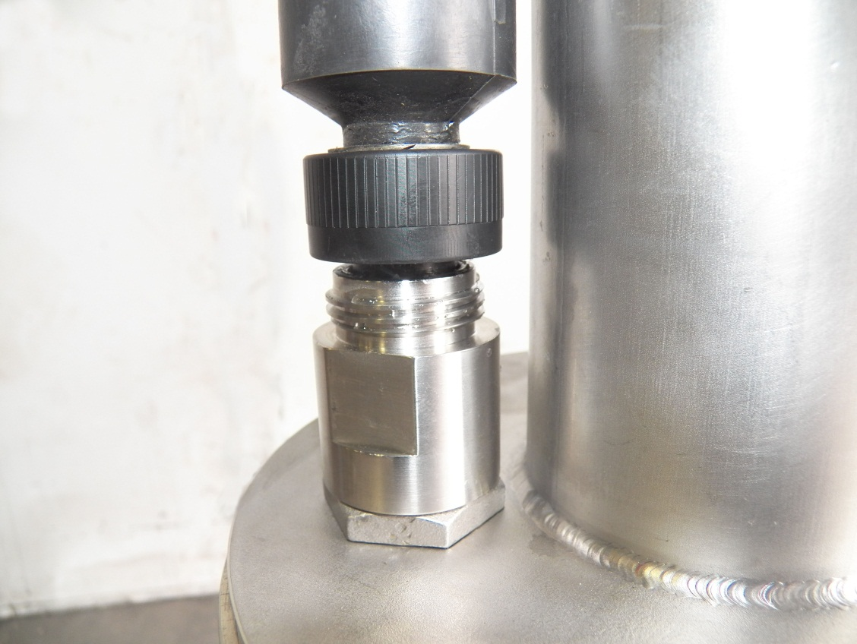
UFV Operations Setup
Pre Start up:
WARNING:
Install the power cord to pump pigtail HAND TIGHT ONLY.
Do NOT use any tools (pliers, channel locks etc.) to tighten the connection.
Notes:
When installing and removing the power cord, do not move the power cable connector with side to side motion in an attempt to install or remove it.
If difficulty is encountered during installation ensure the keyway is oriented properly and that the male end of the PSC-100P power cord is properly lubricated with a non-conductive electrical lubricant (Dow Corning #4).
If difficulty is encountered during removal ensure the power cable has been unthreaded fully and pull in the vertical direction ONLY to remove the power cable from the pump.
Install the power cord to pump pigtail HAND TIGHT ONLY. DO NOT use any tools (pliers, channel locks etc.) to tighten the connection.

Slide 67
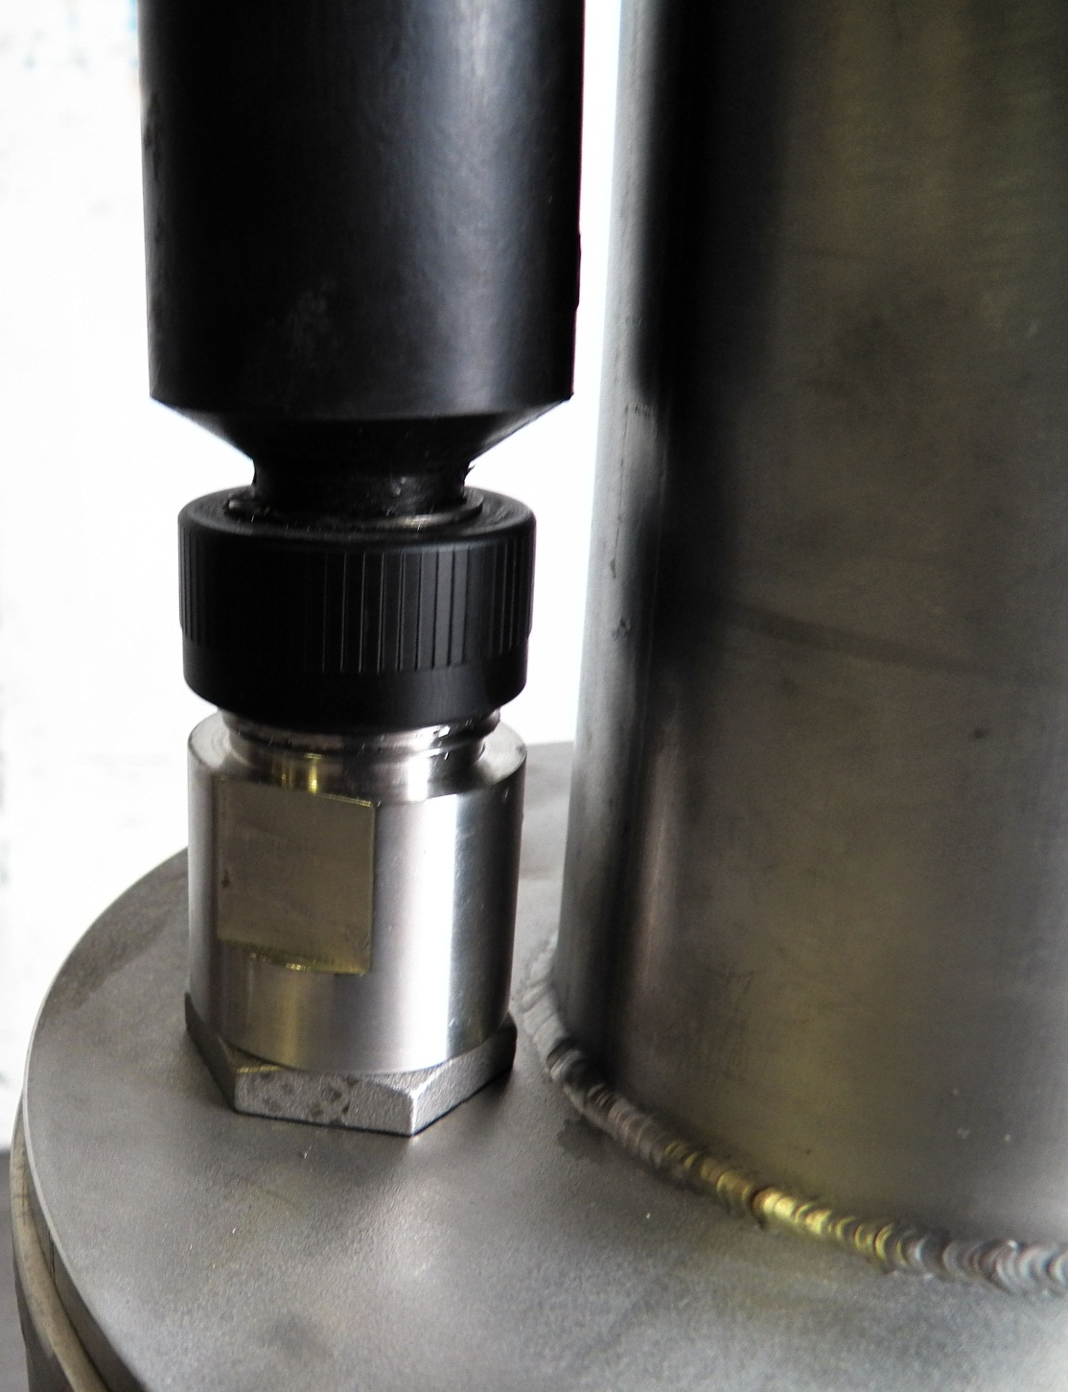
UFV Operations Setup
Pre Start up:
WARNING:
Install the power cord to pump pigtail HAND TIGHT ONLY.
Do NOT use any tools (pliers, channel locks etc.) to tighten the connection.
Notes:
When installing and removing the power cord, do not move the power cable connector with side to side motion in an attempt to install or remove it.
If difficulty is encountered during installation ensure the keyway is oriented properly and that the male end of the PSC-100P power cord is properly lubricated with a non-conductive electrical lubricant (Dow Corning #4).
If difficulty is encountered during removal ensure the power cable has been unthreaded fully and pull in the vertical direction ONLY to remove the power cable from the pump.
Install the power cord to pump pigtail HAND TIGHT ONLY. DO NOT use any tools (pliers, channel locks etc.) to tighten the connection.

Slide 68
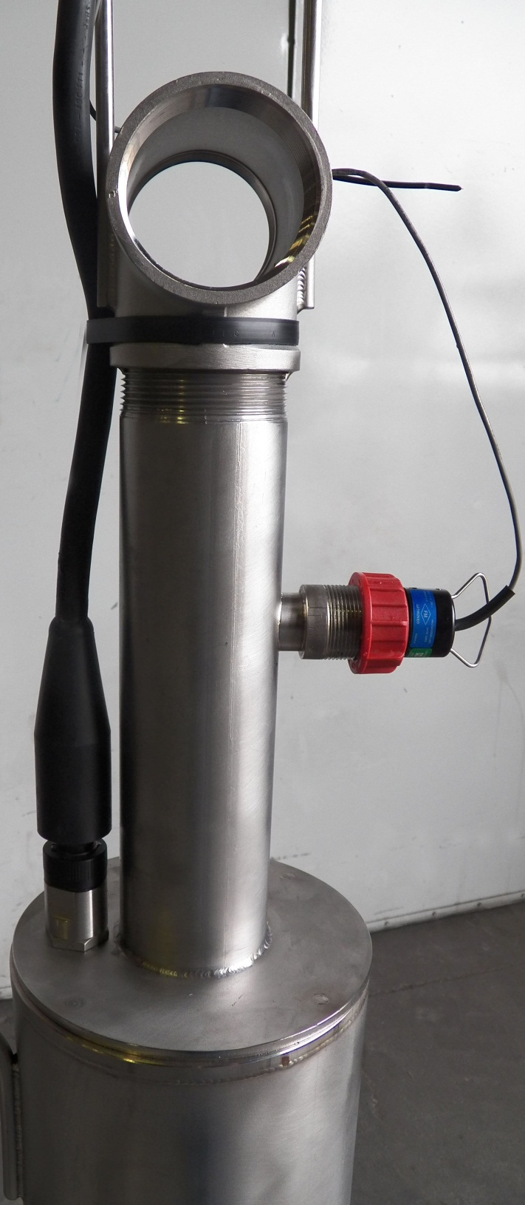
UFV Operations Setup
Pre Start up:
Once the power cord is installed, zip tie it to the vertical section of the pump discharge.
PP-260SC shown, PP-600SC similar
Notes:
Eliminate the possibility of a bending force on the connector by using the cable ties provided to fasten the pump power cable to the vertical discharge pipe of the pump. (see photograph below)
Connect the other end of the power cable to the pump control box.

Slide 69
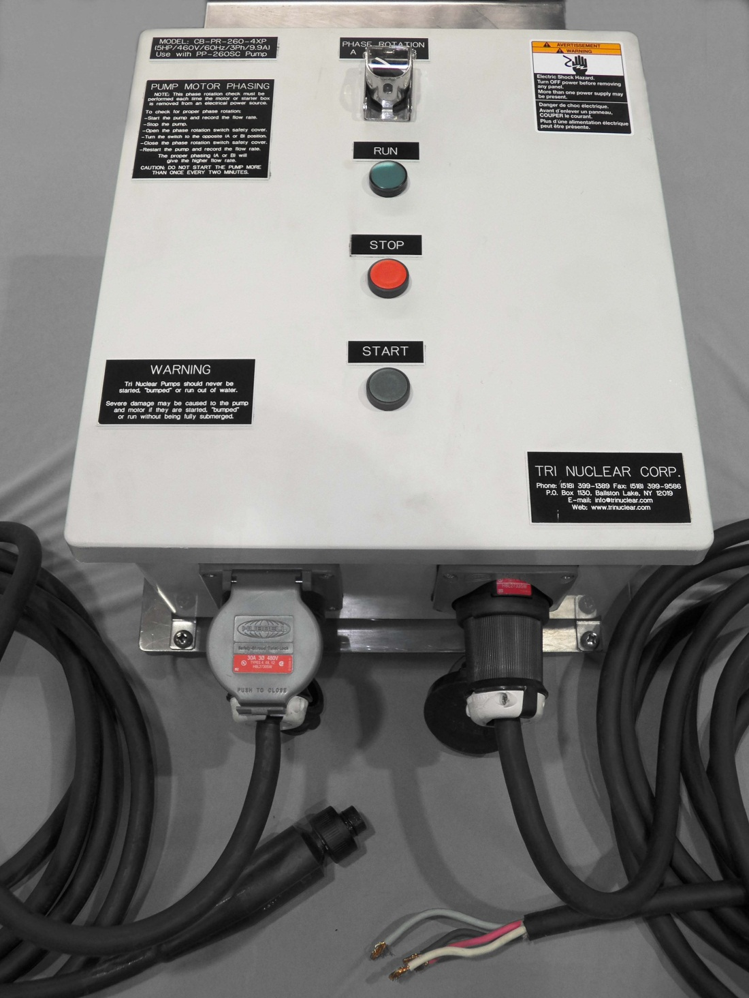
UFV Operations Setup
Pre Start up of CB-PR-600-4XP or CB-600-FM:
Install the PC-50 line in Twist Lock Plug to the control box (shown on right)
Install the PSC-100P Pump Power Cable Twist Lock Plug to the control box (shown on left)

Slide 70
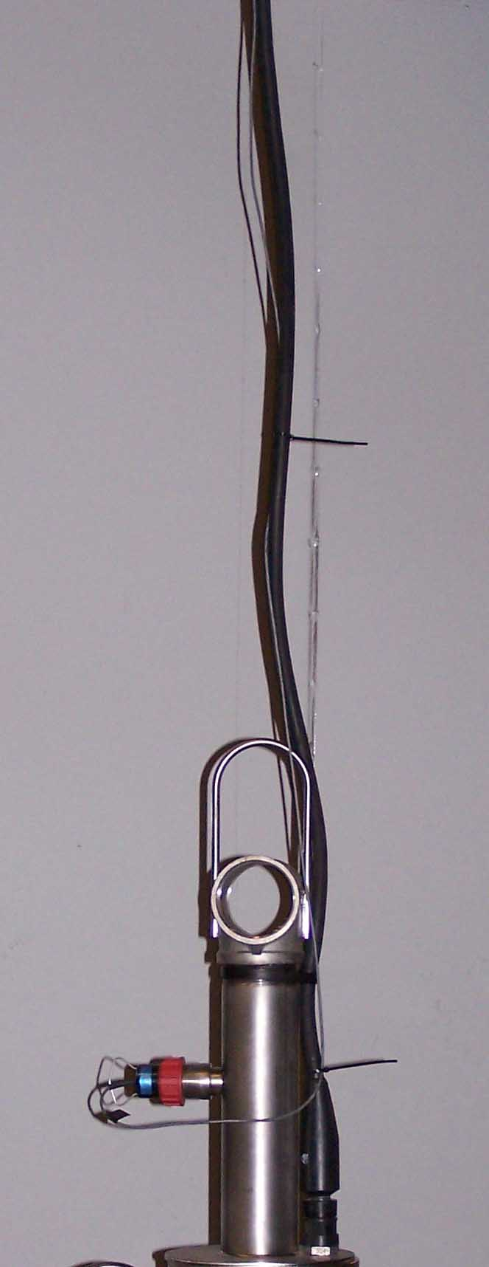
UFV Operations Setup
Pre Start up:
Lay-out the 100 ft. of pump power cable and flow meter cable in a straight line. Tie the two cables together with "zip-ties" every 2 feet starting at the pump end.
Approx. 50 zip-ties are in a small plastic bag in the flow meter box. These “zip-ties” are black in color and are made out of polypropylene. They will float if accidentally dropped in the water.
PP-260SC shown, PP-600SC similar
Notes:
Ask about FME concerns with the zip ties -

Slide 71
UFV Operations Setup
Determine the MODE of Operations
Water Clarity
Two (2) 3in x 25ft lg discharge hoses & UT-8 diffusers attached to the discharge of the PP-600SC pump
NO suction hoses needed/required
Vacuuming
Two (2) 2-1/2in x 50ft lg suction hoses attached to the suction ports.
NO discharge hoses needed/required

Slide 72
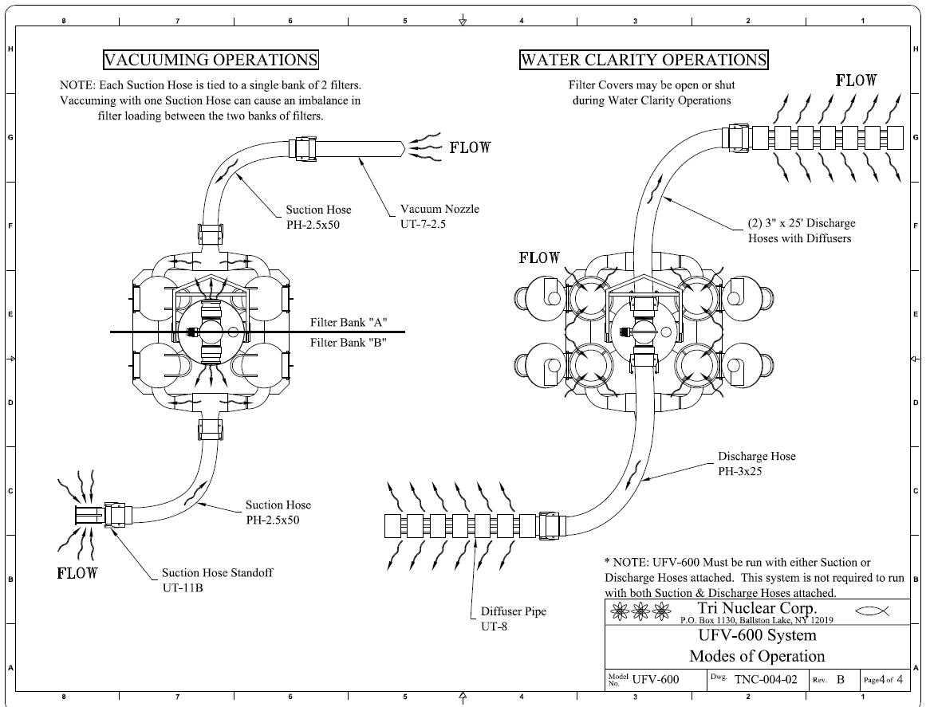

Slide 73
UFV Operations Setup
The UFV-600 must be run with EITHER suction OR discharge hoses attached.
It is not required NOR desired for the unit to run with BOTH suction and discharge hoses installed.

Slide 74
UFV Operations Setup
Water Clarity
Install the two (2) PH-3x25 discharge hoses & UT-8 diffusers attached to the discharge of the PP-600SC pump
NO suction hoses needed/required

Slide 76
UFV Operations Setup
Determine if the unit will be lowered into the pool in one lift or two lifts (regardless of mode of operation)
ONE Lift – Advantages
Unit and all hoses lowered down at same time.
ONE Lift – Disadvantages
Entire unit must be removed from the pool to replace pump or troubleshoot flow meter/sensor problems

Slide 77
UFV Operations Setup
Determine if the unit will be lowered into the pool in one lift or two lifts (regardless of mode of operation)
Two Lift – Advantages
Pump can be installed & removed without removing the entire housing.
Two Lift – Disadvantages
Requires two separate lifts to install the housing and pump into the pool

Slide 78
UFV Operations Setup
Pre Start up:
Install Pump in Housing
After the pre start up checks of section have been performed, lower the PP-600SC pump into the housing using the UT-14 Pump Lift Hook.
NOTE: The pump can be installed AFTER the unit is lowered into the pool.

Slide 79
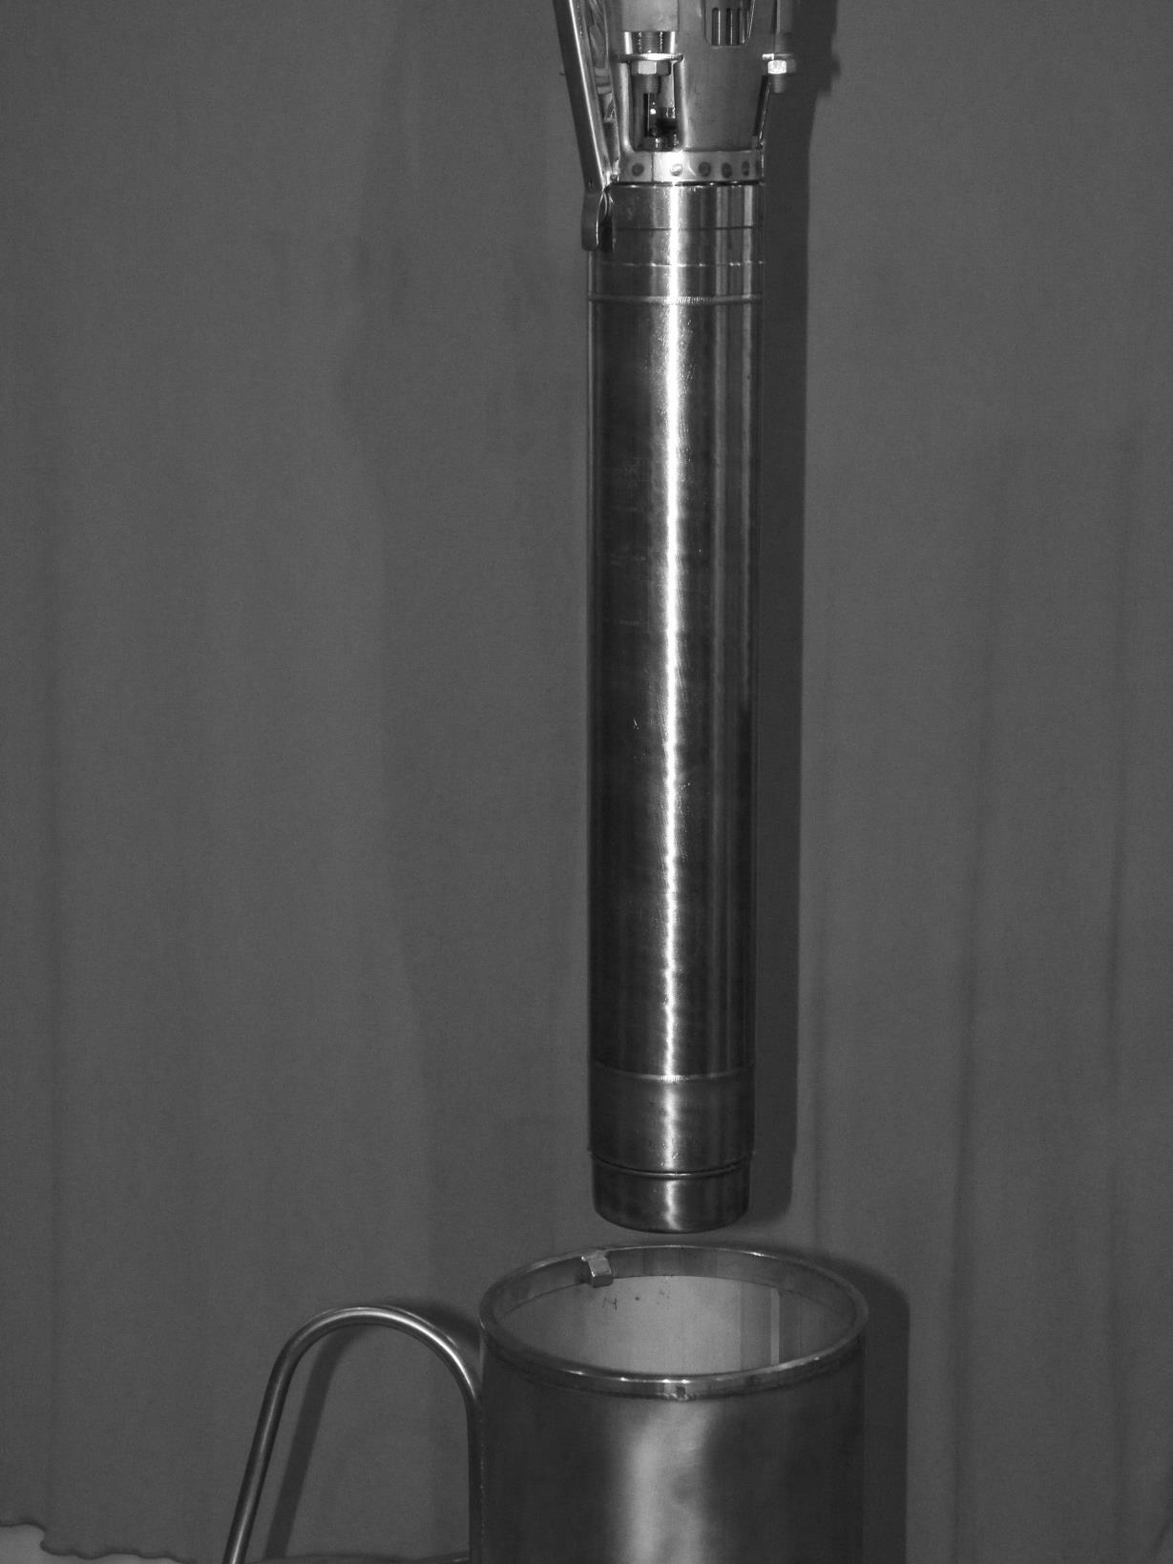
Pump entering the UFV-260 housing
UF-600, UFV-600 and UD-48A similar

Slide 80
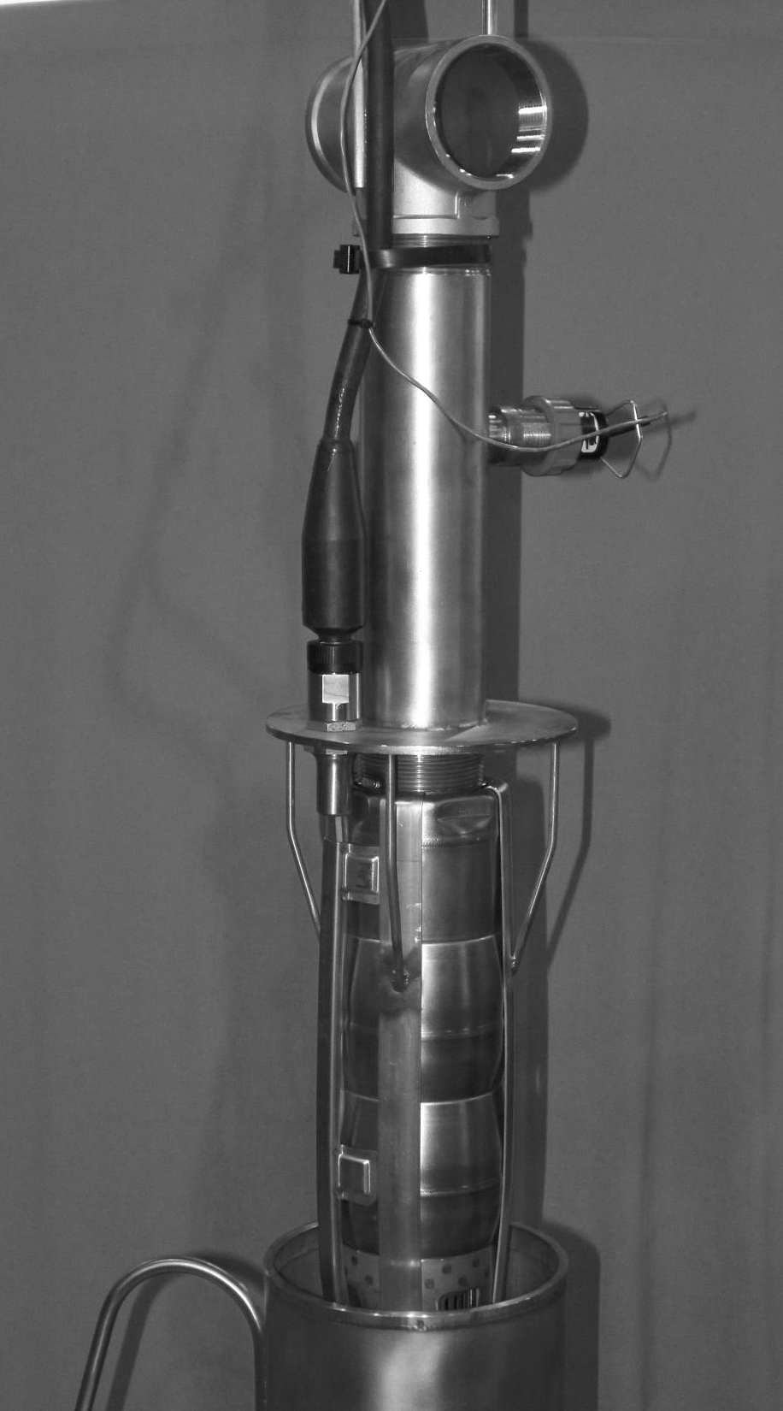
(4) Pump Guides help self center the pump during instillation

Slide 81
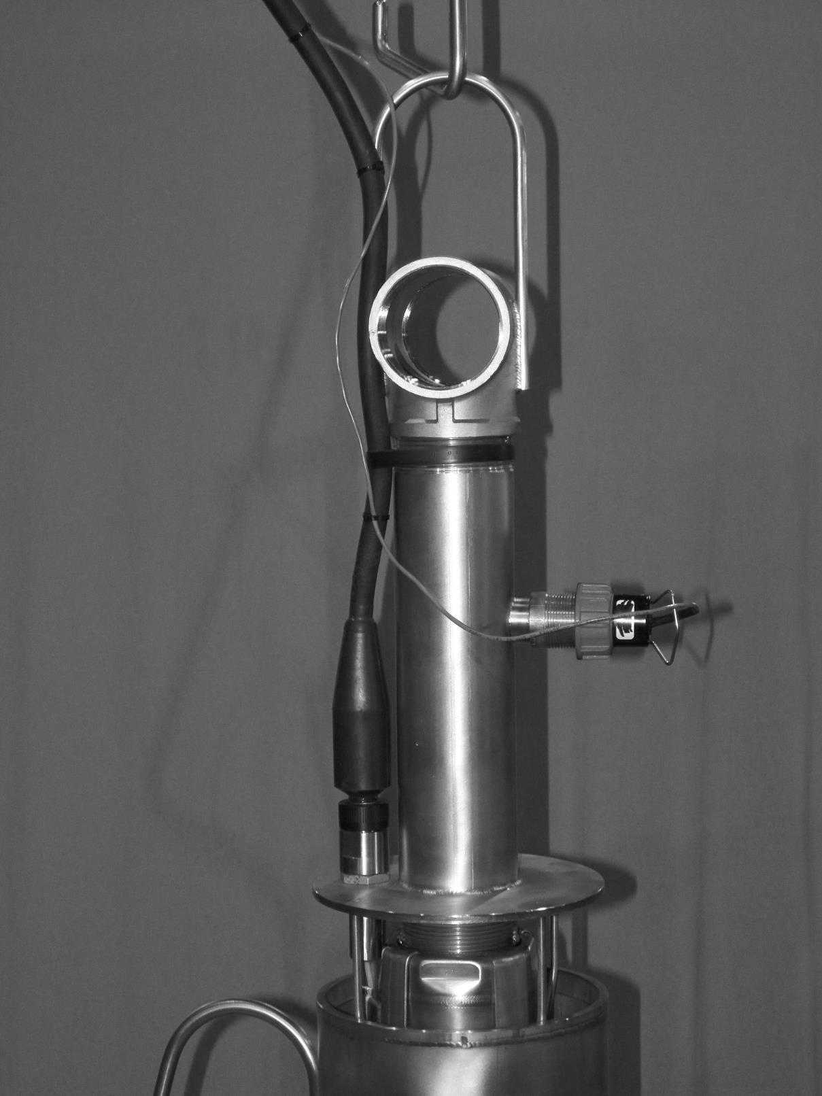
(4) Pump Guides help self center the pump during instillation

Slide 82
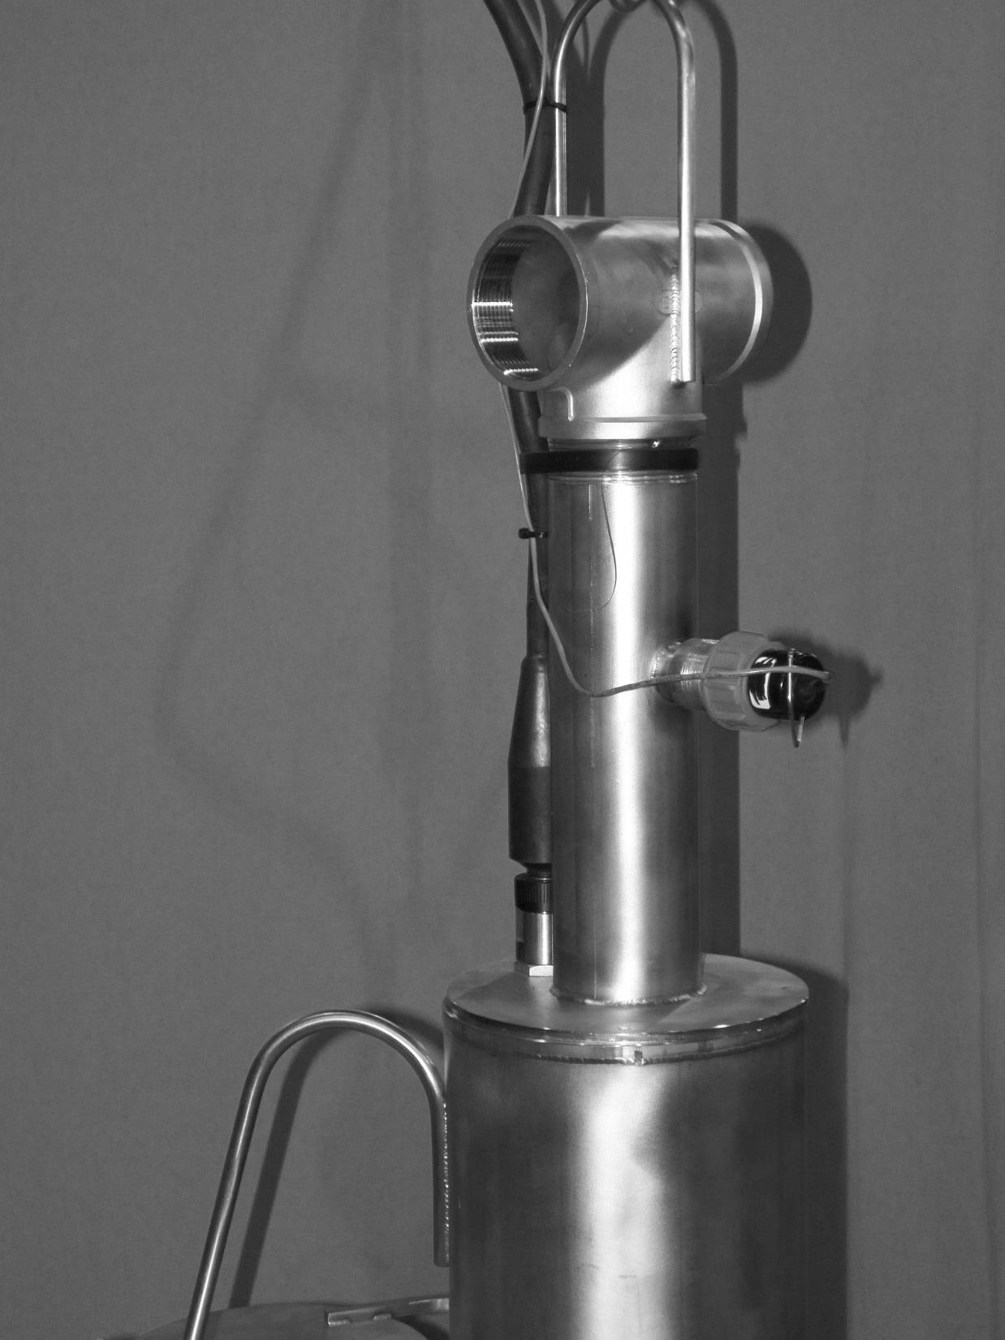
Pump in pump tube

Slide 83
UFV Operations Setup
Vacuuming
Install the two (2) PH-2.5 x 50 suction hoses to the suction ports on the UFV-600 housing. Ensure that the suction hose stand-offs (UT-11B) are installed on the end of the hoses when vacuuming attachments are not used. This will prevent the hose from “deadheading” on the pool floor or wall.
NOTE:
Running the unit without hoses will not produce desired results in pool filtration or water clarity.
NO discharge hoses needed/required

Slide 85
UFV Operations Setup
Pre Start up:
Install Filter cartridges in the UFV-600 unit
Filters may be installed after unit is lowered into the pool
Pre Soaking filter for ~10 minutes in clean water greatly minimizes time spent changing out filters.

Slide 86
UFV Operations Setup
Pre Start up:
Proper Filter Selection is “a must” in order to achieve desired results.
Guidelines for filter selection:
The 10 micron filter VCPH-10PE is normally chosen for high dirt loading when vacuuming settled particulate.
The 5 micron filter VCPH-5PE will capture material that might bypass the 10 micron during vacuuming.
The 1 micron filter VCPH-1PE is excellent for water clarity issues.
The 0.3 micron VCPH-0.3PE filter is used for “polishing” when water clarity is “a must”.

Slide 87
UFV Operations Setup
Pre Start up:
Attach rigging lines (supplied by purchaser) to the main unit, and carefully lower the assembly to the bottom of the pool and tie-off the lifting line to the side of the pool.
The pump assembly may be lowered and installed separately from the main unit using the pump lifting tool, or it may be installed in the unit before lowering it into the water.

Slide 88
UFV-600 Operations Phase Rotation Check – with the CB-PR-600-4X, CB-PR-600-4XP and CB-600-FM control boxes
Start the pump and record the flow rate.
Stop the pump, open the safety cover on the Phase Reversing Switch
Turn the Phase Reversing Switch to the opposite Phase “A” or “B”
Restart the pump and record flow rate
Do not start the pump more than 1x every 2 minutes to prevent damage to the motor windings.
The proper phasing will give the higher flow rate.
Notes:
With clean filters pump phased correctly you will see about 600-800 gpm

Slide 89
UFV-600 Operations Phase Rotation Check
Phased correctly the UFV-600 flow meter should read around 600 GPM with clean filters installed.
Phased incorrectly (backwards) the flow can be as low as 80-100 GPM

Slide 90
UFV-600 Operations Phase Rotation Check
A Phase Rotation Check is necessary because a 3 phase AC pump can run both backwards & forwards.
Running the pump backwards for long periods of time will damage the pumps upper thrust bearing and cause premature failure.
Perform a Phase Rotation Check whenever a pump is disconnected from its electrical power source!

Slide 91
UFV Operations Setup
Lower the UT-3/6 floor storage rack and place near the unit.
Filter cartridges can take several minutes to flood while trying to submerge them in the pool. The flooding time can be minimized by pre
UFV-260 shown, UFV-600 similar.

Slide 92
UFV-600 Operations Installing Filter Cartridges
Rope Filter Lift Tool (RFLT) Model UT-9
Operating Instructions
The UT-9 Rope Filter Lift tool is designed
to remotely change out expended filter cartridges.
Use the 50ft lg SS UT-15 Utility Chain to operate the UT-9 Rope Filter Lift Tool
Notes:
ROPE-FILTER LIFT TOOL (UT-9)
A special18" high tool used for changing out filter cartridges remotely underwater using a rope or hand line. This tool uses a "positive latch" mechanism allowing for a very simple, effective, and quick method for filter change-out.

Slide 93
UFV Operations Installing Filter Cartridges
Rope Filter Lift Tool (RFLT) Model UT-9
Operating Instructions
Open the filter tube cover using the bottom hook on the RFLT
Notes:
ROPE-FILTER LIFT TOOL (UT-9)
A special18" high tool used for changing out filter cartridges remotely underwater using a rope or hand line. This tool uses a "positive latch" mechanism allowing for a very simple, effective, and quick method for filter change-out.

Slide 94
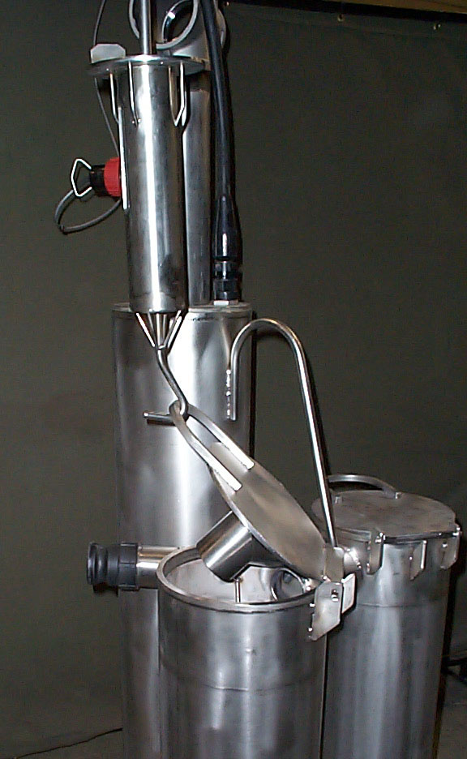
UFV Operations Installing Filter Cartridges
UFV-260 Shown, UFV-600 similar
Notes:
Use the filter tube mock up for show and tell on this.

Slide 95
UFV-600 Operations Installing Filter Cartridges
Rope Filter Lift Tool (RFLT) Model UT-9
Operating Instructions
As the top pull rod is operated up or down in the tool housing, the hinged arms rotating on an internal cam will extend either in or out through the two open slots. The hinged arms will capture the filter for lifting, or release it for withdrawal of the tool.
Notes:
ROPE-FILTER LIFT TOOL (UT-9)
A special18" high tool used for changing out filter cartridges remotely underwater using a rope or hand line. This tool uses a "positive latch" mechanism allowing for a very simple, effective, and quick method for filter change-out.

Slide 97
UFV-600 Operations Installing Filter Cartridges
Rope Filter Lift Tool (RFLT) Model UT-9
Operating Instructions
After the filter tube cover has been opened, lower the RFLT down into the open top of the filter cartridge until the top plate of the rope tool seats on the top of the filter cartridge.
This is determined by a sudden decrease in the weight of the tool on the SS chain.
Notes:
ROPE-FILTER LIFT TOOL (UT-9)
A special18" high tool used for changing out filter cartridges remotely underwater using a rope or hand line. This tool uses a "positive latch" mechanism allowing for a very simple, effective, and quick method for filter change-out.

Slide 98
UFV-600 Operations Installing Filter Cartridges
Rope Filter Lift Tool (RFLT) Model UT-9
Operating Instructions
Continue to partially lower the SS chain ONLY another 4 or 5 inches. This will allow the side arms of the tool to extend out through the open slots on the side of the tool housing and engage the underside of the filter top cap.
Notes:
ROPE-FILTER LIFT TOOL (UT-9)
A special18" high tool used for changing out filter cartridges remotely underwater using a rope or hand line. This tool uses a "positive latch" mechanism allowing for a very simple, effective, and quick method for filter change-out.

Slide 99
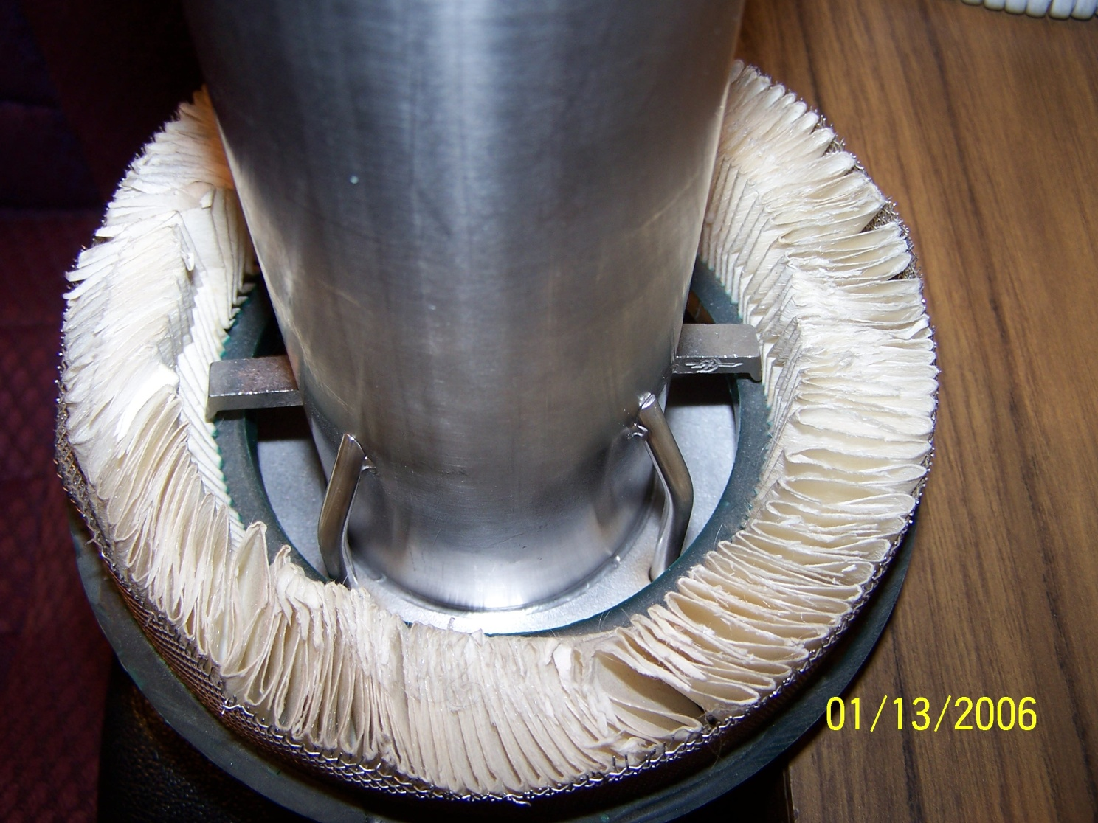
UFV-600 Operations Installing Filter Cartridges
Notes:
ROPE-FILTER LIFT TOOL (UT-9)
A special18" high tool used for changing out filter cartridges remotely underwater using a rope or hand line. This tool uses a "positive latch" mechanism allowing for a very simple, effective, and quick method for filter change-out.

Slide 100
UFV-600 Operations Installing Filter Cartridges
Rope Filter Lift Tool (RFLT) Model UT-9
Operating Instructions
Pull up on the tool to raise the filter out of the filter housing or filter storage rack.
Notes:
ROPE-FILTER LIFT TOOL (UT-9)
A special18" high tool used for changing out filter cartridges remotely underwater using a rope or hand line. This tool uses a "positive latch" mechanism allowing for a very simple, effective, and quick method for filter change-out.

Slide 101
UFV-600 Operations Installing Filter Cartridges
Rope Filter Lift Tool (RFLT) Model UT-9
Operating Instructions
Once the filter cartridge is placed in the UFV-600 or storage rack,
Slack-off the SS Chain until the rope tool slide rod hits the bottom and all of the weight of the rope tool is transferred to the filter cartridge.
This will rotate the internal cam fitting so the hinged arms will no longer extend out through the side slots in the tool housing.
Notes:
ROPE-FILTER LIFT TOOL (UT-9)
A special18" high tool used for changing out filter cartridges remotely underwater using a rope or hand line. This tool uses a "positive latch" mechanism allowing for a very simple, effective, and quick method for filter change-out.

Slide 102
UFV-600 Operations Installing Filter Cartridges
Rope Filter Lift Tool (RFLT) Model UT-9
Operating Instructions
Once the filter cartridge is placed in the UFV-600 or storage rack,
Raise the SS chain and lift the rope tool out of the filter cartridge.
Repeat as necessary for filter change out and instillation.
Notes:
ROPE-FILTER LIFT TOOL (UT-9)
A special18" high tool used for changing out filter cartridges remotely underwater using a rope or hand line. This tool uses a "positive latch" mechanism allowing for a very simple, effective, and quick method for filter change-out.

Slide 103
Tri Nuclear Corp. General UFV-600 Operations

Slide 104
UFV-600

Slide 105
UFV Operations
The UFV-600 can be operated in two different “Modes”
Water Clarity
Vacuuming
“Water Clarity mode” provides a way to clean/polish water in the Rx Cavity or SFP.
“Vacuuming Mode” provides a way to vacuum loose material off of any surface under water in the Rx Cavity or SFP.

Slide 107
UFV-600 Operations Water Clarity
Successful water clarity operations hinge on two things:
Correct Filter selection
Effective cross flow in the pool
Operating the UFV-600 without hoses will not provide desired results.

Slide 108
UFV Operations Water Clarity
Run unit with 2 discharge hoses to different areas of the pool for most effective water turnover
Install a UT-8 diffuser at the end of each discharge hose to prevent hose whipping.

Slide 109
UFV Operations Vacuuming
Vacuuming accomplished with two different tools:
Floor Vacuum Head (UT-5SP-2.5)
Vacuum Nozzle (UT-7-2.5)
Vacuum nozzle is used in conjunction with the Hose to pole clamp UT-6.

Slide 110
UFV-600 Tooling
Floor Vacuum Head,
UT-5SP-2.5
10” x 20”
4 wheels
2 brushes
Suction connect for 2-1/2in hose
UT-15 Utility Chain (not shown)
Notes:
A 10"x 20" four wheel vacuum cleaner head equipped with two brushes, which attaches to the bottom pool pole and to the suction end of a vacuum hose leading to the UFV Unit.

Slide 111
UFV-600 Tooling
UT-7-2.5, Vacuum Nozzle for 2-1/2in hose with the UT-6SP, Hose to Pole clamp.
Nozzle positions:
Vertical
Horizontal
45 deg.
Notes:
HOSE TO POLE CLAMP (UT-6SP)
This fixture attaches to the bottom pool pole, and holds the suction end of a vacuum hose or nozzle with two clamps at one of three orientations. (vertical, 45 deg., or horizontal)
VACUUM NOZZLE (UT-7)
A 2"dia.x 18"lg. vacuum nozzle is connected to the end of a vacuum hose. The vacuum nozzle is used for vacuuming small areas requiring high water velocity for lifting. This is used with the UT-6 Hose To Pole Clamp.

Slide 112
UFV Operations Vacuuming
Pool Poles
The pool poles come in 4 different lengths – 10ft, 5ft, 3ft & 2ft long. Determine the depth the vacuuming will take place and assemble the appropriate number of pool poles for optimal operation interaction with the pool poles and tee handle.
Notes:
A 10"x 20" four wheel vacuum cleaner head equipped with two brushes, which attaches to the bottom pool pole and to the suction end of a vacuum hose leading to the UFV Unit.

Slide 113
UFV Operations Vacuuming
Buoyancy Chambers (BC-1)
The Buoyancy Chamber (BC-1) is designed to reduce the weight of the pool pole by about half. After determining the number of pool poles to be used, install the same number of Buoyancy Chambers on the uppermost, fully submerged pool pole. The placement of the Buoyancy Chambers at the top end of the of the Pool Pole sections helps the operator manipulate the tooling, especially the UT-5SP Vacuum Cleaner Head.
Notes:
A 10"x 20" four wheel vacuum cleaner head equipped with two brushes, which attaches to the bottom pool pole and to the suction end of a vacuum hose leading to the UFV Unit.

Slide 114
Slides over pool poles
6in dia x 18in long
Material: Stainless Steel
Provides positive buoyancy to reduce the overall weight of pool poles. Same connection / design as SP-1 Pool Poles
Reduces the weight of the pool pole by approximately half.
Notes:
Tri Nuclear has developed a Buoyancy Chamber that slides over the pool pole. It is a 6in x 18in long stainless steel chamber that provides positive buoyancy for the pool poles. The effect of this positive buoyancy is to reduce the overall weight of the assembled pool poles for the operator. Each Buoyancy Chamber reduces the weight of the pool by approximately half. The BC-1 Buoyancy Chamber has a handle for ease of moving and installing on the pool pole.

Slide 115
UFV Operations Vacuuming Strategy
Depending on particle size that is trying to be filtered out, the use of large micron filters may not show desired results due to filter bypass.
Filter Selection
10 micron filters best “all purpose” vacuuming filter.
If water clarity becomes an issue during vacuuming, a smaller size micron filter may be needed

Slide 116
UFV Operations Filter Change Out
Filters should be changed out on one of two conditions:
50% clean filter flow
If initial flow was 600 gpm, then filters should be changed out at ~300 gpm
The filter cartridge is ‘expended’ at this point and running it further does not increase dirt loading/holding of the filter by very much at all.
Pre-determined radiation levels
Each plant determines this level

Slide 117
Tri Nuclear Corp. UF Precautions & Limitations

Slide 118
UF Operations Precautions & Limitations
10⁶ Rad Accumulated dose limitation on the following equipment:
Filter Cartridges
Hoses
Power Cables
Motor’s
Chemical breakdown of the plastic hydrocarbon chain can occur causing material embrittlement.

Slide 119
UF Precautions & Limitations
WARNING:
Do not run/bump the pump dry or out of the water! Severe damage to the pump may occur!

Slide 120
UF Precautions & Limitations
WARNING:
Install the power cord to pump pigtail HAND TIGHT ONLY. Do NOT use any tools (pliers, channel locks etc.) to tighten the connection.

Slide 121
UF Precautions & Limitations
CAUTION:
When installing and removing the power cord, do not move the power cable connector with side to side motion in an attempt to install or remove it.
If difficulty is encountered during installation ensure that the keyway is lined up and that the male end of the PSC-100 & PSC-100P power cord is properly lubricated with a non conductive electrical lubricant (Dow Corning #4).
If difficulty is encountered during removal ensure the power cable has been unthreaded fully and pull in the vertical direction ONLY to remove the power cable from the pump.

Slide 122
UF Precautions & Limitations
Do not start the pump more than once every 2 minutes or 300 starts/day. Damage to the motor winding insulation may occur.
Max operating temp 140F
Time operating above 105F should be minimized

Slide 123
UF Precautions & Limitations
CAUTION:
Do not run the pump until a proper phase rotation check is made! Running the pump in reverse for any long duration will damage the pump!
The CB-PR-600-4XP and CB-600-FM are rated for 460V/3ph/60Hz ONLY. Any other voltage/frequency supplied to these control boxes will prevent it from operating properly.

Slide 124
UF Precautions & Limitations
Perform the flow meter check:
before installing the Underwater Filter units into the pool for the first time
whenever the flow meter or sensor is replaced
anytime the flow sensor is suspected of being damaged.

Slide 125
UF Precautions & Limitations
Operating the UFV-600 without suction or discharge hoses attached minimizes pool cross circulation and will lead to inefficient water filtration that may cause water turbidity problems.
It is not required or desired to run the UFV-600 with both suction and discharge hoses installed.

Slide 126
UF Precautions & Limitations
Slowly lower the UFV-600 housing into the water. This allows water to fill the housing from the two 1/2in drain holes in the base plate. Lowering the unit too fast may cause it to become unstable until it fills with water.

Slide 127
UF Precautions & Limitations
Filter cartridges can take several minutes to flood while trying to submerge them in the pool. The flooding time can be minimized by pre-soaking the filters.

Slide 128
UFV Precautions & Limitations
Dense granular material less than .125” dia, may pass through the SB-.125 strainer basket and could collect in the bottom of a filter housing.
For effective straining operations, two (2) SB-.125 Strainer Baskets must be used.
For effective straining operations, two (2) UCB-1 Underwater Catch Baskets must be used.

Slide 129
UFV Precautions & Limitations
Filter cartridges can take several minutes to flood while trying to submerge them in the pool. The flooding time can be minimized by pre-soaking the filters.

Slide 130
Tri Nuclear Corp. UFV-600 Recommended Spare Parts

Slide 131
UFV-600 Recommended Spare Parts
Pump Assembly (PP-600SC)
Pump/motor assembly, power cable & Control Box
CB-600-FM; Qty (1)
PSC-100P; Qty (1)
Discharge Hose (PH-3x25); Qty (2)
Suction Hose (PH-2.5x50); Qty (2)
UT-8 Diffusers; QTY (2)
Filter cartridges
Strainer Baskets / Underwater Catch Baskets

Slide 132
Review / Training Objectives
The trainees at the end of this session will be able to describe:
Principals of Operation for the UFV-600
UFV-600 Equipment Description
Assembly & Installation in pool
System Operations
Storage Requirements
UFV-600 Precautions & Limitations

